Slide 1
Causation and Criminals

Slide 2
Causation
An event occurs for a reason.
Events occur in predictable, nonrandom ways.
One event lead to another.

Slide 3
Multiple Causation
An event occurs as a result of several working factors working in combination.

Slide 4
Causes of Crime
Today you will examine the variables.

Slide 5
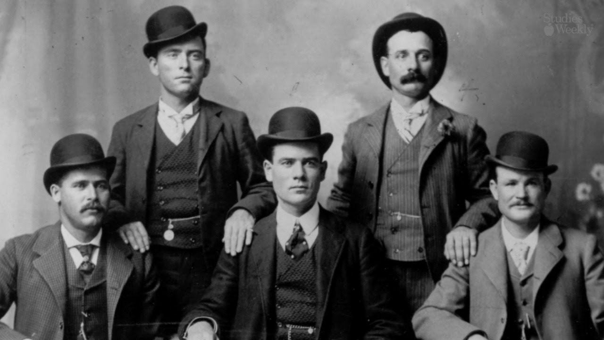
Butch Cassidy, the Sundance Kid and the Wild bunch Gang

Slide 6
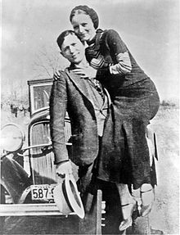
Bonnie and Clyde

Slide 7
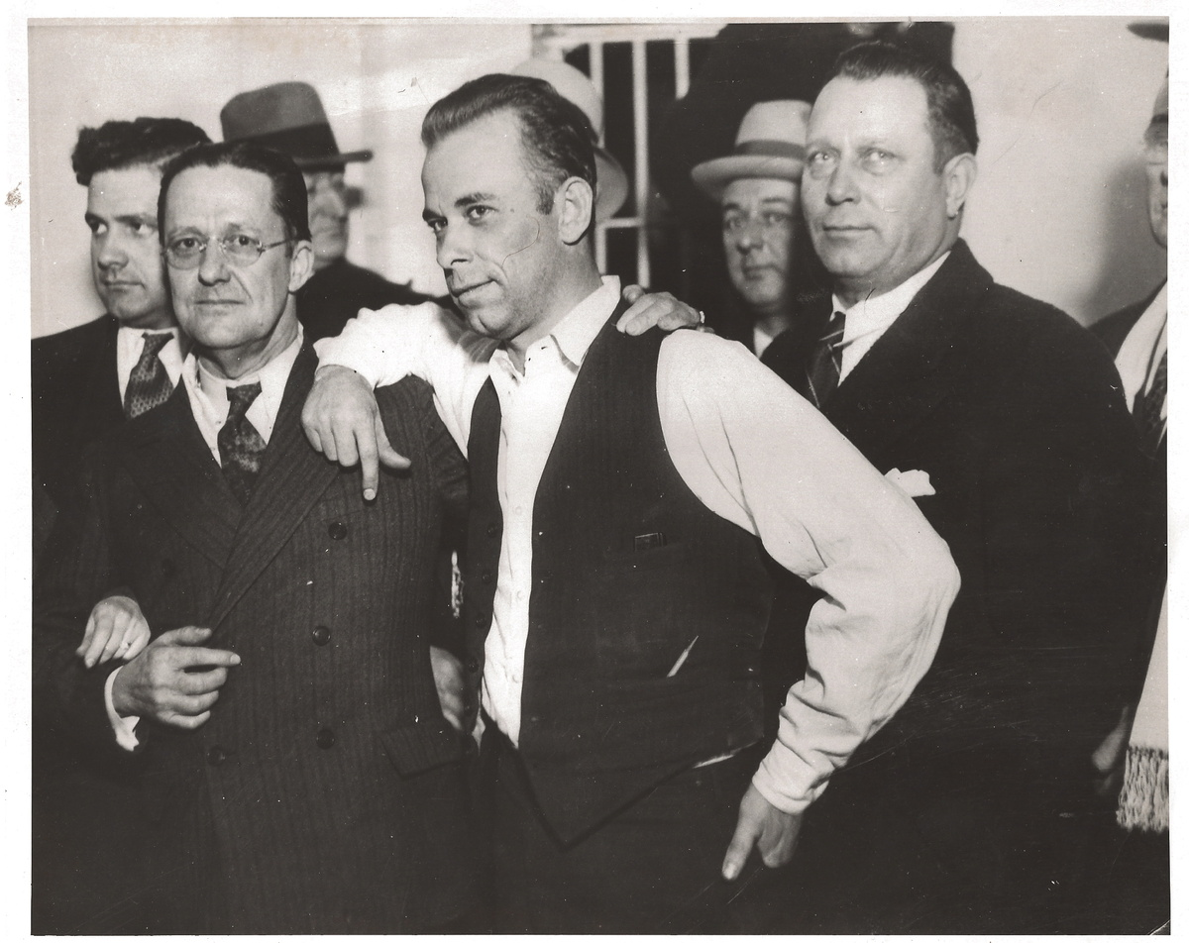
John Dillinger

Slide 8
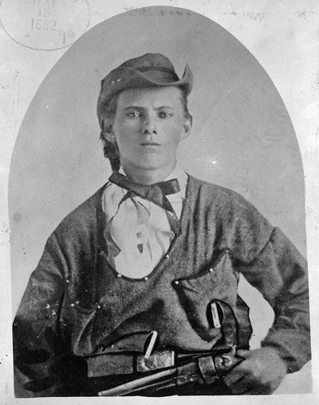
Jesse James

Slide 9
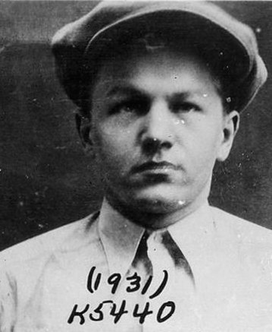
Baby Face Nelson

Slide 10
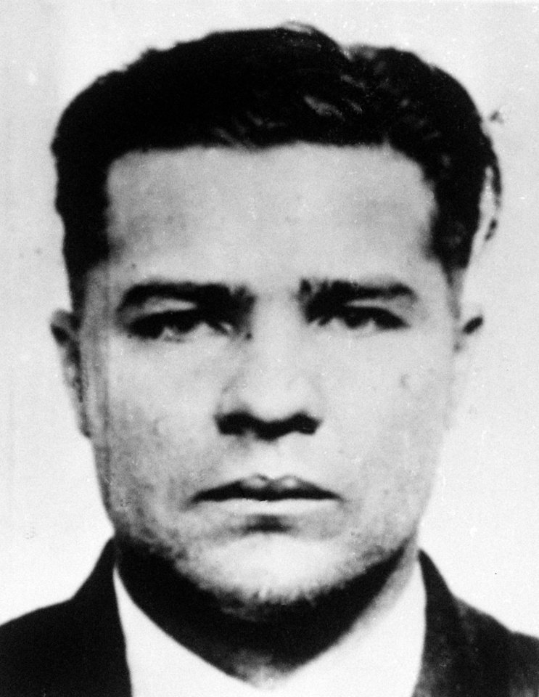
Charles “Pretty Boy” Floyd

Slide 11
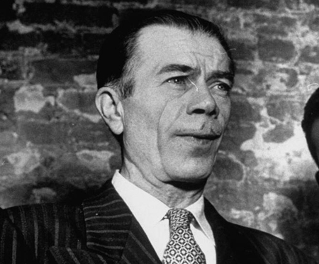
Willie Sutton

Slide 12
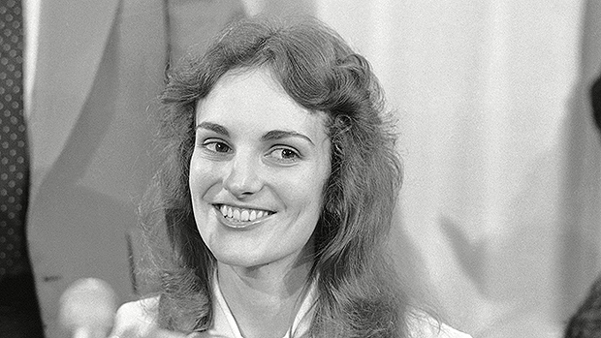
Patty Hearst

Slide 13
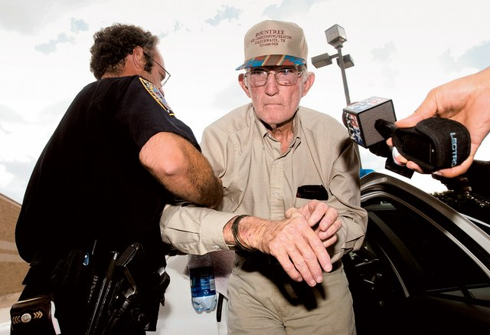
J.L. Hunter “Red” Rountree

Slide 14
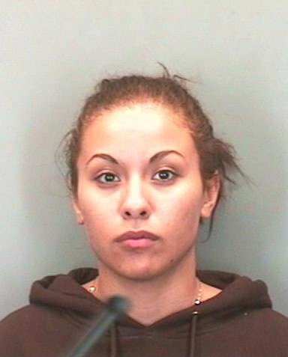
Candice Rose Martinez

Slide 15
Correlation
Measure of how things are related to one another.

Slide 16
What are the correlations in criminal activity?

