Slide 1
Sociology Chapter 9 Section 4: Minority Groups in the United states

Slide 2
Institutionalized
Many people believe that discrimination in the United States ended when civil rights legislation was passed in the 1960s.
Nevertheless, minorities in this country still suffer from what sociologists call institutionalized discrimination (unfair practices that grow out of common behaviors and attitudes and that are a part of the structure of a society).

Slide 3
Schooling is another example of institutionalized discrimination.
Minority children in many states are more concentrated in school districts with a tax base too low to provide resources equal to those in the suburbs. This lack of funding means that teachers in minority schools receive fewer opportunities for training.

Slide 4
African Americans
African American make up the largest racial minority group in the United States.
They are also one of the oldest minorities, first brought to American an indentured servants and slaves in the early 1600s.

Slide 5
What are the barriers to African American assimilation?
Skin color
Status of African Americans has its roots in early American history.
Brought into the country to labor on plantations, African Americans were immediately assigned to the lowest class status.
Even when freed, ex-slaves and their descendants in the United States were rarely accepted as equal to free whites.

Slide 6
What are average income levels for African Americans?
A review of white-collar employment data from the U.S. Equal Employment Opportunity Commission reveals serious gaps in income, promotional opportunities, and advancement for minorities and women of all races.

Slide 7
How do African Americans fare in the job market?
A lower percentage of African American men and women are employed in professional, managerial, technical, and administration occupations.
African Americans are almost twice as likely as whites to work in low-level service jobs.

Slide 8
Hidden Unemployment
Unemployment that includes people not counted in the traditional unemployment categories.
Thousands of African American youths are becoming adults without the job experience vital to securing good employment in the future.

Slide 9
Have African Americans Made Advances?
Education is the traditional American path to economic gain and occupational prestige.
88 percent of Caucasian students graduate from high school.
76 percent of African American students graduate high school.

Slide 10
Underclass
People typically unemployed who come from families that have been poor for generations.

Slide 11
Latinos
Latino is a term that refers to ethnic minorities from Latin America, a region that includes Mexico, Central America, South America, and the islands of the Caribbean.
High birth rates and immigration rates make Latinos (along with Asian Americans) one of the fastest-growing minorities in the United States.

Slide 12
What are the largest Latino groups in the United States?
Nearly 60 percent of Latinos today are of Mexican descent.
Puerto Ricans make up a little less than one-tenth of the total Latino population.

Slide 13
The first large group of Cuban immigrants to enter the United States were successful middle and upper class people who fled from Cuba when Fidel Castro instituted a communist government there in the late 1950s.

Slide 14
What is the general level of education among Latino?
Mexican Americans have the lowest levels of educational attainment.
Cubans have the highest, owing to the fact that many Cuban immigrants to the United States were middle and upper class people.

Slide 15
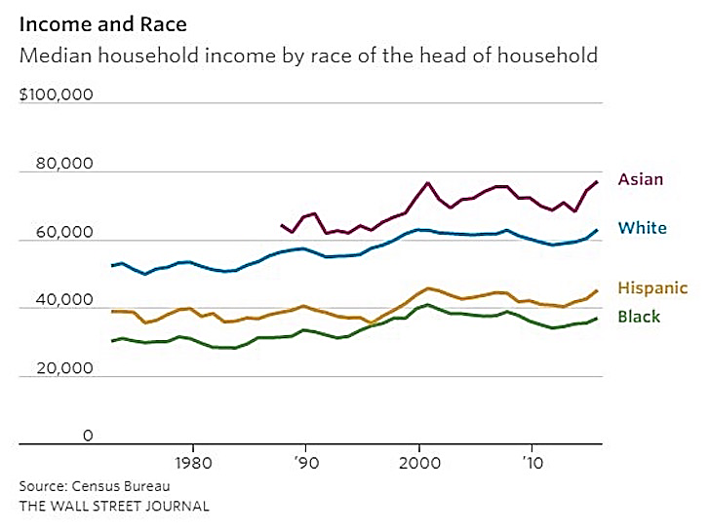
How much money do Latinos earn?

Slide 16
How do Latinos stand politically?
18 Latino Senators
Issues of education and immigration, as well as income and the quality of life, promise to keep Latinos politically actie.

Slide 17
Native Americans
Today, there are over five million Native Americans in the United States, 78% of whom live outside reservations.

Slide 18
What is the current situation of Native Americans?
Fewer Native Americans graduate from high school than any other major minority group.
Native Americans have the lowest annual income of any minority group in the United States.

Slide 19
Are conditions on reservations better or worse?
About one fourth of Native Americans live on reservations.
50 percent of Native Americans who live on reservations are below the poverty level, compared with over 25 percent of the total Native American population.
$35,062 is the median income of American Indian and Alaska Native households. This compares with $50,046 for the nation as a whole.
Source: 2010 American Community Survey for the American Indian and Alaska Native alone population

Slide 20
How have Chinese Americans fared over the years?
Attracted at first by the California gold rush, Chinese immigrants arrived in large numbers during the 1850s.
Chinese Americans were driven into large urban ghettos known as Chinatowns, where they are still concentrated today.

Slide 21
After the 1940s, American born Chinese college graduates began to enter professional occupations, and Chinese American scholars and scientists began to make publicly recognized contributions to science and the arts.

Slide 22
What has been the history of Japanese Americans in the United States?
When Japanese began to compete with white farmers, anti-Japanese legislation was passed.
The California Alien Land Bill of 1913, for example, permitted Japanese to lease farmland for a maximum of three years; it did not allow land they owned to be inherited by their families.

Slide 23
In 1924, the U.S. Congress halted all Japanese immigration, and the 126,000 Japanese already in the United States became targets for still more prejudice, discrimination, stereotyping, and scapegoating.

Slide 24
Pearl Harbor
December 7, 1941

Slide 25
President Roosevelt issued Executive Order 9066.
This emergency law moved more than 110,000 Japanese people into interment camps away from the West Coast.
Eventually in the 1980s, the U.S. government formally apologized to Japanese American internees and paid them $20,000 each in compensation.

Slide 26
Why have so many Asian Americans been successful?
They have used the educational system for upward mobility.
This is reflected in the academic achievement of school-aged Asian Americans, whose average SAT scores are 45 points higher than the general high school population.

Slide 27
White Ethnics
White ethnics are the descendants of immigrants from Eastern and Southern European nations particularly Italy and Poland.
They also include Greek, Irish, and Slavic people.
The majority are blue-collar workers living in small communities surrounding large cities in the eastern half of the United States.

Slide 28
Preserving your heritage
Many think that the price of completely abandoning one’s cultural and national roots is simply too high.

