Slide 1
Sociology Chapter 9 Section 1:
Inequalities of Race and Ethnicity

Slide 2
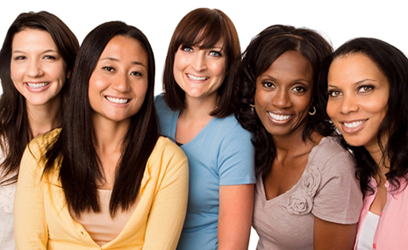
Minorities
Numbers alone are not the basis of the sociological definition of minority.
Women in the United States outnumber males, and yet they are still referred to as a minority.

Slide 3
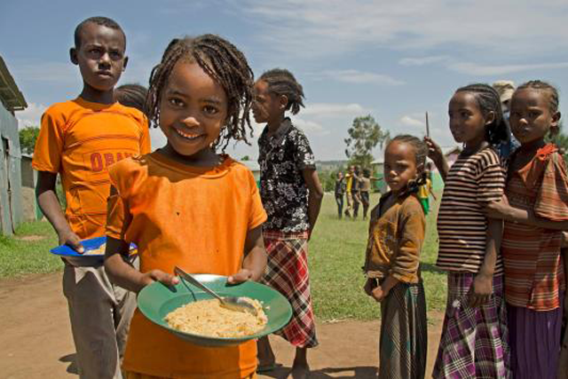
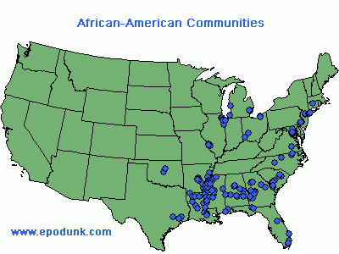
Blacks in Africa and in many large cities in the United States are minority populations even though they outnumber the white population.

Slide 4
What are the characteristics of a minority?
In 1945, sociologist Louis Wirth offered the following definition of minority:
A group of people who, because of their physical or cultural characteristics, are singled out from the others in the society in which they live for differential and unequal treatment, and who therefore regard themselves as objects of collective discrimination.

Slide 5
The existence of a minatory in a society implies the existence of a corresponding dominant group with higher social status and greater privilege.
Minority carries with it the exclusion form full participation in the life of the society.

Slide 8
A minority, then, has several key features:
1. A minority has distinctive physical or cultural characteristics which can be used to separate it from the majority.
2. The minority is dominated by the majority.
3. Minority traits are often believed by the dominant majority to be inferior.
4. Members of the minority have a common sense of identify, with strong group loyalty.
5. The majority determines who belongs to the minority through ascribed status.

Slide 9
Defining Race
Members for a race share certain biologically inherited physical characteristics that are considered equally important within a society.
Biologists use characteristics such as skin color, hair color, hair texture, facial features, head form, eye color, and height to determine race.

Slide 10
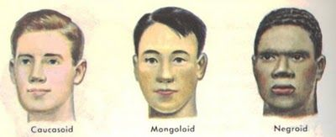
The most common system classifies races into three major divisions.:
Negroid, Mongoloid, and Caucasian.

Slide 11
Is there a scientific basis for race?
Scientists have known for a long time that there is no such thing as a “pure” race.
Features, or markers, typical of one race show up in other races quite frequently.
For sociologists, social attitudes and characteristics that relate to race are more important than physical differences.

Slide 12
But aren’t some physical characteristics superior?
Physical characteristics are superior only in the sense that they provide advantages for living in particular environments.
A narrow opening between eyelids protects against bright light and driving cold such as found in Siberia or Alaska.

Slide 13
A darker skin is better able to withstand a hot sun.

Slide 14
Ethnicity
The term ethnicity comes from the Greek word ethnos, originally meaning people or nation.
Today and ethnic minority is socially identified by unique characteristics related to culture or nationality.

Slide 15
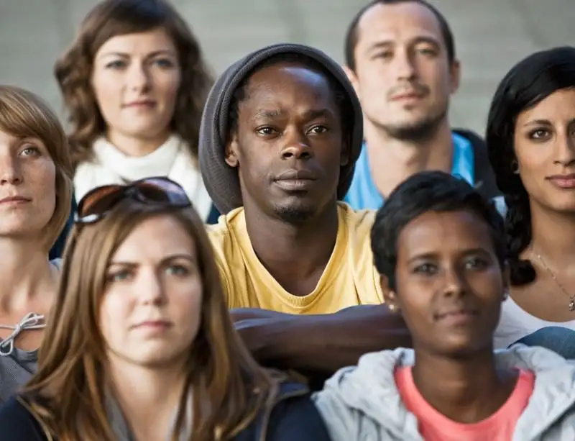
An ethnic minority is a subculture defined by its own language, religion, values, beliefs, norms, and customs.

Slide 16
Why are ethnic minorities seen as inferior?
Negative attitudes toward ethnic minorities exist in part because of ethnocentrism (judging others in terms of one’s own cultural standards).

