Slide 1
Sociology Chapter 9 Review

Slide 2
What aspect alone does not determine the basis for a minority?

Slide 3
Numbers alone are not the basis of the sociological definition of minority.

Slide 4
In 1945, sociologist Louis Wirth offered the following definition of minority:
A group of people who, because of their physical or cultural characteristics, are singled out from the others in the society in which they live for differential and unequal treatment, and who therefore regard themselves as objects of collective discrimination.

Slide 5
What does the existence of a minority group imply?

Slide 6
The existence of a minority in a society implies the existence of a corresponding dominant group with higher social status and greater privilege.

Slide 7
The most common system classifies races into three major divisions, which are…

Slide 8
Negroid, Mongoloid, and Caucasian.

Slide 9
Physical characteristics are superior only in the sense that they…

Slide 10
Physical characteristics are superior only in the sense that they provide advantages for living in particular environments.

Slide 11
Today a(n) _______________________is socially identified by unique characteristics related to culture or nationality.

Slide 12
ethnic minority

Slide 13
Why have Scientists known for a long time that there is no such thing as a “pure” race?

Slide 14
Features, or markers, typical of one race show up in other races quite frequently.

Slide 15
For sociologists, ___________________ and characteristics that relate to race are more important than physical differences.

Slide 16
social attitudes

Slide 17
Negative attitudes toward ethnic minorities exist in part because of __________________________(judging others in terms of one’s own cultural standards).

Slide 18
ethnocentrism

Slide 19
Generally, minority groups are either accepted- which leads to _________________________- or rejected- which lead to conflict.

Slide 20
assimilation

Slide 21
____________________________ has been the most prevalent pattern of assimilation in America.

Slide 22
Anglo-conformity

Slide 23
Desire of a group to maintain some sense of identity separate from the dominant group is known as…

Slide 24
Cultural Pluralism

Slide 25
Occurs when a minority maintains its own culturally unique way of life.
Example: Amish in Pennsylvania.

Slide 26
Accommodation

Slide 27
The systematic effort to destroy an entire population.

Slide 28
Genocide

Slide 29
List the levels of the pyramid of hate starting with bias.

Slide 30
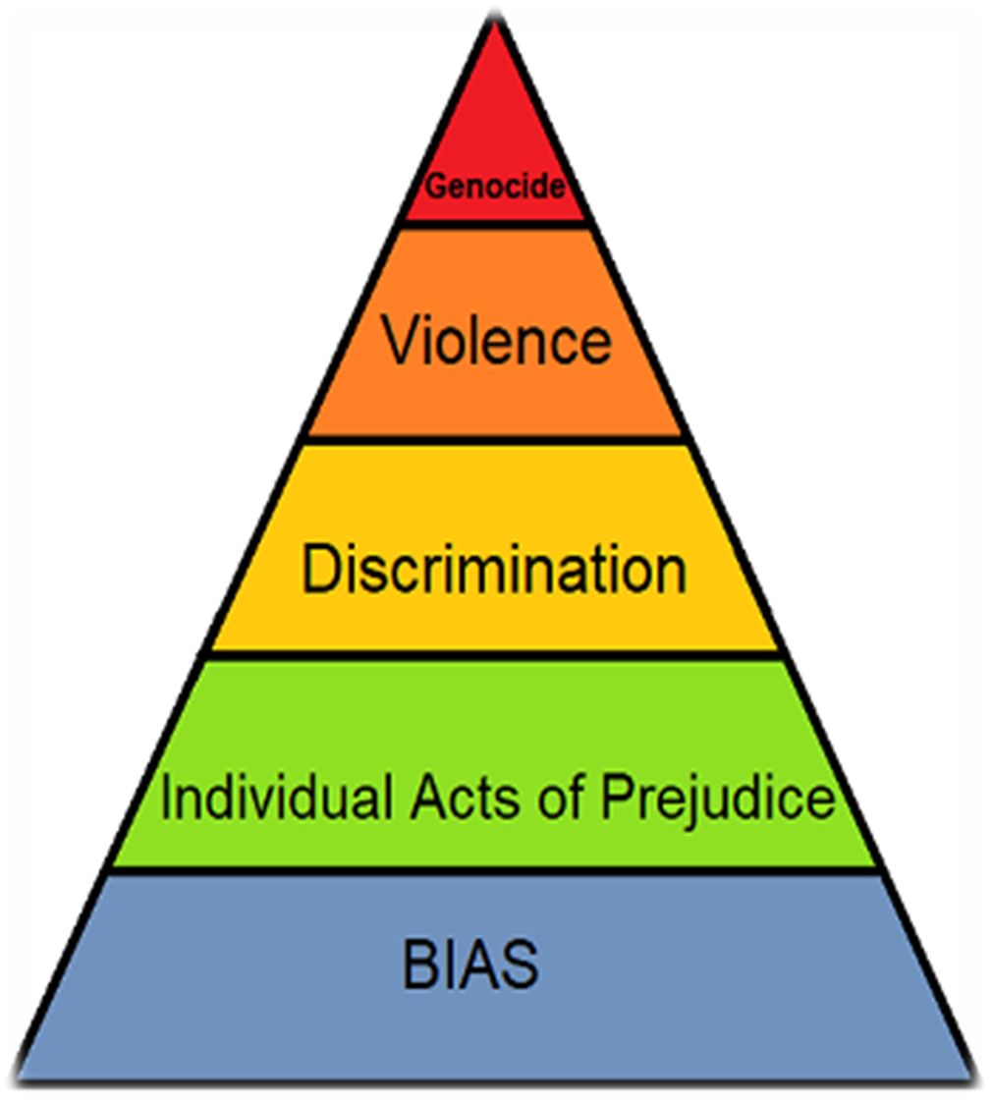

Slide 31
In________________________, a minority is forced either to move to a remote location or to leave entirely the territory controlled by the majority.
Trail of Tears: 1838 16,000 Cherokees

Slide 32
population transfer

Slide 33
_____________________ is the most common pattern of conflict- a minority is denied equal access to the culture and lifestyle of the larger society.

Slide 34
Subjugation

Slide 35
De jure segregation
Denial of equal access based on the _____________.
Brown vs. Board of Education of Topeka (1954)- the Supreme Court overturned previous case law that had made racial segregation legal in the U.S.

Slide 36
law

Slide 37
De facto segregation
Denial of equal access based on_____________________.
Neighboring homeowners agree among themselves not to sell to members of certain ethnic groups or races.

Slide 38
everyday practice

Slide 39
Widely held negative attitudes toward a group (minority or majority) and its individual members.

Slide 40
Prejudice

Slide 41
An extreme form of prejudice, because if not only involves judging people unfairly, but it assumes that a person’s own race or ethnic group is superior.

Slide 42
Racism

Slide 43
Explain how prejudice and discrimination differ.

Slide 44
While prejudice involves holding biased opinions, discrimination involves acting upon those opinions by treating people unfairly.

Slide 45
Involve bias related to race, religion, sexual orientation, national origin, or ancestry.

Slide 46
Hate crimes

Slide 47
A(n) __________________ is a set of ideas based on distortion, exaggeration, and oversimplification that is applied to all members of a group.

Slide 48
stereotype

Slide 49
In studying prejudice and discrimination, functionalists focus on the ___________________caused by these practices.

Slide 50
dysfunctions

Slide 51
According to conflict theory, a majority uses prejudice and discrimination as weapons of power to ______________________.

Slide 52
control a minority

Slide 53
According to the symbolic interactionist perspective, members of a society learn to be prejudice in much the same way they learn to be ________________________.

Slide 54
patriotic

Slide 55
Symbolic interactionism underlies the concept of the ____________________________an expectation that leads to behavior that then causes the expectation to become a reality.

Slide 56
self-fulfilling prophecy-

Slide 57
Nevertheless, minorities in this country still suffer from what sociologists call ___________________________ (unfair practices that grow out of common behaviors and attitudes and that are a part of the structure of a society).

Slide 58
institutionalized discrimination

Slide 59
______________________is the traditional American path to economic gain and occupational prestige.

Slide 60
Education

Slide 61
Why were Cubans able to be so successful in the United States?

Slide 62
The first large group of Cuban immigrants to enter the United States were successful middle and upper class people who fled from Cuba when Fidel Castro instituted a communist government there in the late 1950s.

Slide 63
Fewer _____________________ graduate from high school than any other major minority group.

Slide 64
Native Americans

Slide 65
Attracted at first by the_______________________, Chinese immigrants arrived in large numbers during the 1850s.

Slide 66
California gold rush

Slide 67
President Roosevelt issued Executive Order 9066. Summarize the order.

Slide 68
This emergency law moved more than 110,000 Japanese people into interment camps away from the West Coast.

Slide 69
How did the U.S. government apologize to Japanese internees?

Slide 70
Eventually in the 1980s, the U.S. government formally apologized to Japanese American internees and paid them $20,000 each in compensation.

Slide 71
__________________are the descendants of immigrants from Eastern and Southern European nations particularly Italy and Poland.
They also include Greek, Irish, and Slavic people.

Slide 72
White ethnics

