Slide 1
Sociology Chapter 8 Section 5
Social Mobility

Slide 2
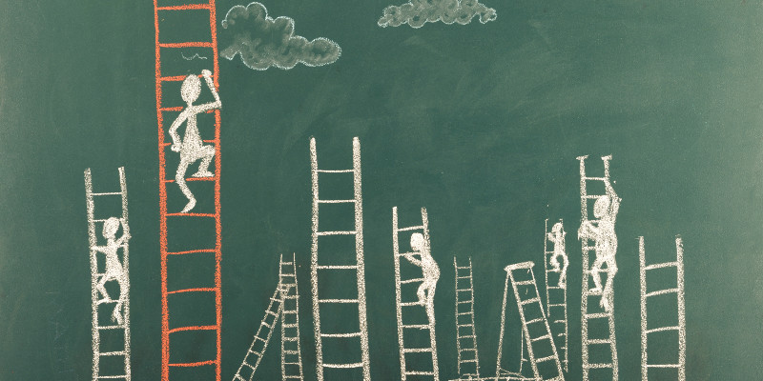
Types of Social Mobility
Social Mobility is the movement of people between social classes.

Slide 3
What are the types of social mobility
Horizontal mobility involves changing from one occupation to another at the same social class level.
Example: An Army captain becomes a public school teacher.

Slide 4
Because horizontal mobility involves no real change in occupational status or social class, sociologists are not generally interested in investigating it.

Slide 5
With vertical mobility, a person’s occupational status or social class moves upward or downward.

Slide 6
When the change takes place over a generation, it is called intergenerational mobility.
Example: If a plumber’s daughter becomes a physician.

Slide 7
What is a caste system?
In a caste system, there is no social mobility because social status is inherited and cannot be changed.
In a caste system, statuses (including occupations) are ascribed or assigned at birth.
Individuals cannot change their statuses through any efforts or their own.
By reason of religious, biological, superstitious, or legal justification.

Slide 9
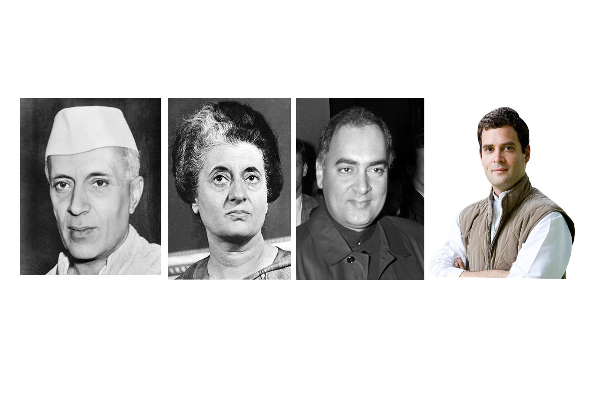
How is the caste system kept intact?
Traditional rulers exist in India to prevent movement into a higher caste.
Prime Minister or Dynasty
Nehru Dynasty

Slide 10
What is an open-class system?
In an open-class system, an individual’s social class is based on merit and individual effort.

Slide 11
Upward and downward Mobility
Abraham Lincoln
While considerable upward mobility has occurred, great leaps in social-class levels are rare.
Upward mobility typically involves only a small improvement over the social class situation of one’s parents.

Slide 12
Is upward mobility increasing?
After World War II, an explosion in the availability of high-paying manufacturing jobs made it relatively easy for people to move upward.
However, with computer-driven production, improved means of communication, and better transportation, it is possible for U. S. companies seeking to lower their costs to move their manufacturing operations overseas.

Slide 13
U.S. workers, then, who lack the education needed to perform the more technologically sophisticated jobs are being forced to take lower-paying jobs.
Downward mobility

Slide 14
What are the social and psychological costs of downward mobility?
Downwardly mobile people experience lowered self-esteem, despair, depression, feelings of powerlessness, and a loss of sense of honor.

