Slide 1
Sociology Chapter 8 Section 4:
Poverty in America

Slide 2
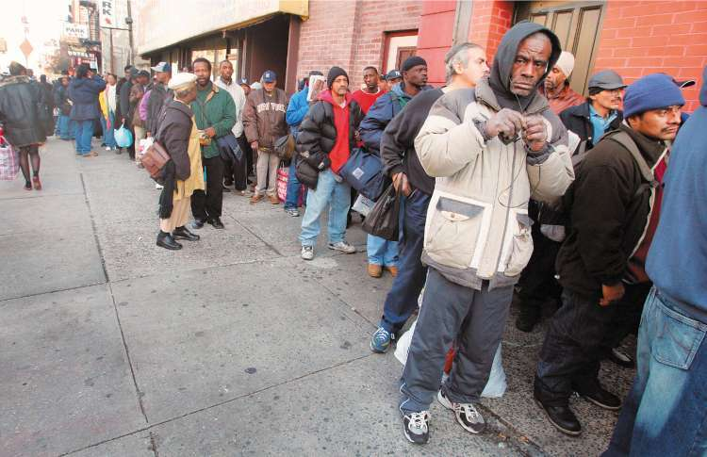
Measuring Poverty
Absolute poverty is the absence of enough money to secure life’s necessities- enough food, a safe place to live, and so forth.

Slide 3
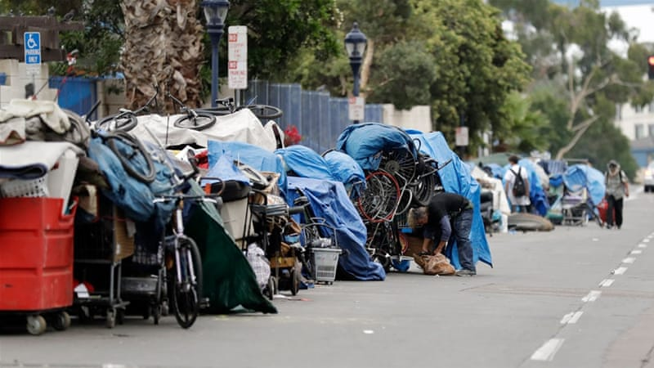
We measure relative poverty by comparing the economic condition of those at the bottom of society with the economic conditions of other members of that society.
According to this measure, the definition of poverty can vary.

Slide 4
How is poverty measured in the United States?
Historically, the United States government has measured poverty by setting an annual income level and considering people poor if their income is below that level.
3 people in the household (income altogether $21,330)

Slide 5
How many Americans are poor?
Official Poverty Rate – 2018 (12.3 percent)
2000 U.S. Census (11.8 percent)

Slide 6
Identifying the Poor
Minorities
Female-headed households
People under eighteen years of age
Elderly people
People with disabilities
People who live alone or with nonrelatives
Make up the most disadvantaged groups in the United States

Slide 7
How are race and ethnicity related to poverty?
The poverty rate for African Americans and Latinos is much higher than that for whites.
African Americans and Latinos account for one-fourth of the total population, but they make up nearly half of the poor population.

Slide 8
How are gender and age related to poverty?
Female-headed households
Nearly one half of poor households are female headed.
The high poverty rates for women and children reflect a trend in U.S. society.

Slide 9
Between 1960 and today, women and children make up a larger proportion of the poor.
Sociologists refer to this trend as the feminization of poverty.

Slide 10
Why women have a higher risk of being poor.
Women earn only about $.72 cents for every dollar earned by men.
Women with children find it more difficult to find and keep regular, long-term employment.
A lack of good child-care facilities adds to the likelihood that they will not be able to continue working.
Full time daycare averages $900 to $1,500 dollars a month.

Slide 11
Older Americans
Older Americans account for another large segment of the poor.
About 9 percent of people aged sixty-five or older live in poverty.

Slide 12
Americans with disabilities
Another large segment of the poor are people with disabilities- those who are blind, deaf, or otherwise disabled.
This group accounts for 12 percent of America’s poor.

Slide 13
Responses to the problem of Poverty
In 1964, President Lyndon Johnson marshalled the forces of the federal government to begin a War on Poverty.

Slide 14
What were the goals of the war on poverty?
Philosophy – “Help the poor people help themselves).
Almost 60 percent of the first poverty budget was earmarked for youth opportunity programs and the work experience program (work and job training designed primarily for welfare recipients and unemployed fathers).

Slide 15
Has welfare reform worked?
Most people entering the workforce after receiving welfare hold entry level jobs- in restaurants, cleaning services, and retail stores.
Most people have jobs without benefits.

