Slide 1
Sociology Chapter 8 Section 3:
Social Classes In America

Slide 2
Class Consciousness
Americans have always been aware of inequality, but they have never developed a sense of class consciousness- a sense that identification with the goals and interests of the members of a particular social class.
It was not until the 1920s that sociologists in the United States began systematically to identify social classes.

Slide 3
Early efforts to study stratification were mostly case studies of specific communities.
Only in relatively recent times have attempts been made to describe the stratification structure of America as a whole.

Slide 4
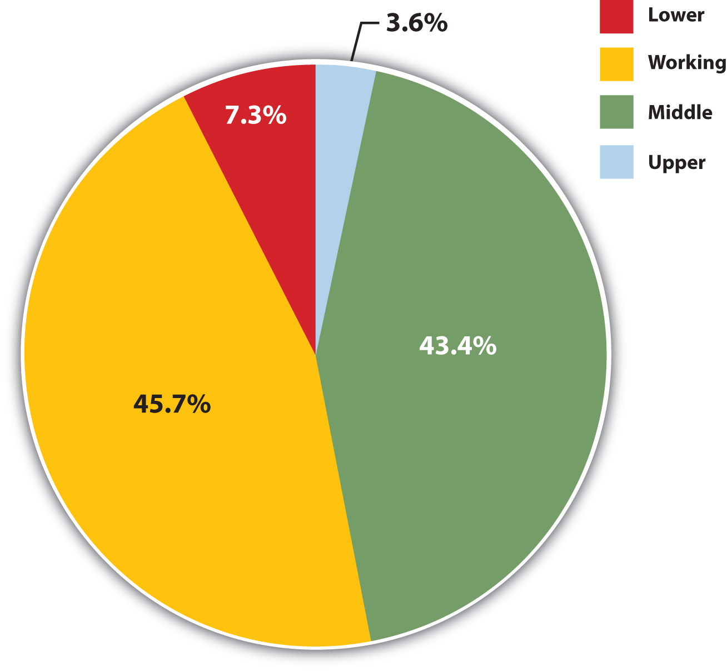
Since social classes are changeable and full of exceptions, any attempt to identify the social-class structure of American society is hazardous.
Nevertheless, sociologists have described some of the major classifications.

Slide 5
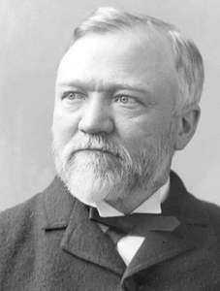
The upper class
The upper class includes only one percent of the population and may be divided into the upper-upper class and the lower-upper class.
At the top is the aristocracy- its members represent the old-money families whose names appear in high society- Ford, Rockefeller, Vanderbilt, and du Pont.

Slide 6
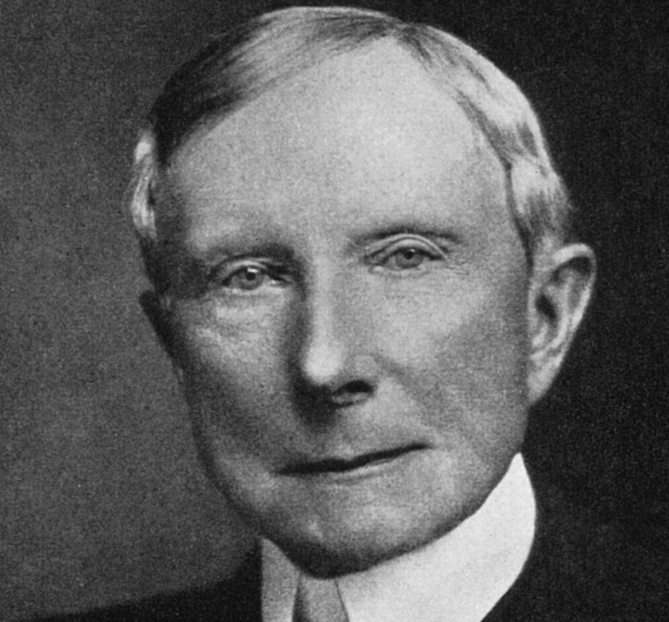
The basis for membership in this most elite of clubs is blood rather than sweat and tears.
Parent in this class send their children to the best private school and universities.
People in this group seldom marry outside their class.

Slide 7
People are in the lower-upper class more often because of achievement and earned income than because of birth and inherited wealth.

Slide 8
The Middle Class
Most Americans think of themselves as middle class.
In reality though, only about 40 to 50 percent of Americans fit this description and most of these people are not in the upper-middle class.

Slide 9
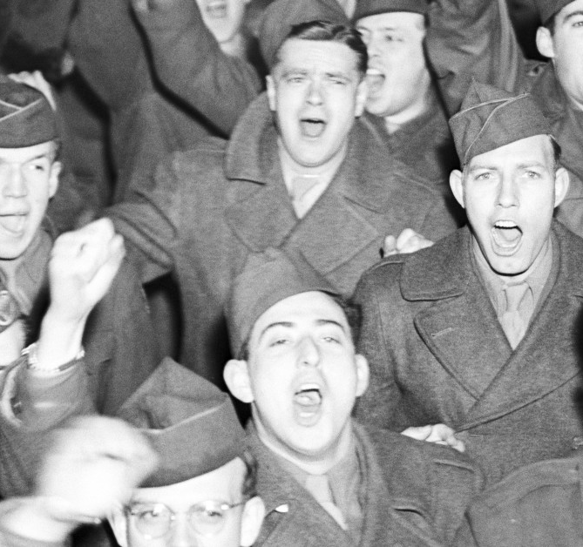
The upper-middle class (14 percent of the population) is composed of those who have been successful in business, the professions, politics, and the military.
This class is made up of individuals and families who benefited from the tremendous corporate and professional expansion following World War II.

Slide 10
They are typically college educated and have high educational and career goals for their children.

Slide 11
The middle-middle class (30 percent of the population) is a very mixed bag.
Its member include owners of small businesses and farms; independent professionals (small-town doctors and lawyers); other professionals (clergy, teachers, nurses, firefighters, social workers, police officers).
Their income level, which is at about the national average ($45,200), does not permit them to live as well s the upper-middle class.

Slide 12
Many have only a high school education, although many have some college. And some have college degrees.

Slide 13
The Working Class
Often referred to as the lower-middle class- comprises almost one-third of the population.
Working class people include roofers, delivery truck drivers, machine operators, and salespeople.
Members of the working class have below-average income and unstable employment.
They generally lack hospital insurance and retirement benefits.

Slide 14
The working poor
The working poor (13 percent of the population) consists of people employed in low-skill jobs with the lowest pay.
Its members are typically the lowest-level clerical workers, manual workers (laborers), and service workers (fast-food servers).

Slide 15
Lacking steady employment, the working poor do not earn enough to rise about the poverty line (a family of 4 with no children under 18 years of age is $22,541).

Slide 16
The Underclass
The underclass (12 percent of the population) is composed of people who are usually unemployed and who come from families with a history of unemployment for generations.
They either work in part-time menial jobs (unloading trucks, pick up litter) or are on public assistance.
Physical or mental disabilities are common and many are single mothers with little or no income.

Slide 17
The most common shared characteristics of the working poor and the underclass is a lack of skill to obtain jobs that pay enough to meet basic needs.
There are many routs into these classes- birth, old age, loss of marriage partner, lack of education or training, alcoholism, physical or mental disability.

