Slide 1
Sociology Chapter 4 Section 4: Processes of Socialization

Slide 2
Desocialization and Resocialization
Whenever change occurs over the course of your life, you will learn new behaviors and skills.

Slide 3
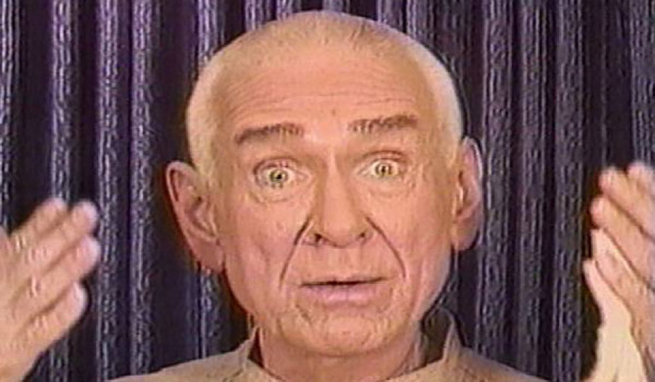
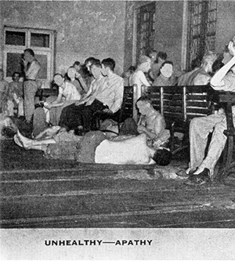
How does desocialization prepare people for new learning?
Mental hospitals, cults, and prisons are total institutions- places were residents are separated from the rest of society.
Controlled and manipulated by those in charge.
The end purpose of this control and manipulation is to permanently change the residents.

Slide 4
Step One.
Desocialization
The process by which people give up old norms, values, attitudes, and behaviors.
Desocialization often means the destruction of old self-concepts of personal identify.

Slide 5
Accomplishing desocialization in institutions.
Replace personal possessions with standard-issue items.
Promotes sameness among the residents.
The use of serial numbers to identify people and the loss or privacy.

Slide 6
How does resocialization begin?
Once the self-concept has been broken down, resocialization- the process in which people adopt new norms, values, attitudes, and behaviors can begin.

Slide 7
Rewards and punishments, attempt to give residents new self concepts.
Rewards can include food, special responsibilities, or periods of privacy.
Punishments for noncorformity involve shaming, loss of special privileges, physical punishment, and physical isolation.

Slide 8
Anticipatory Socialization
The process of preparing (in advance) for new norms, values, attitudes, and behaviors.
It does not generally occur in prisons or mental hospitals because it involves voluntary change.

Slide 9
Anticipatory socialization may occur in people who are moving from one stage in their lives to another.
Teens become their new reference group- the group they use to evaluate themselves and from which they acquire attitudes, values, beliefs, and norms.

