Slide 1
Sociology Chapter 3 Section 3: Norms and Values

Slide 2
Norms: The Rules We Live By
Norms: Values and beliefs, and its use of material objects.
Norms- rules defining appropriate and inappropriate behavior.

Slide 3
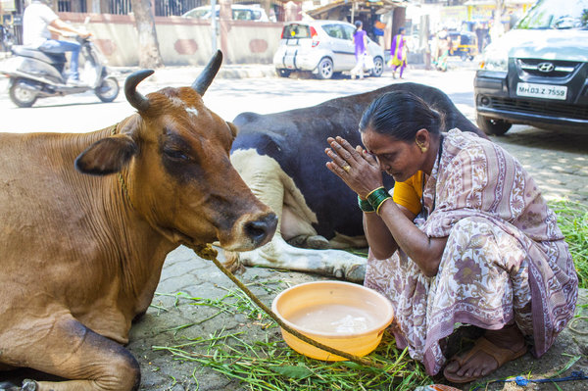
A Hindu peasant in India can be found lying dead of starvation beside perfectly healthy cattle.

Slide 4
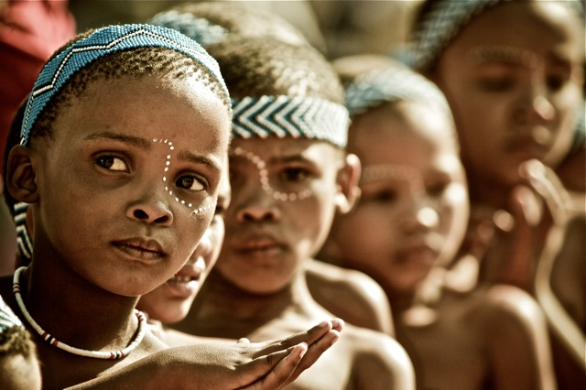
A young Basarwa girl in Africa might become engaged to a man she has not met.

Slide 5
Roman emperors routinely exiled relatives to small isolated islands for disgracing the family.

Slide 6
Cultural Norms – ways of behaving in a specific situation.

Slide 7
William Graham Sumner
An early sociologist who wrote about norms.
Anything, he stated, can be considered appropriate when norms approve of it.
Once norms are learned, members of a society use them to guide their social behavior.

Slide 8
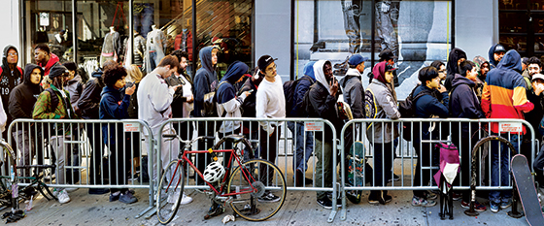
Going to a concert
You may not think about standing in line for concert tickets as a norm until someone attempts to step in front of you.
Cutting in front of a line violates a norm.

Slide 9
Folkways, Mores (MOR-ays), and Laws
William Sumner identified three basic types of norms: folkways, mores, and laws.

Slide 10
Folkways
Norms that lack moral significance.
Examples: sleeping in a bed versus on the floor, supporting school activities, speaking to other students in the hall, and removing your hat in church if you are a male.

Slide 11
Failure to offer a woman a seat on a crowded bus may get a social reaction.

Slide 12
Mores (MOR-ays)
Based on the word moral
Mores are norms of great moral significance.
Vital to the well being of a society

Slide 13
Examples:
Failure to stand at attention while the national anthem is being played is not as serious a violation of American mores as using loud profanity during a religious service.

Slide 14
Taboos
The most serious mores are taboos.
Taboo- a norm so strong that is violation demands punishment by the group (or, some people think even the supernatural).

Slide 15
In India, followers of Hinduism have a taboo forbidding the killing of cows.
Although definitions of incest vary from society to society, the incest taboo (forbidding sexual contact with close relatives) is generally regarded as the only taboo that is present in all societies.

Slide 16
Mother-in-law Taboo
Prohibits or severely restricts social contact between a husband and his wife’s mother.

Slide 17
How do laws differ from mores?
The third type of norm is a law.
Laws are norms that are formally defined and enforced by officials.
Folkways and mores emerge slowly and are often unconsciously created, while laws are consciously created and enforced.

Slide 18
Laws often remain on the books for a long time after the mores of a society have changed.
Example: It is illegal in Minnesota to hang male and female undergarments on the same clothesline.

Slide 19
Enforcing the Rules
Norms must be learned and accepted.
Sanctions – rewards and punishments used to encourage conformity to norms.

Slide 20
What are formal sanctions?
Sanctions that may be applied only by officially designated persons such as judges and teachers.
Positive Sanction- a soldier earning a Congressional Medal of Honor
Negative Sanction – Protestant Reformation – lenders charging interest on money (public humiliation and economic ruin).

Slide 21
What are informal sanctions?
Sanctions that can be applied by most members of a group.
Include thanking someone for pushing a car out of a snowbank or staring at someone who is talking loudly during a movie.

Slide 22
Values – The Basis for Norms
Values- broad ideas about what most people in a society consider to be desirable.
Values are so general that they do not dictate precise ways of thinking, feeling, and behaving.
Values of freedom is various countries.
Soviet Leaders- people are free because they provide full employment.
American Leaders – people are free because they have the right to free speech and the right to assembly.

Slide 23
Why are values important?
They form the basis of norms.
Example: A society that values democracy will have norms ensuring personal freedom.

Slide 24
Basic Values in the United States Created by Sociologist Robin Williams (1970)
Achievement and Success
Activity and work
Efficiency and practicality
Equality
Democracy
Group superiority

Slide 25
Do these values still prevail in the United States today?
Many American values remain the same based on Robin Williams list, however, some sociologists would add
Optimism
Honesty
Friendliness

