Slide 1
Sociology Chapter 3 Section 2: Language and Culture

Slide 2
If culture is to be transmitted, it must be learned anew by each generation.

Slide 3
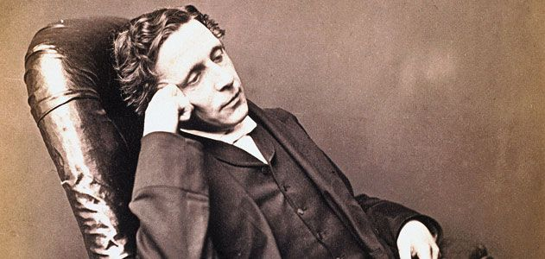
What are symbols?
In Lewis Carroll’s Through the Looking Glass, Humpty Dumpty says to Alice, “When I use a word, it means just what I choose it to mean – neither more nor less.”

Slide 4
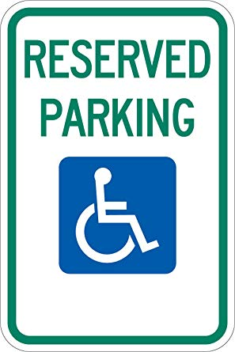
Symbols- things that stand for or represent something else.

Slide 6
How are language and culture related?
Language
Frees humans
Create culture

Slide 7
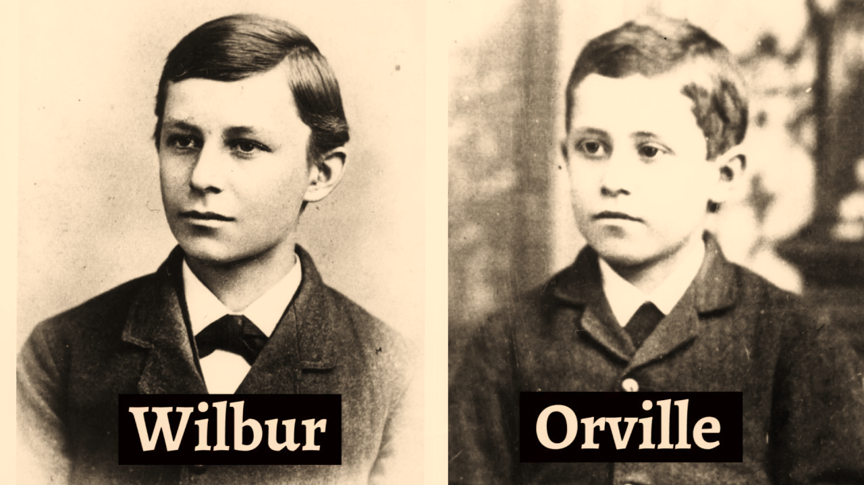
The Wright Brothers
Built their airplane according to principles of flight already existing in American culture.

Slide 8
Think about one object…

Slide 9
The Sapir-Whorf Hypothesis
Edward Sapir / Benjamin Whorf
Language is our guide to reality.
Our idea of reality depends largely upon language.

Slide 10
What can vocabulary tell you about a culture?
When something is important to a society, its language will have many words to describe it.

Slide 11
Time is very important in American culture.
Nanosecond (one billionth of one second), millisecond (one tenth of a second), moment (120 seconds), minute (sixty seconds), hour (sixty minutes)

Slide 12
When Christian missionaries first went to Asia, the Chinses language contained no word for sin.

Slide 13
Does the hypothesis of linguistic relativity mean we are prisoners of our language?
We are not forever trapped by our own language.
Exposure to another language or to new words can alter a person’s perception of the world.

Slide 14
Most people do confine themselves to the language and vocabulary they learned from birth.

