Slide 1
Sociology Chapter 3 Culture Section 1- The Basis of Culture

Slide 2
Culture and Society
Culture
knowledge, language, values, customs, and physical objects that are passed from generation to generation among members of a group.

Slide 3
Material Side
Physical objects
Skyscrapers, fast-food restaurants, cell phones, and cars.

Slide 4
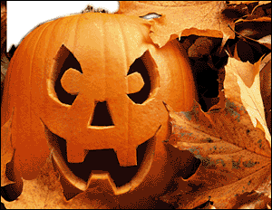
Nonmaterial Side
Beliefs, rules, customs, family systems, and a capitalist economy.

Slide 5
Culture and society cannot exist without the other, but they are not identical.

Slide 6
Society- a group of people who live in a defined territory and participate in a common culture.

Slide 7
Human behavior is based on culture.
Human cultural behavior must be learned.

Slide 8
Culture and Heredity
Instincts – genetically inherited patterns of behavior.

Slide 9
Why is culture more important than instinct in determining human behavior?
If humans were controlled by instinct, we would all behave in the same way.

Slide 10
Mothering instinct
All women would want children

Slide 11
Humans rely on the culture they have created for their basic needs.

Slide 12
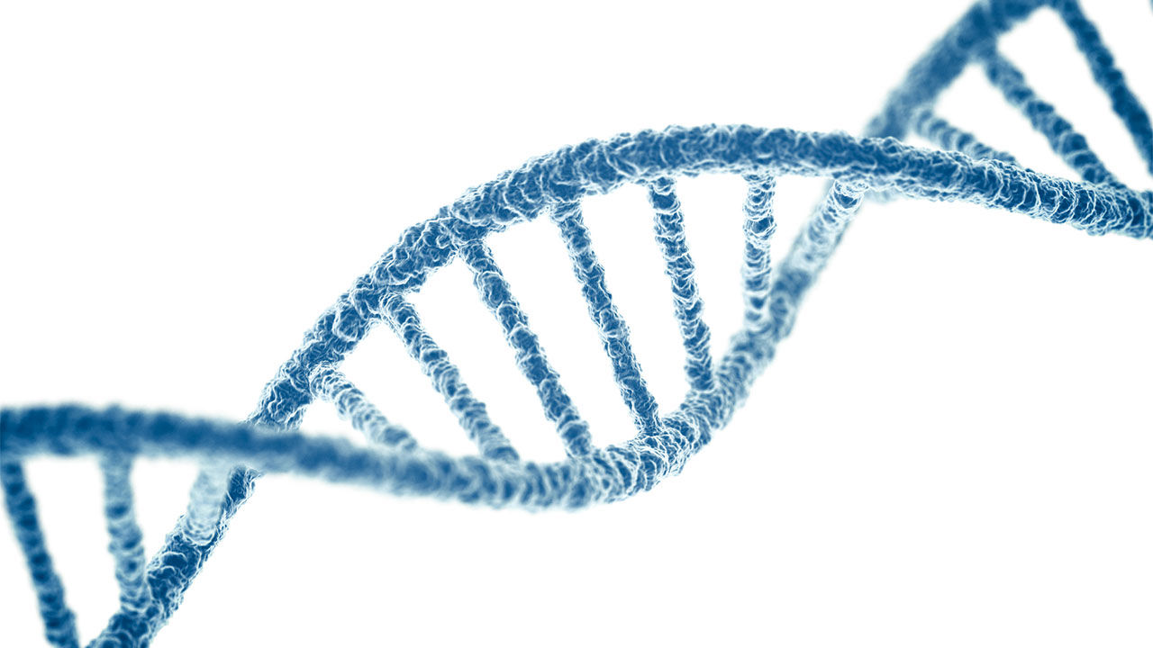
How does heredity affect behavior?
Genetic inheritance also plays a role on human behavior.

Slide 13
Nature versus Nurture
Using studies of identical twins, researchers have determined that about half of your personality traits are determined by your genetic makeup and about half by environmental factors.

Slide 14
Reflexes
Simple, biologically inherited, automatic reactions to physical stimuli.

Slide 15
We also have biologically inherited drives, or impulses, to reduce discomfort.
We want to eat, drink, sleep, and associate with others.

Slide 16
Sociobiology
The study of the biological basis of human behavior.
It combines Darwin’s theory of natural selection with modern genetics.

Slide 17
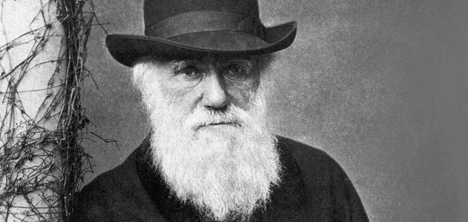
How do sociobiologists view human behavior?
According to Darwin’s theory of evolution, organisms evolve through natural selection.

Slide 18
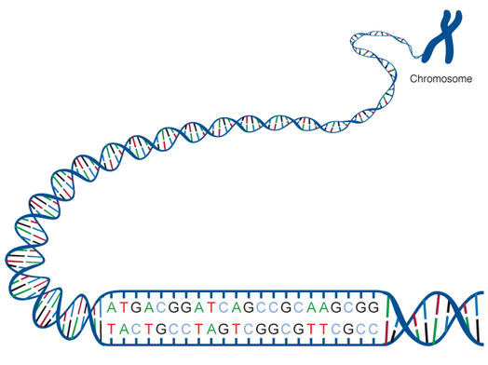
Sociobiologists assume that the behaviors that best help people are biologically based and transmitted in the genetic code.

Slide 19
Many non-human animals, claim sociobiolgists, show intelligence of a kind formerly thought to be unique to humans.

Slide 20
What are some criticisms of sociobiology?
The importance placed on genetics could be used as a justification to label specific races as superior or inferior.

Slide 21
Critics also point out that there is too much variation in societies around the world for human behavior to be explained on strictly biological grounds.

Slide 22
Is there a middle ground?
Genes work with culture in a complex way to shape and limit human nature and social life.

