Slide 1
Chapter 2 Section 3: Procedures and Ethics in Research

Slide 2
Steps for Doing Research
Scientific Method
Involves the pursuit of knowledge in a systematic way.

Slide 3
Identify the Problem
Review the Literature
Formulate Hypothesis
Develop a Research Design
Collect Data
Analyze Data
State Findings and Conclusions

Slide 4
Hypothesis- a testable statement of relationships among well-defined variables.

Slide 5
Developing a Research Design
States the procedures the researcher will follow for collecting and analyzing data.

Slide 6
Realistically, do sociologists follow these steps?
The research model is too rigid to be used in studying human society
The model is followed, just not always followed mechanically
May conduct exploratory studies prior to stating hypothesis and developing research.

Slide 7
Ethics in Social Research
Research is a distinctly human activity.
There are principals for conducting research, such as objectivity and verifiability.
Scientists do fail to live up to these principles.

Slide 8
Unfortunately, there is a long list of examples of ethical lapses in medical research.

Slide 9
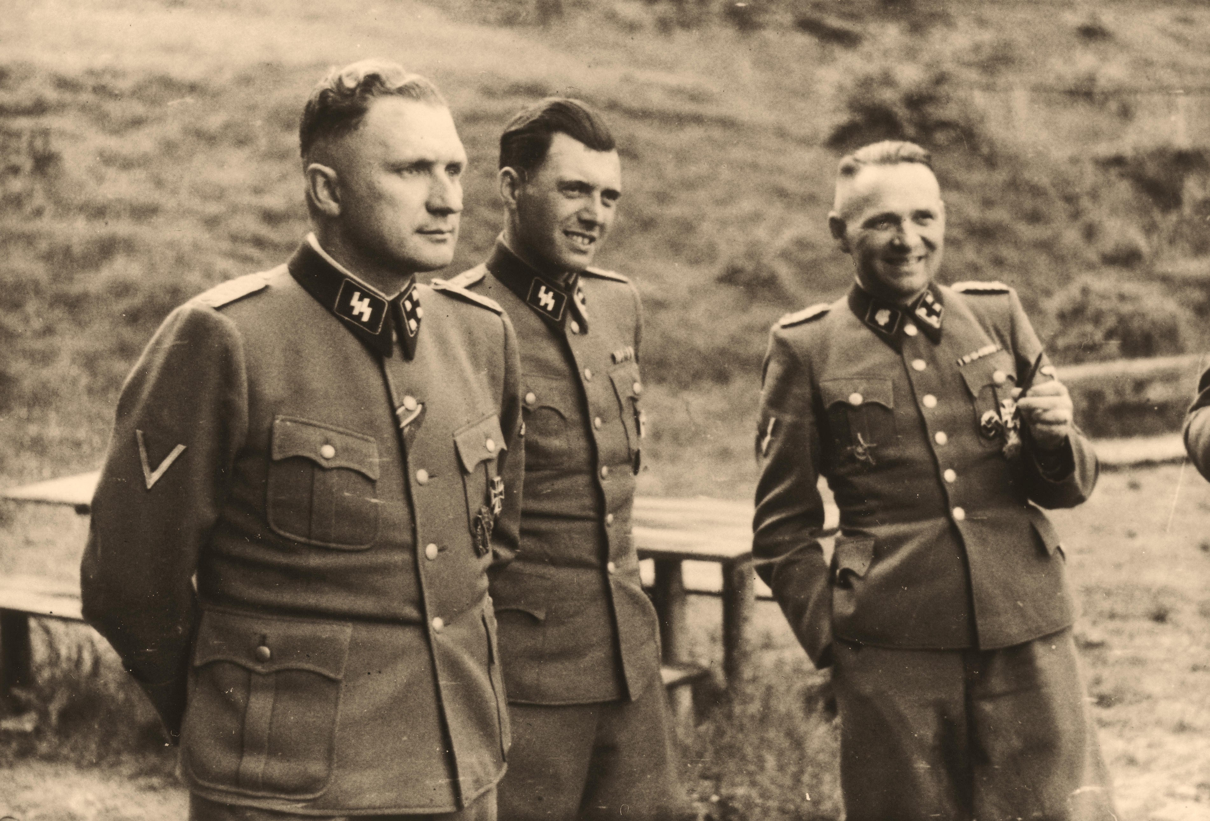
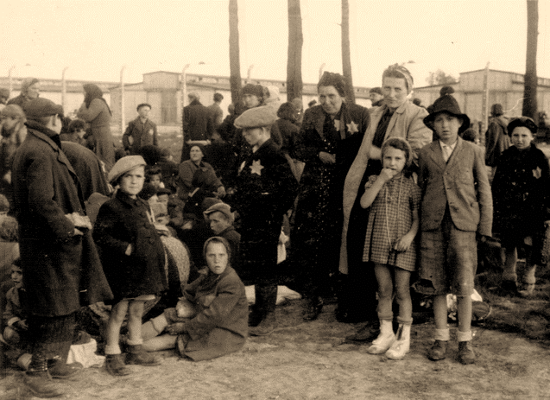
The Nuremberg Trials
16 Nazi doctors were convicted of conducting sadistic experiments on concentration camp inmates.

Slide 10
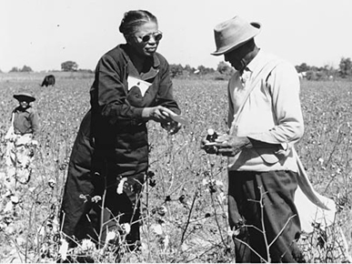
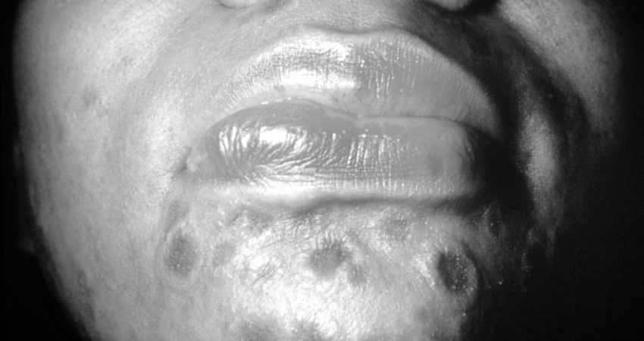
From 1932 to 1972, the Public Health Service of the U.S. Government deliberately did not treat 399 syphilitic African American agricultural workers and day laborers so that biomedical researchers could study the full evolution of the disease.

Slide 11
For twenty years, researchers at Germany’s University of Heidelberg used human corpses, those of adults and children, in high-speed automobile crash tests.

Slide 12
Federal investigators in the United States have documented over ten years of fraud in some of the most important breast cancer research ever down.

Slide 13
More often, however, sociologists routinely protect the rights of research subjects and avoid deceiving or harming them.
Mario Brajuha – graduate student
Kept detailed field notes while doing a participant observation study of a restaurant work. He was an employee at a restaurant with a suspect of arson.
The police had to subpoena his notes.

Slide 14
What is sociology’s code of ethics?
Conducting ethical research means showing objectivity, using superior research standards; reporting findings, and methods truthfully; and protecting the rights, privacy, integrity, dignity, and freedom of research subjects.

Slide 15
The American Sociological Association has published guidelines for conducting research.
The Code of Ethics is concerned with getting the greatest possible benefit with the least possible harm.

Slide 16
Can researchers act ethically and still get the information they need?
Sometimes acting ethically is difficult.
The researcher must balance the interests of those being studied against the need for accurate, timely data.
Balance is the key to the issue of ethics.

Slide 17
At the least, the people involved in sociological research should be protected from social, financial, or psychological damage or legal prosecution.

Slide 18
Project- look up more unethical research projects
The American Sociological Association – Code of Ethics website
Lawsuits from sociological research

