Slide 1
Sociology Chapter 2 Section 2: Causation in Science

Slide 2
According the concept of causation, events occur in predictable, nonrandom ways.
Social Scientists look for the factors that cause social events to occur.

Slide 3
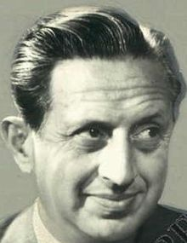
Why do sociologists look for multiple causes?
Leo Rosten, a twentieth century novelist, one wrote “If an explanation relies on a single cause, it is surely wrong.”
Multiple causation- an event occurs as a result of several factors working in combination.
Example: what causes one to a life of crime?
Modern criminologists have shown that many factors contribute to crime, including peer pressure.

Slide 4
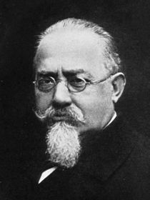
Cesare Lombroso, a nineteenth-century Italian criminologist, mistakenly believed that the tendency to commit crimes was inherited.
Criminals could be identified by certain physical traits such large jaws or receding foreheads.

Slide 5
Modern criminologists have shown that many factors contribute to crime.

Slide 6
Peer pressure, the use of drugs, hopeless poverty, and poor parenting.
Each of these single factors is called a variable.

Slide 7
Variables and Correlations
Variables- a characteristic such as age, education, or occupation that is subject to change.
Variables can be quantitative (measured and given a numerical value) or qualitative (identified by membership in a category).
Sex, marital status, and group membership are three qualitative variables.

Slide 8
Independent an Dependent Variables
The independent variable in a study is the variable that causes something to occur.
The dependent variable is what results form the change in the independent variable.
You might look at the time spent studying for a test as an independent variable that could cause a change in a grade – a dependent variable.

Slide 9
Intervening variable
Influences the relationship between an independent and a dependent variable.
The existence of a government support program, for example, may intervene between poverty and hunger.

Slide 10
What is correlation?
A correlation is simply a measure of how things are related to one another.
When a change in a trait behavior or an event (independent variable) is tied to a change in a trait, behavior, or an event (dependent variable), a correlation exists.
Correlations may be positive or negative.

Slide 11
A positive correlation exists if both the independent variable and the dependent variable change in the same direction.
A positive correlation exists if we find that grades (dependent variable) improve as study time increases (independent variable).

Slide 12
A negative correlation, the variables change in opposite directions.
An increase in the independent variable is linked to a decrease in the dependent variable.
A negative correlation exists if we find that grades (dependent variable) go down as time spent watching television (independent variable) increases.

