Slide 1
Chapter 2 Sociologists Doing Research Section 1: Research Methods

Slide 2
Doing Research in the Social Sciences
The goal of sociological research:
Test common sense assumptions
Replace false ideas with facts and evidence
Part of the sociological perspective is to ask “why” and “how” questions and them from a hypothesis to arrive at accurate understandings.

Slide 3
Social scientists differ from other scientists in the way they conduct research.
Sociologists are very limited in setting up laboratory experiences.
Ethical issues and manipulating people

Slide 4
For sociologists, the world is their laboratory.

Slide 5
How do sociologists do research?

Slide 6
Quantitative – using numerical data
Surveys
Pre-collected data
Qualitative- narrative and descriptive data

Slide 7
Survey Research
Survey
People are asked to answer a series of questions.
Most widely used research method among sociologists.
Best for studying large numbers of people.

Slide 8
How are effective surveys conducted?
Populations
All those people with the characteristics a researcher wants to study.
(high school seniors and retired postal workers)
Samples
Limited number of cases drawn from the larger population.
Must be selected carefully

Slide 9
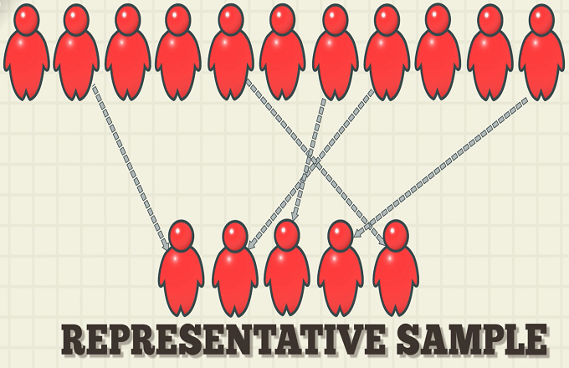
Representative sample
A sample accurately reflecting the characteristics of the population as a whole

Slide 10
The United States Census Bureau
responsible for producing data about the American people and economy.

Slide 11
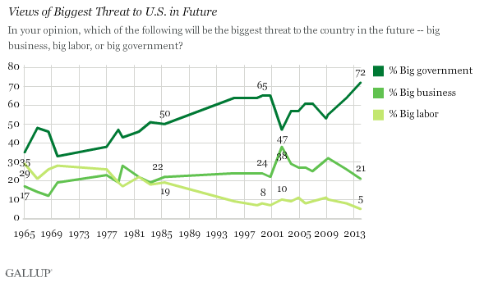
The Gallup Poll
an assessment of public opinion by the questioning of a statistically representative sample.

Slide 12
The Harris Poll
Harris Insights & Analytics Company

Slide 13
How are representative samples selected?
Random or chance selection.
Assigning each member a number and selecting each one randomly.

Slide 14
How is survey information gathered?
Questionnaire
A written set of questions that survey participants answer by themselves.
Interview
A trained interviewer askes questions and records the answers.

Slide 15
Types of Questions
Closed-ended questions
A person answers by choosing from a limited, predetermined set of responses (multiple choice questions).
Sometimes fail to uncover underlying attitudes and opinions.
Easier to tabulate and compare
Open-ended questions
Ask the person to answer in his or her own words.
Can reveal many attitudes.
Answers not easy to quantify or compare.
Possible rephrasing of the question.

Slide 16
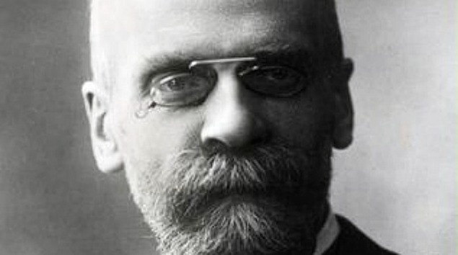
Secondary Analysis
Pre-collected information.
The first sociologists to use statistics in a sociological study- Emile Durkheim- relied on pre-collected data.

Slide 17
Sources for secondary analysis
Government reports
Company records
Voting lists
Prison records

Slide 18
The United States Census Bureau is one of the most important sources of pre-collected data for American sociologists.
Conducted every ten years
Income, education, race, sex, age, marital status, occupation, and death and birth rates.

Slide 19
The U.S. Department of Labor
Unemployment levels
The U.S. Department of Commerce
Issues monthly reports on various aspects of the economy

Slide 20
Field Research
Looks closely at aspects of social life that cannot be measured quantitatively and that are best understood with a natural setting (high school cliques).

Slide 21
When do sociologists use case studies?
Case Study- a thorough investigation of a single group, incident, or community.
Assumes findings in one case can be generalized to similar situations.

Slide 22
When do case studies involve participant observation?
Participant observation – when a researcher becomes a member of the group being studied.
May join a group with or without informing its members that he or she is a sociologist.

Slide 23
Black Like Me – a book written by John Howard Griffin (1961).
Griffin, a white journalist, dyed his skin to study the life of African Americans in the South.
Results posing as an African American were quit different.

Slide 24
Elliot Liebow
Studied disadvantaged African American males who knew he was observing them.

Slide 25
Survey Assignment
Create a paper copy survey based on the impact technology has on society.
You may focus your survey for or against technology.
All questions you ask must be school appropriate.
You must ask at least 20 questions.

Slide 26
Types of Surveys
Yes/ No
Multiple Choice
Checkbox
Interview

