Slide 1
Sociology Chapter 10 Section 3: Gender Inequality

Slide 2
Women as a minority
Most scientists consider biological determinism to be a moral threat because historically it has been used to rationalize the treatment of some people as inferior.

Slide 3
Sexism is defined as a set of beliefs, attitudes, norms, and values used to justify gender inequality.
Sexist ideology- the belief that men are naturally superior to women- has been used and is still being used to justify men’s leadership and power positions in the economic, social, and political spheres of society.

Slide 4
Isn’t sex discrimination disappearing?
Some segments of American society now have more positive attitudes about women.
A few women now hold key positions traditionally reserved for men.
A careful examination reveals many gaps in social rights, privileges, and rewards for women in the United States.

Slide 5
Occupational and Economic Inequality
75 percent of women today work outside the home.
80 percent of men today work outside the home.
The greatest change in patterns of work involves married women with children under six years of age.

Slide 6
What kinds of jobs are women doing?
Although women are participating in the labor force at increasing levels, they are concentrated in lower status occupations.
This is known as occupational sex segregation.
Women occupy nearly all of the “pink-collar” jobs- secretaries and clerks.
Female lawyers in firms seldom occupy the higher-level administrative positions.

Slide 7
Do women earn less than men?
There is a wide discrepancy between the earnings of American women and men.
The salary gap is decreasing.

Slide 8
Are all occupations affected?
The earning gap persists, regardless of educational attainment.
Women in the same professional occupations as men earn less than their male counterparts.
This is true for women who have pursued careers on a full-time basis for all of their adult lives.

Slide 9
How do American women fare globally?
Women in the United States do not fare very well economically, compared with women in other developed countries.
Although women in the United States are not at the bottom of the equality list, they are closer to the bottom than the top.

Slide 10
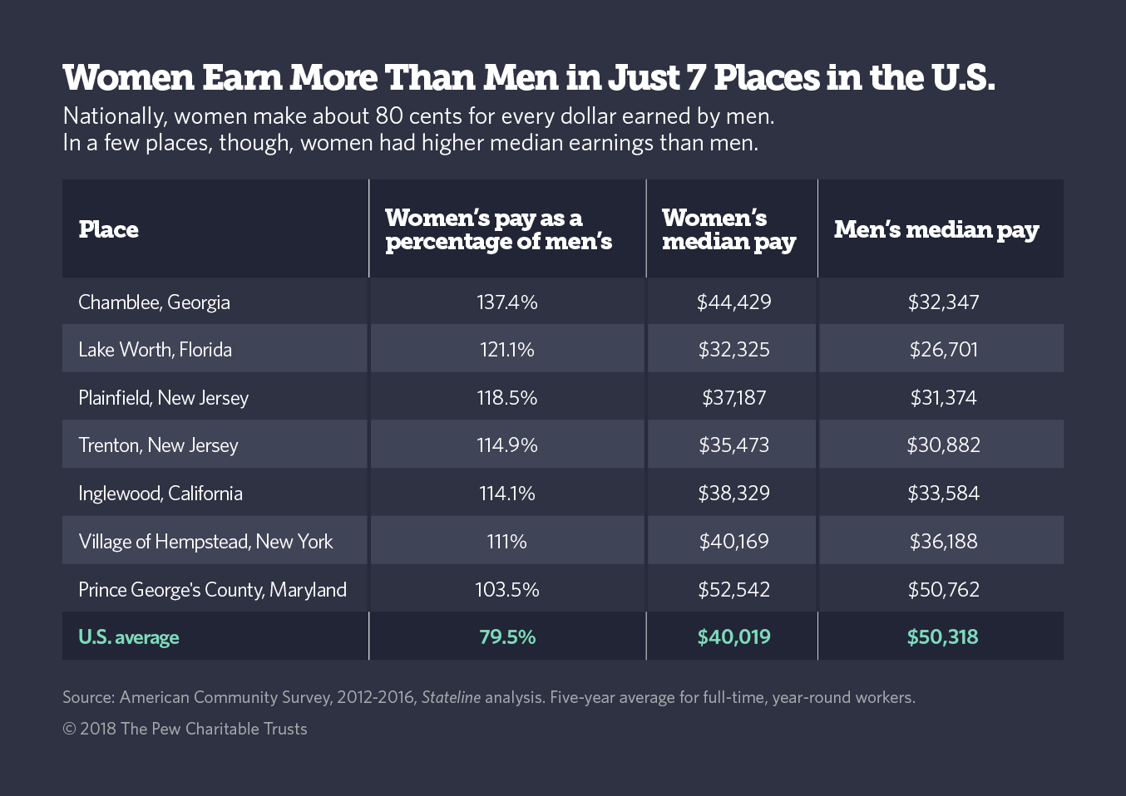

Slide 11
Legal and Political Inequality
Supporters of women’s rights point to laws that show a bias against women.

Slide 12
What are some biases in law?
Women’s groups point to the U.S. Supreme Court decision that refused to grant women the legal guarantee of health insurance benefits for pregnancy-related medical costs.
This was despite the fact that medical coverage for conditions unique to men- such as prostate problems was routinely provided.

Slide 13
Some states have refused women the right to keep their own surnames after marriage.
Other states have had protective legislation restricting women’s rights.
Limited the number of hours women could not work.
Barring women from toxic areas because of potential birth defects in their children.

Slide 14
The Family and Medical Leave Act (1993), which requires that employees be given up to twelve weeks without pay for childbirth, adoption, personal illness, or caring for a family member with a serious illness, still negatively affects women.
This legislation give employers another reason to give hiring preference to men.

Slide 15
How do American women stand politically?
Women are participating in elective politics at an increasing rate.
The numbers of female governors, lieutenant governors, attorney’ general, and mayors have been growing.
In 1984, Geraldine Ferraro became the first female vice-presidential candidate in the history of the United States.
Madeleine Albright was named the first female secretary of state in 1996.
Elizabeth Dole campaigned for her party’s nomination for president before the election of 2000.

Slide 16
Still, although women constitute more than half the population, they hold a relatively small proportion of important pollical positions.

Slide 17
Sociologist Richard Zwiegenhaft and William Domhoff do point out that women are now part of the power elite.
The power elite is no longer exclusively the male group it used to be.
Still women are seriously under represented, and most of those women who do join the power elite come from upper-class backgrounds.

