Slide 1
Psychology Chapter 9:Inelligence Section 1: What is Intelligence

Slide 2
According to psychologists, one thing intelligence is not is achievement.
Achievement refers to knowledge and skills gained from experience.
Achievement focuses on the things that you know and can do.

Slide 3
Although intelligence is not the same as achievement, intelligence can provide the basis for achievement.
Intelligence make achievement possible by giving people the ability to learn.

Slide 4
Intelligence can be defined as the ability to learn from experience, to think rationally, and to deal effectively with the environment.

Slide 5
Spearman’s Two Factor Theory
Nearly 100 years ago, British psychologist Charles Spearman suggested that all the behavior we consider to be intelligent has a common underlying factor.
He labeled the factor “g,” which stands for “general intelligence.”
The g factors represents the abilities to reason and to solve problems.

Slide 6
The most capable people are relatively better at some things than others, such as writing and music rather than math.
For this reason, he suggested that specific or “s” factors account for particular abilities.

Slide 7
Thurstone’s Theory of Primary Mental abilities
American psychologist Louis Thurstone believed that nine separate factors make up intelligence.
He called them primary mental abilities.

Slide 8
Visual and spatial ability (the ability to picture shapes and spatial relationships).
Perceptual speed (the ability to understand perceptual information rapidly and to see the similarities and differences between stimuli).
Numerical ability (the ability to calculate and recall numbers).
Verbal meaning (knowledge of the meanings of words).
Memory (the ability to recall information, such as words and sentences).
Word fluency (the ability to think of words quickly for such tasks as rhyming or doing crossword puzzles).
Deductive reasoning (the ability to derive examples from general rules).
Inductive reasoning (the ability to derive general rules from examples).

Slide 9
Gardener’s theory of Multiple Intelligences
Howard Gardner believes that intelligence has a broader base and there are actually seven different kinds of intelligence within us:
Linguistic intelligence
Logical-mathematical intelligence
Visual-spatial intelligence
Body-kinesthetic intelligence
Musical-rhythmic intelligence
Interpersonal intelligence (insight into one’s own inner feelings)
Intrapersonal intelligence (sensitivity to other people’s feelings)

Slide 10
A major difference between Gardner’s and Thurstone’s theories is that Thurstone believed that the nine factors he identified, when taken together, make up intelligence.
Gardner on the other hand, proposes that the seven different intelligences are independent of each other.

Slide 11
Critics of Gardner’s views think that exceptional abilities in the musical or bodily-kinesthetic areas are not really part of intelligence at all.
They argue that those skills are talents and that being talented is not the same thing as being intelligent.

Slide 12
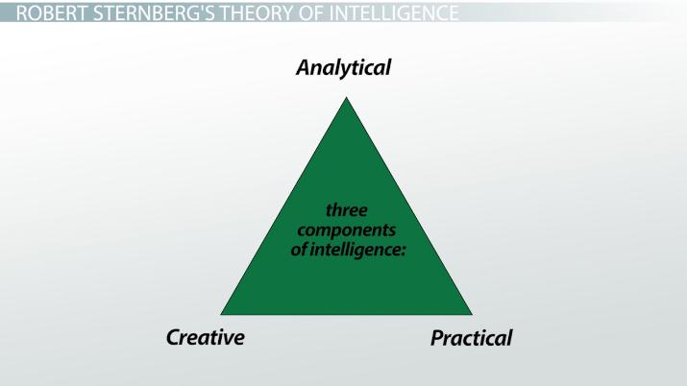
Sternberg’s Triarchic Theory
Robert Sternberg believes that different kinds of intelligence all work together.
He has created a three-level, or triarchic, model of intelligence.
Sternberg’s intelligence includes analytic, creative, and practical abilities.

Slide 13
Emotional intelligence
Psychologist Daniel Goleman in why people are not always as successful as might be expected.
He proposes yet another kind of intelligence: emotional intelligence.
Emotional intelligence consists of five factors that are involved in success in school or on the job.

Slide 14
Self awareness (the ability the recognize our own feelings).
Mood management (the ability to distract oneself from an uncomfortable feeling).
Self motivation (the ability to move ahead with confidence and enthusiasm).
Impulse control (the ability to delay pleasure until a task has been accomplished).
People skills (the ability to emphasize, understand, communicate, and cooperate with others).

Slide 15
Links between different types of Intelligence
Musical training might help develop the connections between nerve cells in parts of the brain.
The beneficial changes in the nervous system may help children in geometry, art and design, and geography.

