Slide 1
Psychology Chapter 8 Section 1
What is Thinking?

Slide 2
Thinking is the mental activity that is involved in the understanding, processing, and communicating of information.

Slide 3
Symbols
When we think we use symbols to represent the things about which we are thinking.
A symbol is an object or an act that stands for something else.
Symbols are part of our daily lives
School mascots
American Flag

Slide 4
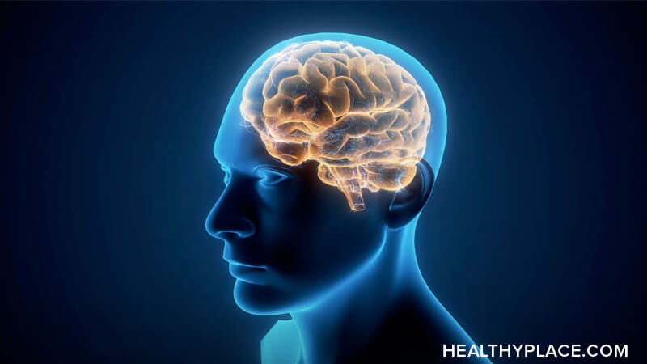
Letters and words are also symbols.
Even your mental images are a type of symbol.

Slide 5
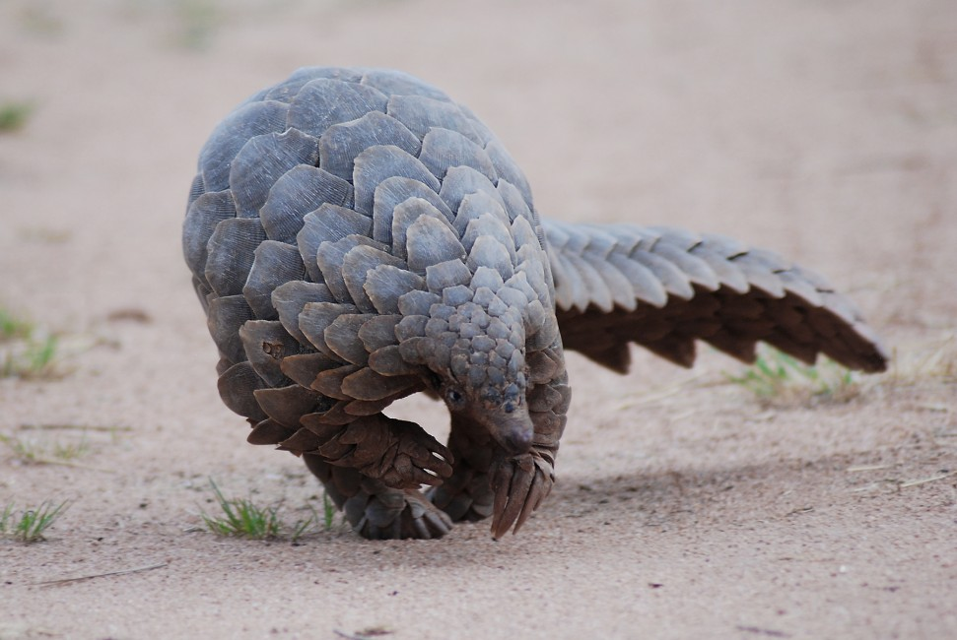
Concepts
When we think, we tend to mentally group together objects, events or ideas that have similar characteristics.
Such grouping is called a concept.
Example: Mammals

Slide 6
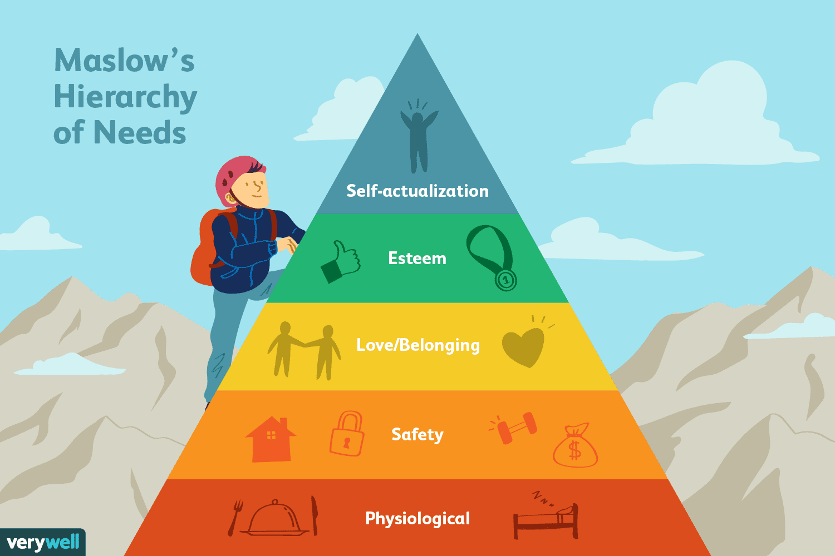
People organize concepts in Hierarchies
Series of levels that go from broad to narrow.

Slide 7
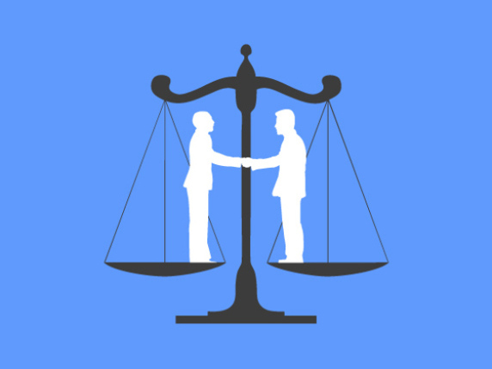
People learn concepts through experience.
Communication of the meaning of abstract concepts such as fairness, beauty, and goodness.
It may require detailed explanations, a variety of personal experiences, and many examples.

Slide 8
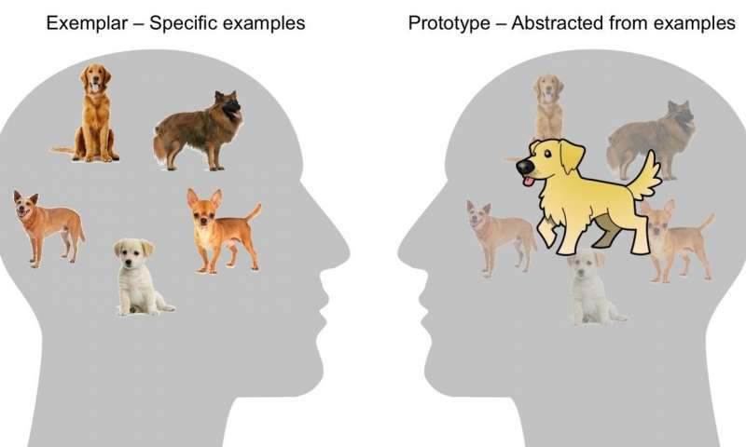
Prototypes
Prototype- an example of a concept that best exemplifies that concept.
A prototype can be more like an average of all experienced examples.

