Slide 1
Psychology Chapter 7 Section 4:
Forgetting and Memory Improvement

Slide 2
Forgetting can occur at any one of the three stages of memory- sensory, short-term, or long-term memory.
Information encoded in sensory memory decays almost immediately unless you pay attention to it and transfer it into short-term memory.

Slide 3
A memory trace in a visual sensory register decays in less than a second, and a sound recorded in echoic memory lasts no more than a few seconds.
Information in short-term memory does not last much longer. It will disappear after 10 or 12 seconds unless you find a way to transfer it into your long-term memory.

Slide 4
Information in long-term memory also can be lost.
Since long-term memory holds such vast amounts of material and because the material is represented in an abstract form, forgetting and other memory errors occur.

Slide 5
Old learning can interfere with new learning.
If you study a new foreign language, your knowledge of a language you already know or are studying at the same time can interfere with your new learning.

Slide 6
Basic Memory Tasks
oik, ppl, tmv, pmy, byy, eeb, bwy
Nonsense syllables provide psychologists with a way to measure three basic memory tasks: recognition, recall, and relearning.

Slide 7
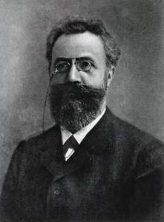
Herman Ebbinghaus (1850-1909)
The first researcher to use nonsense syllables to study memory and forgetting.
Because nonsense syllables are meaningless, remembering them depends on acoustic coding (saying them out loud or in one’s mind and mechanical repetition.

Slide 8
1. Recognition
Recognition- involves identifying objects or events that have been encountered before.
It is the easiest of the memory tasks.
Example: Multiple choice tests are often considered easier than other tests.
In a multiple choice test, you need only recognize the right answer.
You do not have to come up with answer on your own.

Slide 9
2. Recall
To recall something means to bring it back to mind.
In recall, you do not simply recognize whether you have come across something before.
Rather, you try to reconstruct it in your mind.

Slide 10
Hermann Ebbinghaus studied his own recall ability.
He would study nonsense syllables and try to recall them.
Typically he could remember seven nonsense syllables.

Slide 11
Studying Spanish
Mano means hand…
Use the English term manually to remember…
Otherwise, the only way to remember the foreign word is by mechanical repetition (maintenance rehearsal).

Slide 12
3. Relearning
Sometimes we do not remember things we once knew.
People who have been out of school for 25 years might not remember the algebraic formulas they learned when they were in high school.
We can usually relearn fairly rapidly things we once knew but have forgotten.

Slide 13
Different Kinds of Forgetting
1. Interference occurs when new information shoves aside or disrupts what has been placed in memory.
2. Decay- the fading away of memory.

Slide 14
Repression
Some memories may be so painful and unpleasant that they make us feel anxiety, guilt, or shame.

Slide 15
Amnesia
Psychoanalysts believe that repression is responsible for a rare but severe kind of forgetting called dissociative amnesia.
Amnesia is severe memory loss caused by brain injury, shock, fatigue, illness, or repression.
Thought to be caused by psychological trauma ( an extremely upsetting experience or series of experiences).

Slide 16
Infantile Amnesia
Freud found that his patients could not remember things that had happened to them before age of three.
This forgetting of early events is called infantile amnesia.
People who think that they can remember their birth have probably constructed the memory from other memories.

Slide 17
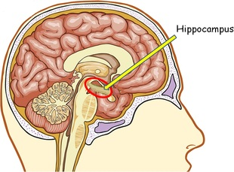
Many psychologists believe that infantile amnesia is primarily the result of biological and cognitive factors.
The part of the brain most involved in memory (the hippocampus) remains underdeveloped until people are about two years old, so infants may be biologically incapable of forming memories.

Slide 18
Anterograde Amnesia
Trauma to the brain caused by a blow to the head, electric shock, or brain surgery can cause memory loss of events that took place both before and after the trauma.
Memory loss from trauma that prevents a person from forming new memories is called anterograde amnesia.

Slide 19
Retrograde Amnesia
In retrograde amnesia, people forget the period leading up to a traumatic event.
Athletes who are knocked unconscious during a game often have no memory of what happened before the play in which they were injured.

Slide 20
Improving memory
Drill and Practice
Go over it again and again.
Mechanical repetition may sound boring, but it was repetition that we all learned the alphabet and how to count.

Slide 21
Remembering names of people your met.
Use the names right away.

Slide 22
Relate to things you already know.
Relating new information to what you already know requires you to think more deeply about the new information.

Slide 23
Form Unusual Associations
Make unusual or humorous connections with information.

Slide 24
Construct Links
Find part or the foreign word and construct a sentence or phrase that includes that part of the word.

Slide 25
Use Mnemonic Devices
Combine chunks of information into a format, such as an acronym, phrase, or jingle.
Roy G. Biv

Slide 26
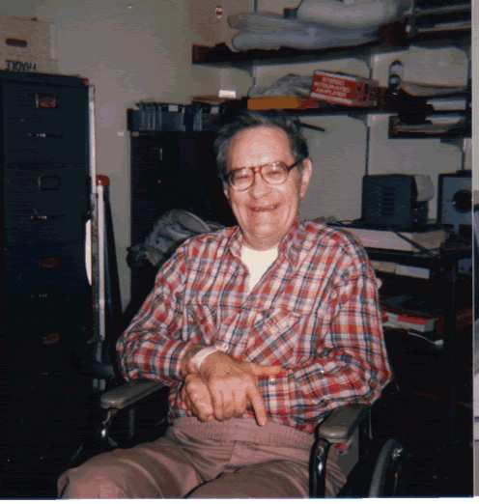
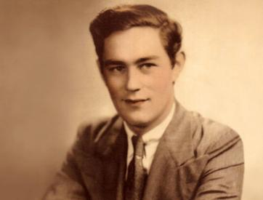
H.M. Henry Molaison 1926-2008

Slide 27
