Slide 1
Psychology Chapter 7: Memory
Section 1: Three Kings of Memory

Slide 2
Memory
Memory- The process by which we recollect prior experiences and information and skills learned in the past.
One way to classify memory is according to the different kinds of information it contains: events, general knowledge, and skills.

Slide 3
Episodic Memory
Episodic memory- memory of a specific event.
The event took place in the person’s presence, or that person experienced the event.
What you age for dinner last night is an example of episodic memory.

Slide 4
The special kind of episodic memory in which we recall events in great detail is called flashbulb memory.
Some episodic memories are of events so suprising or significant to us that it is as if a flashbulb went off at the event and we photographed many details of what happened.

Slide 5
There are several reasons why certain memories become etched in our minds when the “flashbulb” goes off.
1. Distinctness of the memories.
We pay more attention to events that have a special meaning for us.
2. We think about flashbulb memories often.
First love, the birth of child, special accomplishment.
3. Sometimes places or events make an impression on us.
They are connected to other events that are important at the time.

Slide 6
One flashbulb memory that many adults have pertains to the explosion of the space shuttle Challenger.

Slide 7
Generic Memory
Generic memory- general knowledge that people remember.
We remember that George Washington was the first president of the United States.
We usually do not remember when we acquired the information in our generic memory.

Slide 8
Procedural Memory
Procedural memory- consists of the skills or procedures you have learned.
These might include riding a bicycle or swimming.
Once a skill has been learned, it usually stays with you for many years.

Slide 9
Droodles
Estonian Folklore Archives

Slide 10
The question is formed by a minimal picture (regularly framed) drawn on a piece of paper together with one word.

Slide 11
Help

Slide 12
a blind beggar behind a street corner.

Slide 13
Up

Slide 14
A gentleman's bow tie got stuck between the elevator doors.

Slide 15
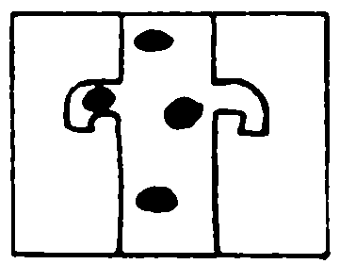
Stuck

Slide 16
A giraffe has swallowed a telephone.

Slide 17
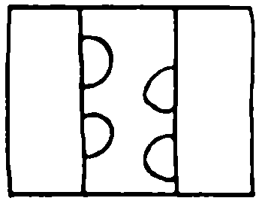
Bark

Slide 18
A bear is climbing up the tree

Slide 19
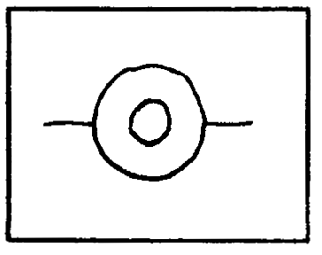
Two

Slide 20
A cowboy is riding a bicycle

Slide 21
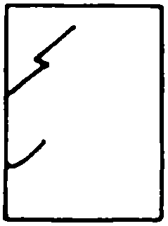
Civilian

Slide 22
A dog and a man, who’s got a gun with a bayonet on back, went inside through the door

