Slide 1
Psychology Chapter 4 Section 5: Perception

Slide 2
Perception is the way in which we organize or make sense of our sensory impressions.

Slide 3
Rules and Perceptional Organization
Gestalt psychologists applied the principle that “the whole is more than the sum of its part” to the study of perception.
They noted many different ways in which people make sense of sensory information.
These ways are called the rules of perceptual organization and include closure, figure-ground perception, proximity, similarity, continuity, and common fate.

Slide 4
Closure

Slide 5
Closure
What you are doing with the image is filling in the blanks.
Gestalt psychologists refer to this as the principle of closure.
Closure is the tendency to perceive a complete or whole figure even when there are gaps in what your senses tell you.

Slide 7
Figure-ground perception
Perception of figures against a background.
What we perceive as the figure and what we perceive as the background influence our perception.

Slide 9
Other rules of Organization
Proximity – or nearness

Slide 11
Similarity- people think of similar objects as belonging together.

Slide 13
Continuity
People usually prefer to see smooth continuous patterns, not disrupted ones.

Slide 15
Common fate
You assume that they are part of the same group and that they are all running to the same place- that they have a common fate.

Slide 16
Perception of Movement
To be able to sense movement, humans need to see an object change its position relative to other objects.

Slide 17
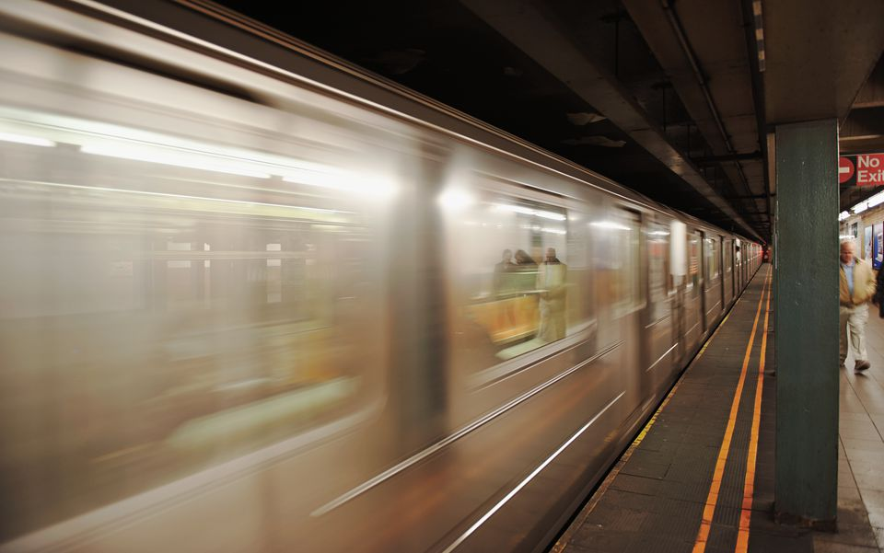
One way to know if you are moving is to look at objects that you know are stable, like buildings, signs, or trees.

Slide 18
Stroboscopic Motion
Stroboscopic motion- illusion of movement is produced by showing the rapid progression of images or objects that are not moving at all.
Example (movies)

Slide 20
Depth Perception
Depth means distance away.

Slide 21
Monocular Cues for Depth
Need only one eye to be perceived.
Monocular cues cause certain objects to appear more distant from the viewer than others.
These cues include perspective, clearness, overlapping, shadow, and texture gradient.

Slide 23
Motion Parallax
The most complex of monocular cues for depth is called motion parallax.
Tendency of objects to seem to move forward or backward depending on how afar away they are from the viewer.

Slide 25
Binocular Cues for depth
Both eyes are required for depth.
Two binocular cues for depth are retinal disparity and convergence.

Slide 26
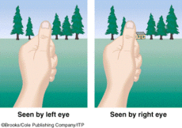
Retinal disparity
the way that your left eye and your right eye view slightly different images.

Slide 27
Convergence
Associated with feelings of tension in the eye muscle.
(Magic eye)

Slide 29
Perceptional Constancies
The reason you know your friends are not getting larger when you move closer to them or the reason a pet owner knows their pet from every angle is due to experience.
Each person creates perceptual constancies of size, color, brightness, and shape.

Slide 30
Size Constancy
Through experience, people acquire a sense of size constancy.
Without constancy, you may think a buffalo far away is the same size as an insect close up.

Slide 31
Color Constancy
Color constancy is the tendency to perceive objects as keeping their color even though different light might change the appearance of their color.

Slide 32
Brightness constancy
The tendency to perceive an object as being equally bright even when the intensity of the light around it changes.

Slide 33
Shape constancy
The knowledge that an item has only one shape no matter what angle you view that item from.
Example: top of a glass.

Slide 34
Visual Illusions
Do your eyes play tricks on you?
Actually, your eyes are not to blame, but your brains use of perceptual constancies is at fault.

Slide 35
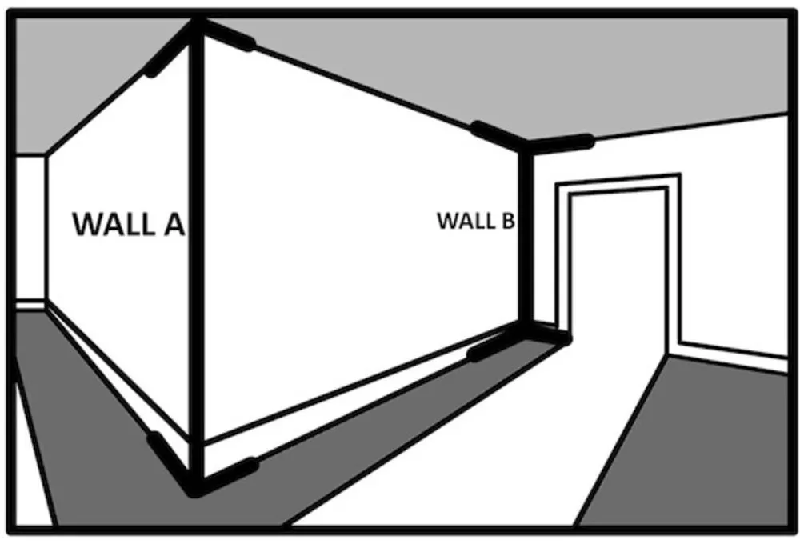
Muller-Lyer Illusion
Which line at the top is longer?

Slide 36
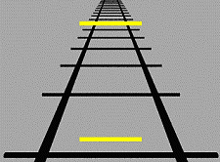
Ponzo illusion

