Slide 1
Psychology Chapter 4 Section 4: Other Senese

Slide 2
Smell and taste are called the chemical senses.
We sense molecules of substances.

Slide 3
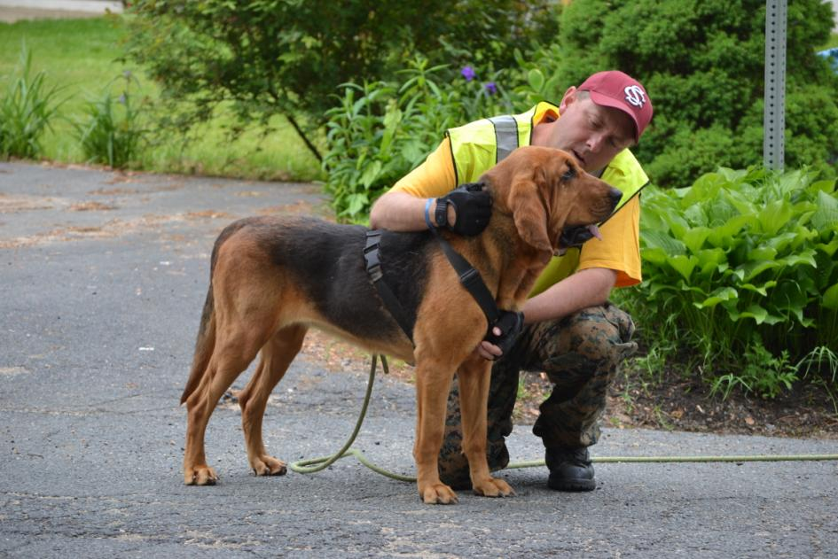
Smell
Dogs use seven times as much of the cerebral cortex from smell as people do.

Slide 4
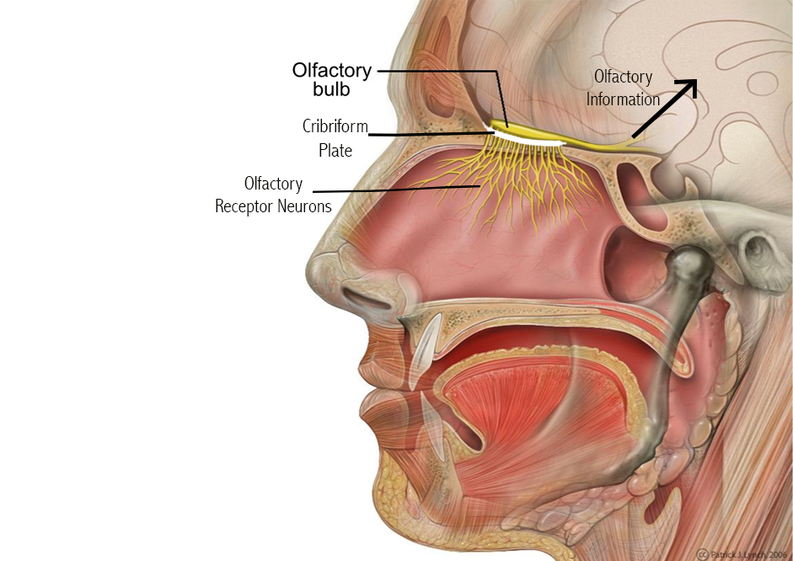
Without smell, you would not be able to taste as much as you do.
If your sense of smell were not working, an onion and an apple would taste very much alike to you.
Odors of substances are detected by receptor neurons high in each nostril.
Receptor neurons react when molecules of the substance in the forms of a gas come into contact with them.

Slide 5
The receptors send information about the odors to the brain via the olfactory nerve.

Slide 6
Our sense of smell adapts quickly.
This could be unfortunate if harmful fumes, such as from a car, are present.

Slide 7
Taste
Dogs can taste sweetness, but cats cannot.
The four basic taste qualities are sweetness, sourness, saltiness, and bitterness.

Slide 8
What you are experiencing if the flavor of food, which involves odor, texture, and temperature as well as taste.
If you have a cold, for example, food tastes flat because you cannot smell it.

Slide 9
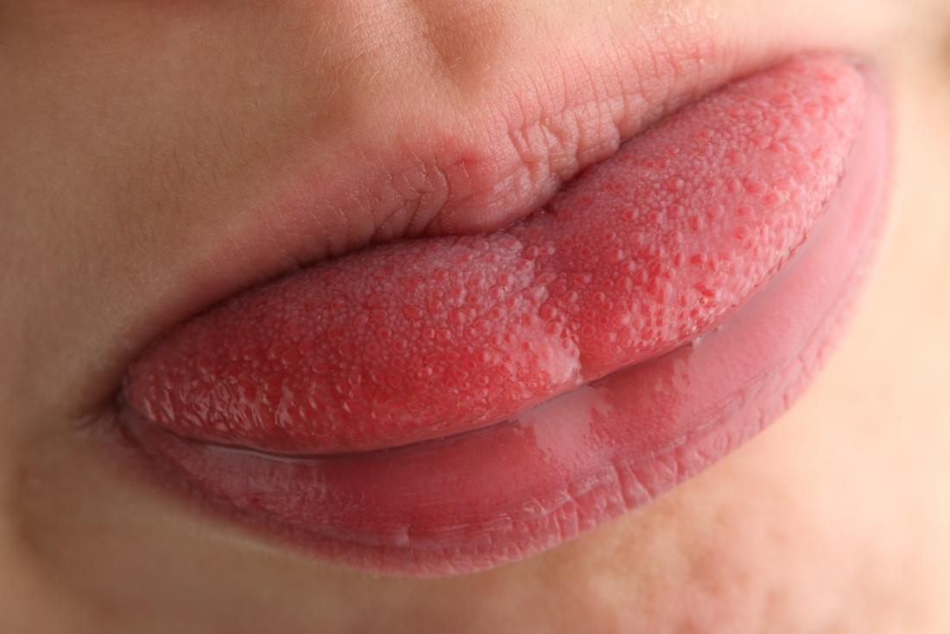
Taste is sensed through receptor neurons located on taste buds on the tongue.
Taste buds specialize.

Slide 11
The skin senses
What we normally call touch is better called the skin senses, because touch is a combination of pressure, temperature, and pain.
Studies have shown that premature infants grow more quickly and stay healthier if they are touched.

Slide 12
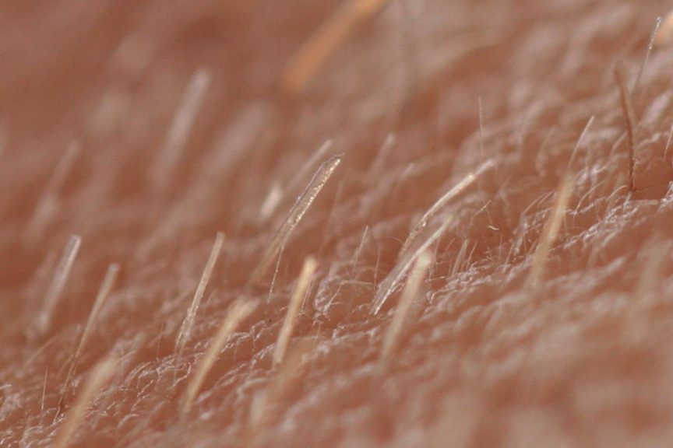
Pressure
Your body is covered with hairs, some of the roots of hair cells fire where the skin is touched.
The fingertips, lips, nose, and cheeks are more sensitive than the shoulders, thighs, and calves.

Slide 13
Temperature
When your body temperature is at a normal 98.6 degrees Fahrenheit, you might perceive another person’s skin as being warm.
We adapt to differences in temperature (Swimming pool)

Slide 14
Pain
Pain is adaptive
It motivates us to do something to stop it.
The more pain receptors located in a particular area of our skin, the more sensitive that area is.

Slide 15
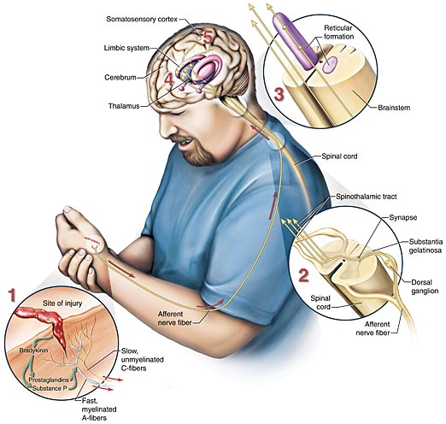
The pain message is sent from the point of contact to the spinal cord to the thalamus in the brain.
Then it is projected to the cerebral cortex, where the person registers the location and severity of the pain.

Slide 16
Chemicals called prostaglandins help the body transmit pain messages to the brain.

Slide 17
Gate theory suggest that only a certain amount of information can be processed by the nervous system at a time.
Rubbing or scratching the area transmits sensation to the brain that compete with the pain messages for space.

Slide 18
Phantom-limb pain
About two out of three combat veterans with amputated limbs report pain in the missing, or “phantom,” limbs.
Although the limbs are gone, the pain is real enough.
Phantom limb pain appears to reflect the activity of the neurons in the brain that store memories connected with the missing limb.

Slide 19
Body senses
Body senses are the sense that people are least aware of.

Slide 20
The vestibular sense
You vestibular sense tells you whether you are physically upright without your having to use your eyes.
You vestibular sense enables you to keep your balance.

Slide 21
kinesthesis
Kinesthesis is the sense that informs people about the position and motion of parts of their bodies.
In kinesthesis, sensory information is fed to the brain from sensory organs in the joints, tendons, and muscles.

