Slide 1
Psychology Chapter 4 Section 3: Hearing

Slide 2
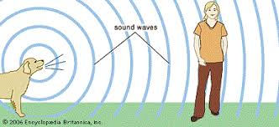
Sound travels through the air in waves.
It is caused by changes in air pressure that result from vibration.
Anything that makes a sound causes vibrations.

Slide 3
Each vibration is called a cycle or a sound wave.

Slide 4
Pitch
The pitch of a sound- how high or low the sound is- depends on its frequency, or the number of cycles per second.
The more cycles per second, the higher the pitch of a sound.

Slide 5
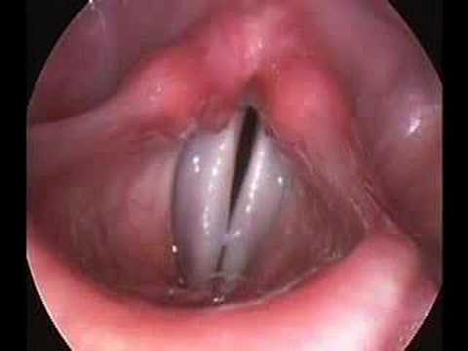
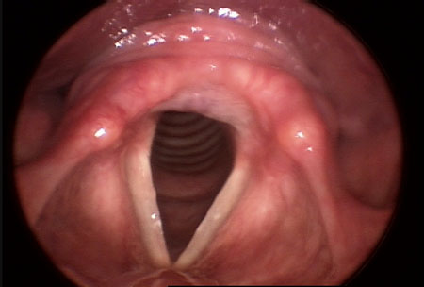
Women’s voices usually have a higher pitch than those of men because women’s vocal cords tend to be shorter and therefore vibrate at a greater frequency.

Slide 6
The human ear can hear sound waves that vary from 20 to 20,000 cycles per second.

Slide 7
Loudness
The loudness of a sound is determined by the height, or amplitude, of sound waves.
The higher the amplitude of the wave, the louder the sound.

Slide 8
The loudness of a sound is measured in decibels, a unit that is abbreviated dB.
Zero dB is considered the threshold of hearing.
Zero dB is about as loud as the ticking of a watch 20 feet away, in a very quiet room.

Slide 9
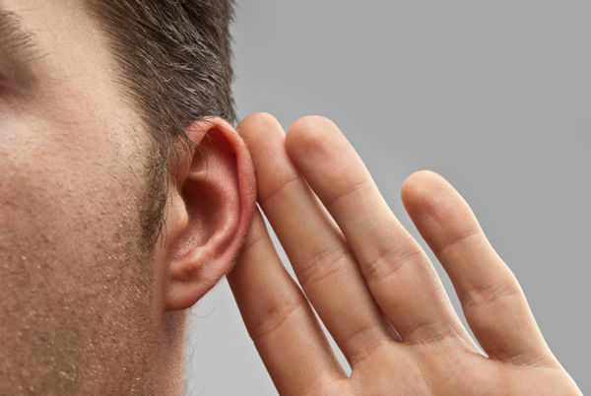
The Ear
The ear is shaped to capture sound waves, to vibrate with them, and to transmit sound to the brain.
What we think out the ear, is actually the outer ear.

Slide 10
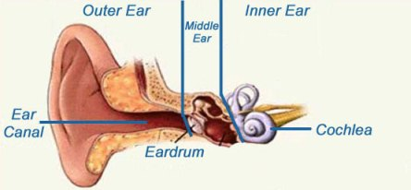
We also have a middle ear and an inner ear.

Slide 11
The eardrum is the gateway from the outer ear to the middle ear.
Thin membrane that vibrates when sound waves strike it.
As it vibrates, it transmits the sound to three small bones in the middle ear

Slide 12
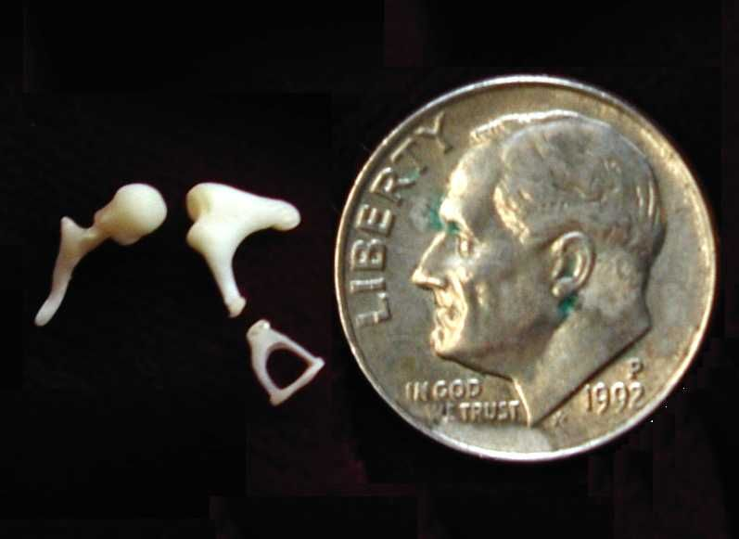
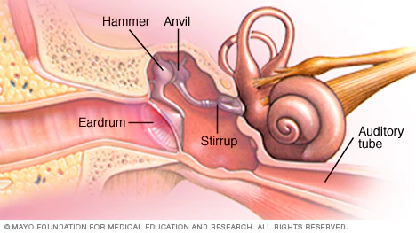
The hammer, the anvil, and the stirrup.
The stirrup is the smallest bone in the human body.
These bones then also begin to vibrate and transmit sound to the inner ear.

Slide 13
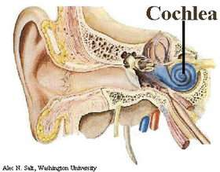
The inner ear consist of the cochlea
It is shaped like the shell of a snail.
Bony tube that contains fluids as well as neurons that move in response to the vibrations of the fluids.

Slide 14
The movement generates neutral impulses that are transmitted to the brain via the auditory nerve.
Within the brain, auditory input is projected onto the hearing areas of the cerebral cortex.

Slide 15
Locating Sounds
You usually turn your head just a little to determine which ear the sound increases.
You also use information from vision and other cues in locating the source of sounds.

Slide 16
Deafness
About 2 million Americans are deaf.
Deafness may be inherited or caused by a disease, injury, or old age.

Slide 17
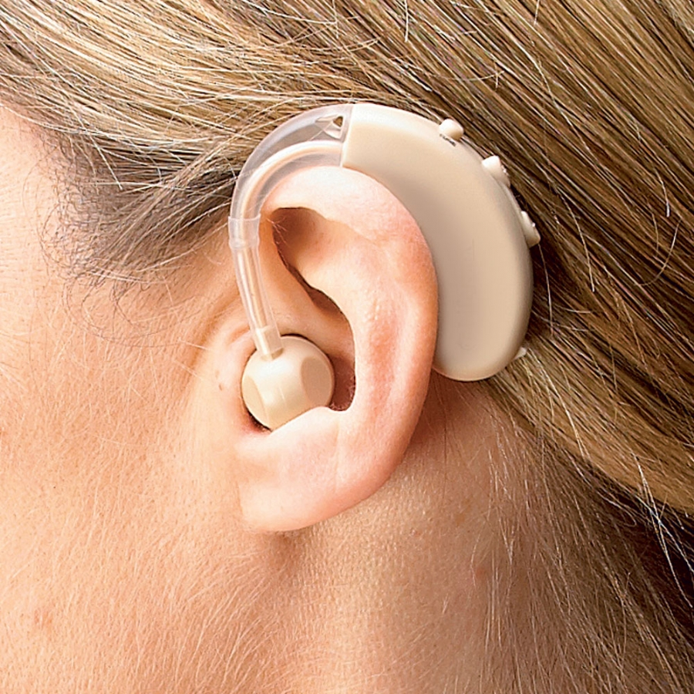
Conductive Deafness
Occurs because of damage to the middle ear.
People with conductive deafness often are helped by hearing aids.

Slide 18
Sensorial Deafness
Many people do not perceive sounds of certain frequencies.
This is a sign of sensorial deafness
Caused by damage to the inner ear.
The neurons in the cochlea are lost.
Damage is caused to the auditory nerve, either through disease or through prolonged exposure to very loud sounds.
The ringing from a loud concert means neurons were lost.

Slide 19
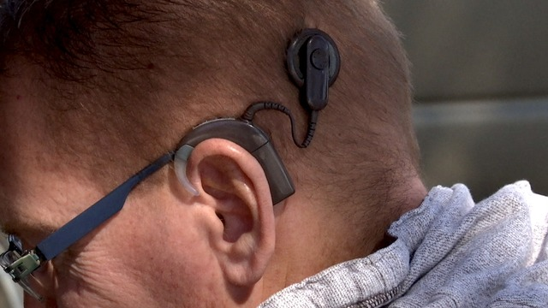
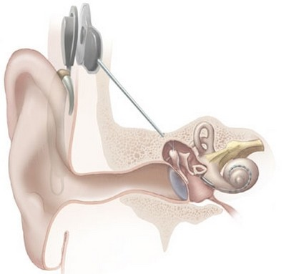
Cochlear Implants
Artificial ears
Contain microphones that sense sounds and electronic equipment that stimulates the auditory nerve directly.
If the auditory nerve is damaged, a cochlear implant cannot help.

Slide 20
Deafness in the world today
Heather Whitestone, who lost her hearing in infancy, became Miss America in 1995.
She is a dancer of classical ballet.
She uses vibrations of the music to dance to rhythm.

Slide 21
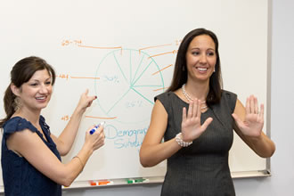
Interpreters are often on hand to translate speeches into languages (American Sign Language) used by members of the audience who are hearing impaired.
More and more schools are offering courses in American Sign Language.
Closed captioned television program.

