Slide 1
Psychology Chapter 4 Section 2: Vision

Slide 2
Light
Light is electromagnetic energy.
It is described in wavelengths
Not all light is visible to humans.
Light that humans can see makes up only a small part of the spectrum of electromagnetic energy.

Slide 3
You have probably seen sunlight broken down into colors as it filters through water vapor- this is what makes a rainbow.
Sunlight can also be broken down into colors by means of a glass structure called a prism.

Slide 4
The main colors of the spectrum from longest to shortest wavelengths, are…
Red, orange, yellow, green, blue, indigo, and violet.
(People have remembered the order by using the made-up name Roy G. Biv)

Slide 5
The eye
Light enters the eye and then is projected onto a surface.
The amount of light that enters is determined by the size of the opening in the colored part of the eye.

Slide 6
The opening is called the pupil.
When you look into someone’s eyes, the black circles your see in the middle are the pupils.
They may look solid to you, but actually they are holes.

Slide 7
The size of the pupil adjusts automatically to the amount of light entering the eye.
In a bright room the pupils are smaller.
In a dark room the pupils are larger.

Slide 8
Pupil size is also sensitive to our emotions.
“Wide eyed with fear” when we are afraid.

Slide 9
The lens adjusts to the distance of objects by changing its thickness.
When people squint to look at something, they are adjusting the thickness of the lens.

Slide 10
The retina is the sensitive surface in the eye that acts like the film in a camera.
The retina consists of neurons.
Neurons that are sensitive to light are called photoreceptors.
Once the light hits the photoreceptors, a nerve carries the visual input to the brain.
In the brain, the information is relayed to the visual area of the occipital lobe.

Slide 11
The blind spot
Blind spot
Where the optic nerve leaves the eye
When light hits that point, the eye registers nothing because that area lacks photoceptors.
We all have a blind spot.
If we did not, we would never be able to “see” anything.
No visual input would reach the brain through the optic nerve for interpretation.

Slide 12
Rods and Cones
There are two kinds of photoreceptors:
1. Rods
2. Cones

Slide 13
1. Rods
Are sensitive only to the brightness of light.
They allow use to see in black and white.

Slide 14
2. Cones
Provide color vision.

Slide 15
Dark and Light adaptations
Dark Adaptation
Adjustment to lower lighting
Your ability to see in low light continues to improve for up to 45 minutes.
Adaptation to bright light happens much more quickly than adaptation to the dark.

Slide 16
Visual acuity
Visual Acuity
The sharpness of vision.
Determined by the ability to see visual details (in normal light)

Slide 17
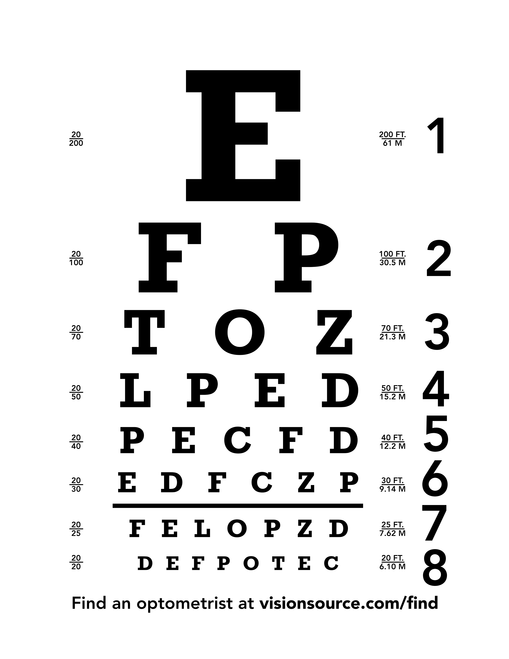
The Snellen Chart
Used to measure visual acuity.

Slide 18
If you would stand 20 feet from the Snellen Chart and could only read the T or E, we would say that your vision is 20/100.
This would mean that a person with normal vision could see from a distance of 100 feet away and you could see from no more than 20 feet away.
In this case you would be nearsighted – you would have to be particularly close to an object to make out its details.

Slide 19
A person who is farsighted, on the other hand, needs to be farther away from an object than a person with normal vision to see it clearly.
Elderly people are often farsighted
As people reach middle age, their lenses become relatively brittle.
It is more difficult for them to focus, especially on nearby objects.

Slide 20
Color vision
The wavelength of light determines the color.
People with normal color vision see any color in the spectrum of visible light.

Slide 21
Dogs and cats see far fewer colors than you do but insects, birds, fish, and reptiles experience a wide variety of colors.

Slide 22
The color circle
Colors of the spectrum bent into a circle.
The colors across from each other are called complementary colors.
Red-green and blue-yellow are the major complementary pairs.
If we mix complementary colors together, they form gray.
We are talking about light, not pigments in art class.

Slide 23
Cones and color vision
Cones, one of the two types of photoreceptors in the retina of the eye, enable us to perceive color.
Some cones are sensitive to blue, some to green and some to red.
When more than one king of cone is stimulated at the same time, we perceive other colors of the spectrum, such as yellow and violet.

Slide 24
Television Screens use only tiny dots with a mixture of blue, green, or red.

Slide 25
Afterimages
Look at the colored flag for at least half a minute on the next slide.
Then look at a sheet of white paper.

Slide 26
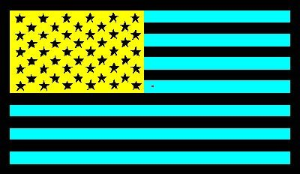

Slide 27
If your color is working properly and if you looked at the flag long enough, you should see a flag composed of the familiar red, white, and blue.

Slide 28
The afterimage of a color is its complementary color.
You perceive an afterimage when you have viewed a color for a while and then the color is removed.

Slide 29
Colorblindness
If you can see the colors of the visible spectrum, you have normal color vision.
People who do not have normal color vision are said to be color blind.
These people are partially or totally unable to distinguish color due to an absence of, or malfunction in, the cones.

Slide 30
People who are totally colorblind are sanative only to light and dark and see the world as most people do on a black and white television set.
Partial colorblindness, on the other hand, is fairly common. People who are partially color blind see some colors but not others.
Particularly common is red-green color blindness, in which a person has difficulty seeing shades of red and green.

