Slide 1
Psychology Chapter 2 Section 5: Ethical Issues

Slide 2
Ethics are standards for proper and responsible behavior.
Psychologists follow ethical standards to promote the dignity of the individual, foster human welfare, and maintain scientific integrity.

Slide 3
Psychologists follow ethical standards to promote the dignity of the individual, foster human welfare, and maintain scientific integrity.

Slide 4
Ethical standards limit the type of research that psychologists may conduct.

Slide 5
What are the ethical standards researchers adhere to?
The APA (American Psychological Association) has provided some guidelines about what is needed to make a study ethical.

Slide 6
Confidentiality
Records are private.
Psychologists respect people’s right to privacy
People are more likely to disclose true information and feelings when they know that what they say will remain confidential.

Slide 7
In very rare circumstances, such as when a client reveals plans to harm someone, a psychologist may disregard confidentiality in order to protect people.

Slide 8
Informed consent
People agree, or consent, to participate in a research study only after they have been given…
a general overview of the research
a general overview of the research
The choice of whether or not to participate

Slide 9
Deception
New drug experiments and other blind studies cannot be conducted without keeping participants unaware of the treatment they are receiving.

Slide 10
According to the APA’s statement of ethical principles, psychologists may use deception only under specific circumstances.
The benefits of the research outweigh its potential harm.
Individuals might have been willing to participate if they had understood the benefits of the research.
Participants receive an explanation of the study after it has occurred.

Slide 11
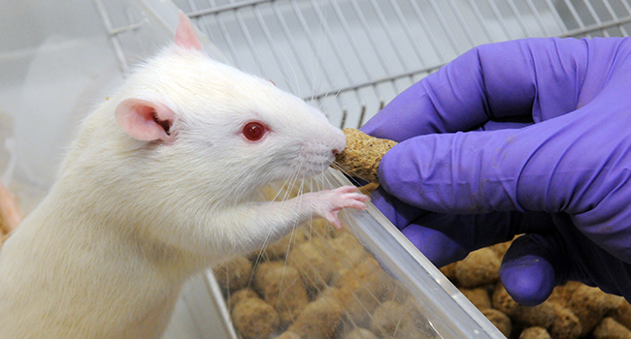
Research with Animals
Must studies do not harm the animals.
Psychologists and other scientists conduct research that may be harmful to animals.

Slide 12
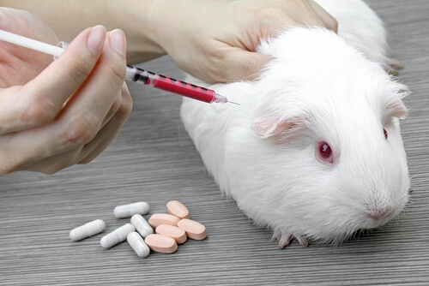
Psychologists use animals only when there is no alternative and when they believe that the potential benefits outweigh the harm.

Slide 13
Ethics in Using Data
When researchers conduct a study, they need to be as objective as possible in planning their study, collecting their data, and analyzing their data.

Slide 14
When information collected by researchers contradicts their hypothesis, they must be willing to discard their hypothesis in light of the evidence.

