Slide 1
Government
Chapter 4 Section 2: Growth of Federalism

Slide 2
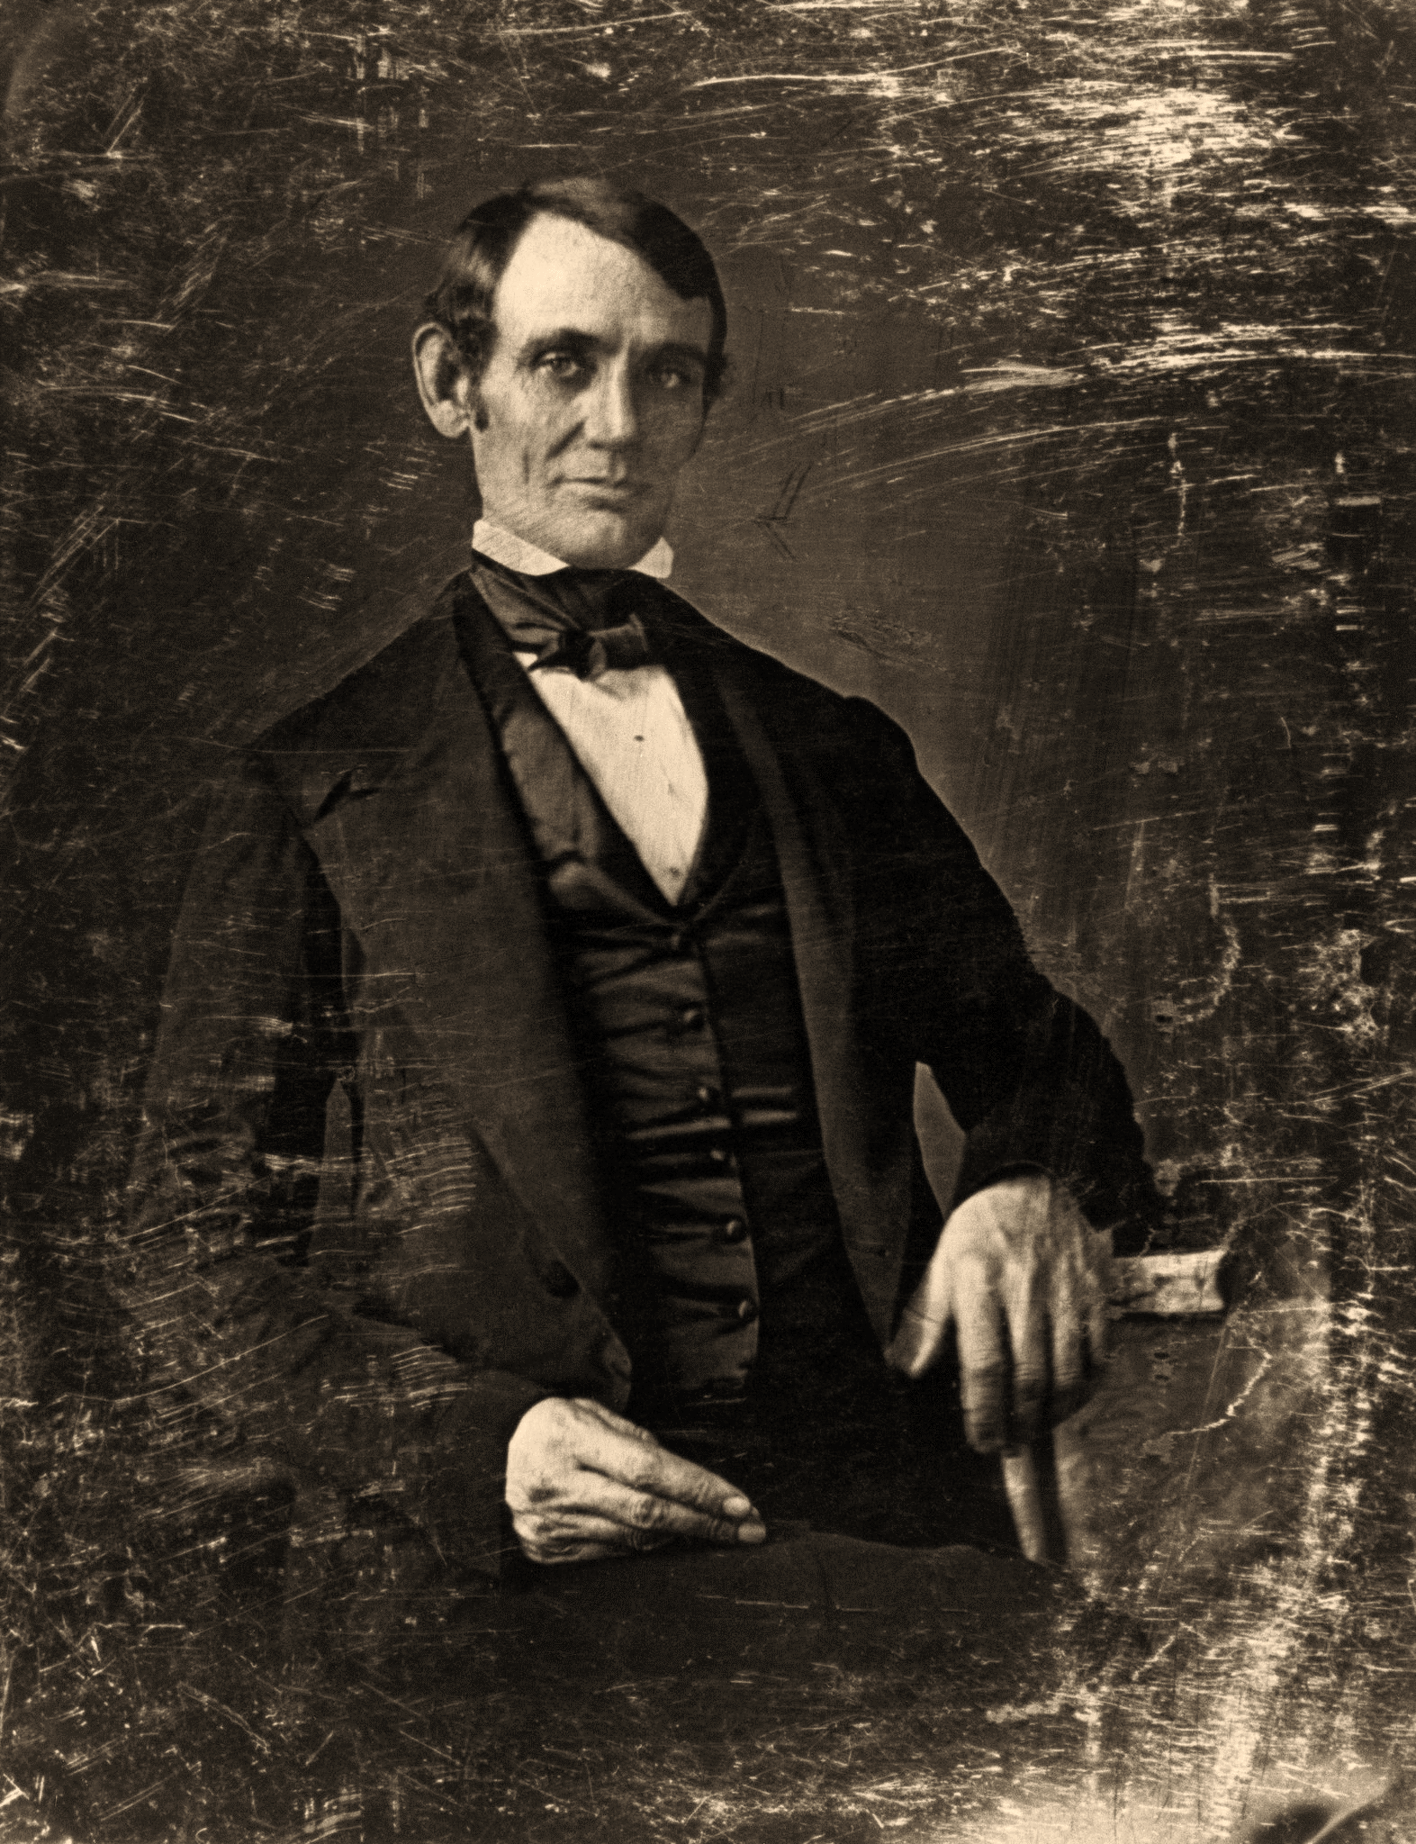
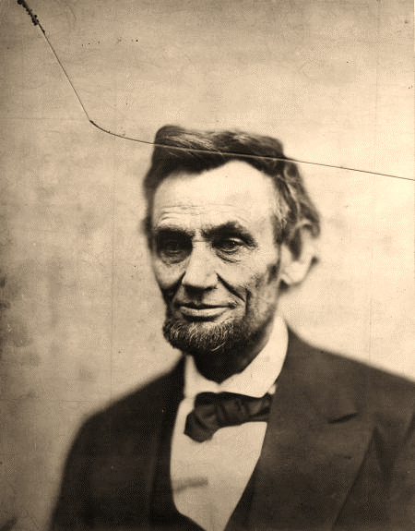
During the mid 1800s, eleven southern states claimed the right to secede from, or leave, the United States.
Many people in these believed that under President Abraham Lincoln’s administration the government threatened southern institutions, including the system of slavery, and hence their way of life.

Slide 3
Confederate States of America
 |  | Seceded from the Union | Readmitted to the Union
1. | South Carolina | Dec. 20, 1860 | July 9, 1868
2. | Mississippi | Jan. 9, 1861 | Feb. 23, 1870
3. | Florida | Jan. 10, 1861 | June 25, 1868
4. | Alabama | Jan. 11, 1861 | July 13, 1868
5. | Georgia | Jan. 19, 1861 | July 15, 1870²
6. | Louisiana | Jan. 26, 1861 | July 9, 1868
7. | Texas | March 2, 1861 | March 30, 1870
8. | Virginia | April 17, 1861 | Jan. 26, 1870
9. | Arkansas | May 6, 1861 | June 22, 1868
10. | North Carolina | May 20, 1861 | July 4, 1868
11. | Tennessee | June 8, 1861 | July 24, 1866

Slide 5
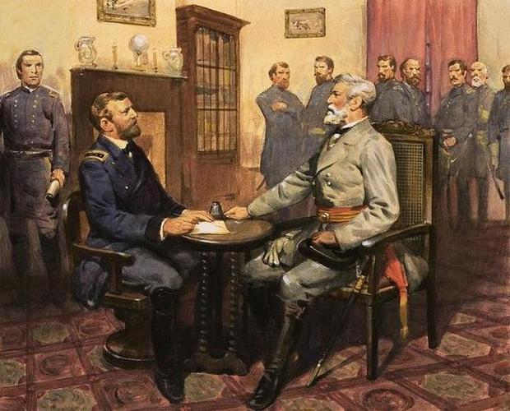
The Civil War defeat of the 11 southern states that seceded from the Union in 1860 and 1861 firmly established the federal government’s supreme authority.

Slide 6
The Supreme Court has ruled that the Constitution’s Supremacy Clause does not allow states to reject federal laws as long as those laws are constitutional.

Slide 7
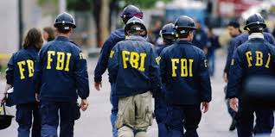
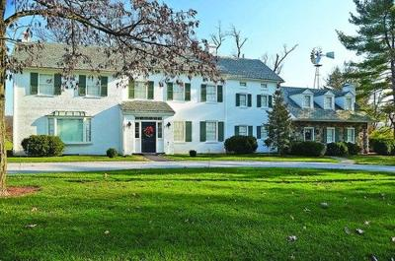
Increasing Federal Involvement
The Federal Bureau of Investigation (FBI) often helps state and local officials solve major crimes.

Slide 8
1970s/ 1980s – Federal tax dollars were shared with state and local governments.
Under the system of revenue sharing, states had a great deal of freedom spending their share of federal money.
Revenue sharing ended in the mid-1980s, under pressure to cut federal spending.
Federal grants are still received from states today.
Example- student aid for college.

Slide 9
The Grant System
Grants-in-aid
Money or other resources that the federal government provides to pay for state and local activities.
Used for specific projects and programs authorized by the federal government. Example: Public Universities (Penn State and Temple University).

Slide 10
The Land Ordinance of 1785 under the Articles of Confederation set aside land for public schools in the territories won from Great Britain during the Revolutionary War.

Slide 11
Morrill Act of 1862
Gave grants of federally owned land to the states.
The states used the money they earned from selling the land to establish colleges.
Texas A and M (Agricultural and Mechanical) and Ohio State have their origins in the Morrill Act.

Slide 12
Grants today also support…
Transportation systems
House projects

Slide 13
Categorical Grants
Payments by the federal government to carry out specific activities.
Includes…
Building airports
Unemployment compensation
Fight crime
Providing aid after natural disasters
Grants typically require the state or local governments to contribute their own funds in an amount determined by Congress.

Slide 14
Block Grants
Federal funds can be used by a state or locality in a broadly defined area such as…
Welfare
Community development
Health
Education
Public transpiration systems
Anticrime programs
Community youth activities
State and local governments prefer block grants because they have more freedom to decide how to spend federal money.

Slide 15
Federal Mandates
Requirements that the federal government imposes on state and local governments.
Example: some federal mandates have established protections for the environment and measures to protect the health and safety of workers.

Slide 16
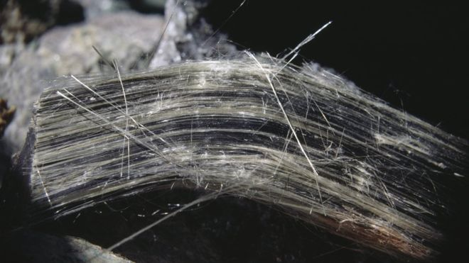
Forms of Mandates
Three basic forms:
1. Law directing state or local governments
Asbestos Hazard Emergency Response Act of 1986 required public schools to take certain steps to protect children from exposure to asbestos, a fireproof mineral that can cause health problems.

Slide 17
2. Gives states the choice between undertaking and activity themselves or having the federal government do it.
Example:
Clean Air Act – lower pollution levels.
States were allowed to make their own rules as long as they met federal air quality levels.

Slide 18
3. Federal Mandates may come in the form of strings attached to federal aid.
In order to receive aid, state or local governments must follow certain requirements.
1986- states whose minimum age for drinking alcoholic beverages was 20 or less would lose a percentage of their federal aid for construction an maintaining highways if they did not raise the age to 21.

Slide 19
Debate over Mandates
People who do not think that the federal government should issue mandates argue that…
federal rules violate the rights of states to handle their own affairs.

Slide 20
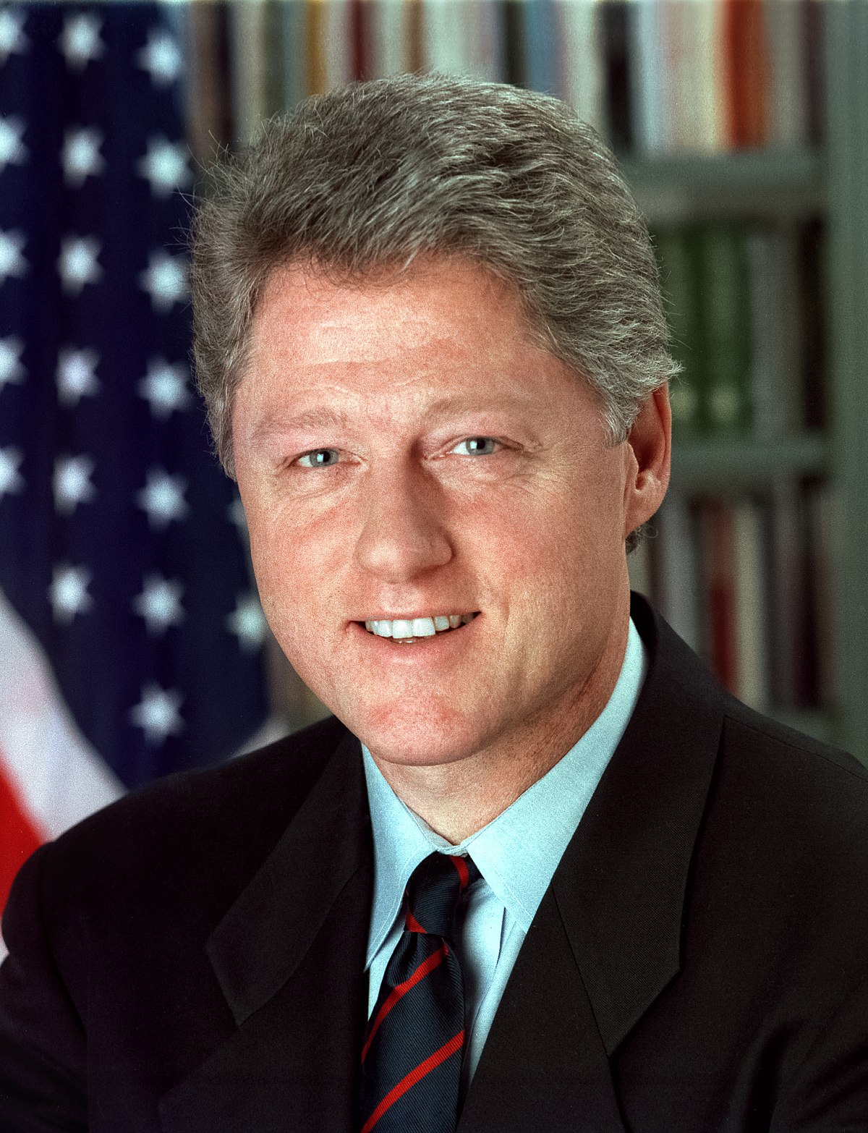
Congress passed and President Clinton signed into law a bill that required the Congressional Budget Office (CBO) to submit a report on the costs a new bill would impose on state and local governments.

