Slide 1
Chapter 2 Section 5 Ratifying the Constitution

Slide 2
Federal
having or relating to a system of government in which several states form a unity but remain independent in internal affairs.

Slide 3
The Battle for Ratification Begins

Slide 4
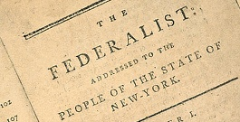
Federalists and Antifederalists
Federalists- supporters of the Constitution
They supported a stronger federal form of government.

Slide 5
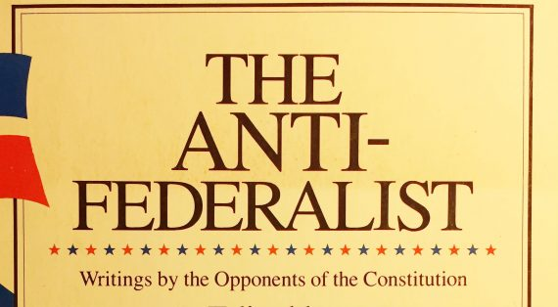
Antifederalists – opponents of the Constitution
Particularly strong in New York and Virginia.

Slide 6
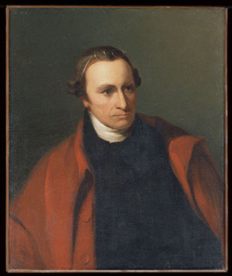
Patrick Henry
Among the most famous Antifederalists
Argued if the Constitution was ratified the national government would become too powerful.
A popular government could exist only in a small territory.

Slide 7
Popular government in a larger territory, such as the United States, would be too difficult because of the many competing interests.
A large territory and a popular government would be held together by force, which would restrict people’s freedom.

Slide 8
Antifederalists
Concerned that a strong executive would be too similar to a monarch.
Antifederalists wanted a bill of rights in the Constitution.
Individual rights must be protected.

Slide 9
Federalists
Argued that the separate powers belonging to each branch of government would check those of the other branches.
No single part of the government, such as the national legislature, could become too powerful and threaten the rights of the states or of the people.

Slide 10
Bill of Rights
The Constitution limited the powers of the national government to those it listed.
Any powers not listed were guaranteed to the states or to the people.

Slide 11
Ratification
Opponents argued that the Constitution favored larger states.
Delaware was the first state to ratify the Constitution on December 7th, 1787.

Slide 12
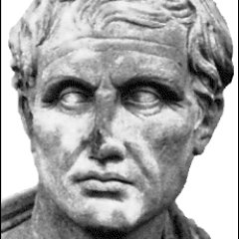
Patrick Henry and James Madison
Alexander Hamilton, James Madison, and John Jay wrote 85 newspaper articles supporting the Constitution.
The series of articles came to be called the Federalist Papers.
Articles appeared under the name Publius, one of the founders of the Roman Republic.

Slide 13
Purpose for the Federalist Papers
Authors hoped that the articles would persuade people to support ratification.
Federalists kept delaying the vote to weaken the opposition.

Slide 14
Virginia and New York finally ratified the Constitution, but only after New Hampshire on June 21st, 1788, became the ninth state to do so.

Slide 15
Temporary Capital settled in New York City.
The first Congress under the new U.S. Constitution had met in New York on March 4th, 1789.
George Washington had been sworn in as the nation’s first president on April 30th, 1789.

Slide 16
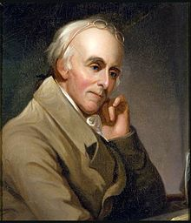
Celebrations
Dr. Benjamin Rush wrote,
“Tis done. We have become a nation.”

