Slide 1
Government Chapter 2 Section 4: The Constitutional Convention

Slide 2
May 25th, 1787
Delegates met in Philadelphia
Consider establishing a stronger national government for the 13 states.
Debt was still a major issue.

Slide 3
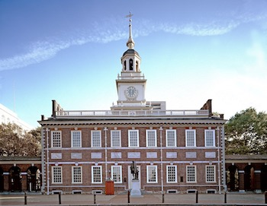
The Delegates
The delegates to the Constitutional Convention included many of the country’s most distinguished leaders and political thinkers.
Independence Hall

Slide 4
Of the 55 delegates…
8 had signed the Declaration of Independence
7 had been in the First Continental Congress
7 had been state governors.
Many would go on to become officials in the national government.

Slide 5
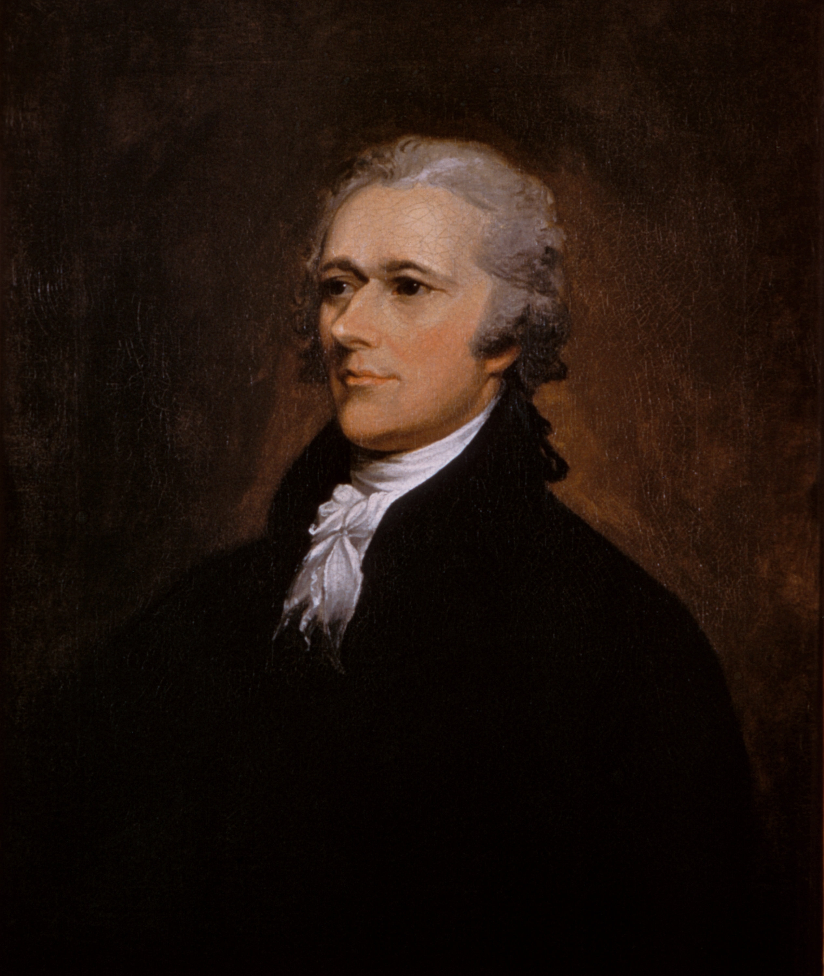
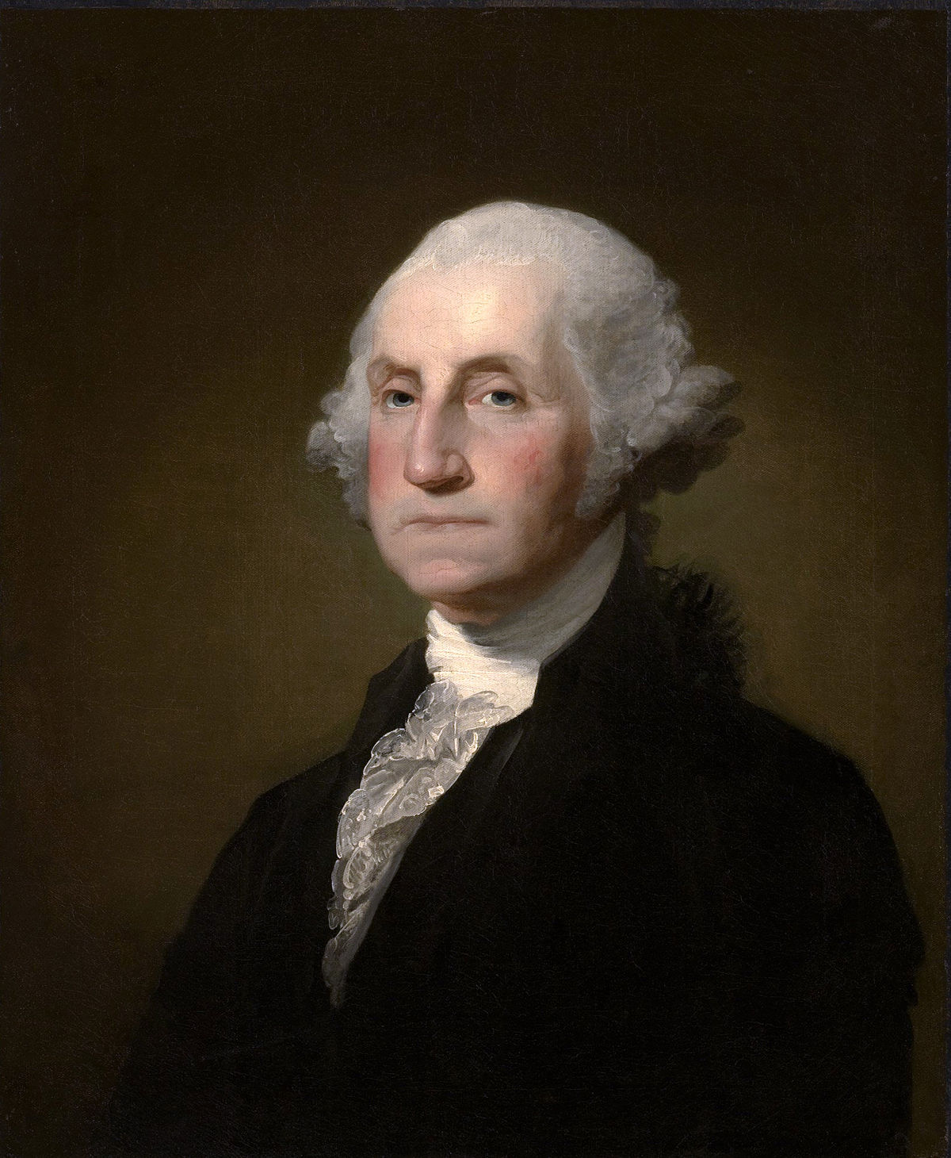
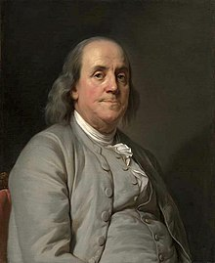
The best known delegates included…
George Washington
Benjamin Franklin
Alexander Hamilton
George Washington was unanimously named chairman of the convention.
Benjamin Franklin was a respected scientist and philosopher.
Alexander Hamilton had fought in the Revolution and served as a delegate in the Continental Congress.

Slide 6
Some well known leaders were absent.
Thomas Jefferson
Patrick Henry
Thomas Jefferson was in Europe as a U.S. representative to France.
Patrick Henry (from Virginia) declined to attend the Convention (he smelled a rat).
They were suspicious that the delegates were plotting to create a powerful central government.

Slide 7
“Father of the Constitution”
Perhaps the most important delegate
James Madison (of Virginia)
The notes he took during the Convention became the main record of what went on during the gathering.

Slide 8
Madison prepared himself for the Convention by studying books about history and politics.
Thomas Jefferson even sent him hundreds of books from Paris.

Slide 9
Rival Plans
Almost as soon as the Convention began, debate moved beyond the original goal of strengthening the Articles of Confederation to one of creating a new government.

Slide 10
The Convention adopted a resolution calling for a national government “to consist of a supreme legislature, executive, and judiciary.

Slide 11
Virginia Plan
Proposed by James Madison and his fellow Virginians
Called for a strong government with a bicameral legislature, a strong executive, and a judiciary, a significant change from the Articles of Confederation.

Slide 12
New Jersey Plan
Favored by delegates who feared that the states would lose too much power under the Virginia Plan.
Called for a national government with legislative, executive, and judicial branches.
Gave the national government the power to tax and the power to regulate trade across state lines.

Slide 13
Voting
On June 19th, 1787, after only three days.
Votes were by state delegation, not by individual delegates.

Slide 14
The Results
Seven state delegations voted for the Virginia Plan.
Three state delegations voted for the New Jersey Plan.
The other three delegations were either split or did not vote.

Slide 15
The Great Compromise
Despite the strong vote for the Virginia Plan, the question of state representation in the new national legislature was not yet resolved.
Small states wanted a government depended on reaching a compromise.

Slide 16
The delegates hammered out an agreement that borrowed elements from both the Virginia and New Jersey Plans.

Slide 17
The agreement, first called the Connecticut Plan, came to be known as the Great Compromise.

Slide 18
Adopted on July 16th, 1787, this compromise called for a bicameral legislature.
Representation in one chamber of the legislature, the House of Representatives, would be based on population.
States with large populations would have more representatives than states with smaller populations. Member would be elected directly by the people (Virginia Plan).

Slide 19
The structure of the second chamber, the Senate, was adapted from the New Jersey Plan.
Each state would have two representatives in the Senate. Thus, the small states would have equal footing with the large states in one half of the legislature.
Senators were to be elected by state legislatures.

Slide 20
Settling Other Issues
“Bundle of Compromises”
Slavery
continued to be a divisive issue.
banned in some northern states
made up a considerable part of the southern states’ population.

Slide 21
The delegates agreed to count each slave – for the purpose of determining a state’s representation in Congress- as three fifths of a free person.
This compromise quieted the debate over slavery- for a time.

Slide 22
Trade
Southerners feared that Congress would use its legislative powers to make importing slaves into the United States illegal.
In addition, southern delegates wanted to prohibit Congress from passing taxes on exported goods.

Slide 23
Compromised again.
Congress could not ban the importation of slaves before 1808.
Congress cold not tax goods that were exported to other countries.

Slide 24
The Presidency
Some delegates believed that the president should be elected directly by the people.
Other delegates wanted the president to be chosen by the states or by the national legislature.

Slide 25
The delegates decided on a system in which the president would be chosen by state electors.
The number of a state’s electors would match the number of its representatives in both houses of Congress.
States choose electors by popular vote.

Slide 26
If no presidential candidate received a majority of electoral votes from the states, the House of Representatives would choose the president.

Slide 27
Finalizing the Constitution
Convention delegates finished their work on the Constitution in August 1787.
On September 17th, 1787 most of the delegates signed the document.
Those who did not sign either had already gone home or else opposed the proposed national government.

Slide 28
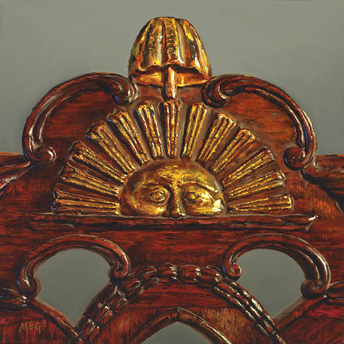
The Sun…
Benjamin Franklin noted that George Washington’s chair had a sun on its back.
Franklin wondered whether this was a rising or a setting sun. He believed it was a rising sun.

