Slide 1
Chapter 2 Section 3: The First National Government

Slide 2
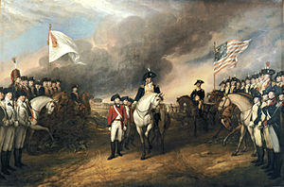
Revolutionary War
Ended with a U.S. victory at the Battle of Yorktown in 1781.

Slide 3
New Challenge
Forming a new government

Slide 4
What challenges did the new country face?

Slide 5
In the same year the war ended, the states created a confederation, or what they called a “a league of friendship.”
The weakness of this confederation, however, made unity among the states difficult and created pressure for a stronger national government.

Slide 6
Articles of Confederation
The Second Continental Congress had held the 13 states together during the war.
It had run affairs of the new nation during much of the fighting.
Appointed George Washington as commander in chief of the army in 1775.
Congress negotiated treaties with foreign powers, created national currency, borrowed money, and established a postal service.

Slide 7
Where is the constitution?

Slide 8
1777
The Second Continental Congress created a document, the Articles of Confederation, loosely tied together the 13 independent states and gave a new national Congress the authority to act that the Second Continental Congress had lacked.

Slide 9
Ratification
Before the Articles could go into effect, however, they needed to be ratified, or gain formal approval of all 13 states.
Maryland was the last state to ratify the Articles in 1781.

Slide 10
The Articles of Confederation limited the powers of the national government.

Slide 11
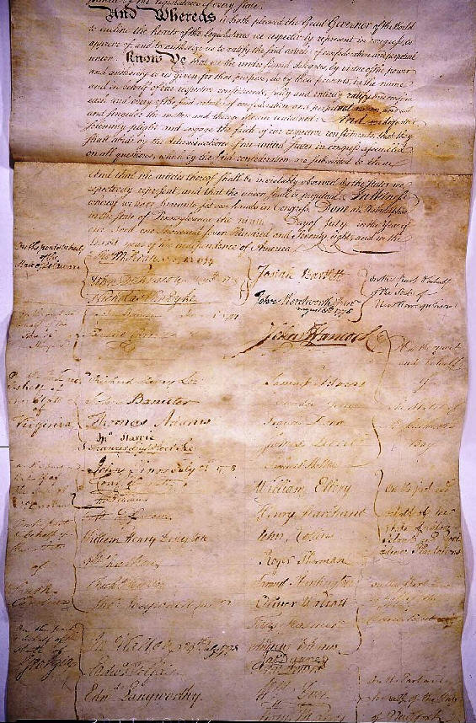
To all to whom

Slide 12
Powers
Unicameral Legislature
The Congress
Delegates to the Congress were chosen by each state’s legislature.
Each state delegation had one vote.
Majority approval was required to pass most decisions, while nine votes were necessary to make major decisions.
Example: wage war or sign a treaty.

Slide 13
Any amendment to the Articles required the approval of all 13 states.
No national executive or judicial branch existed at the time.

Slide 14
Only Congress, not the individual states, had the power to declare war and to conduct foreign policy.

Slide 15
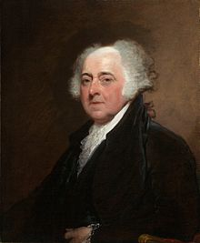
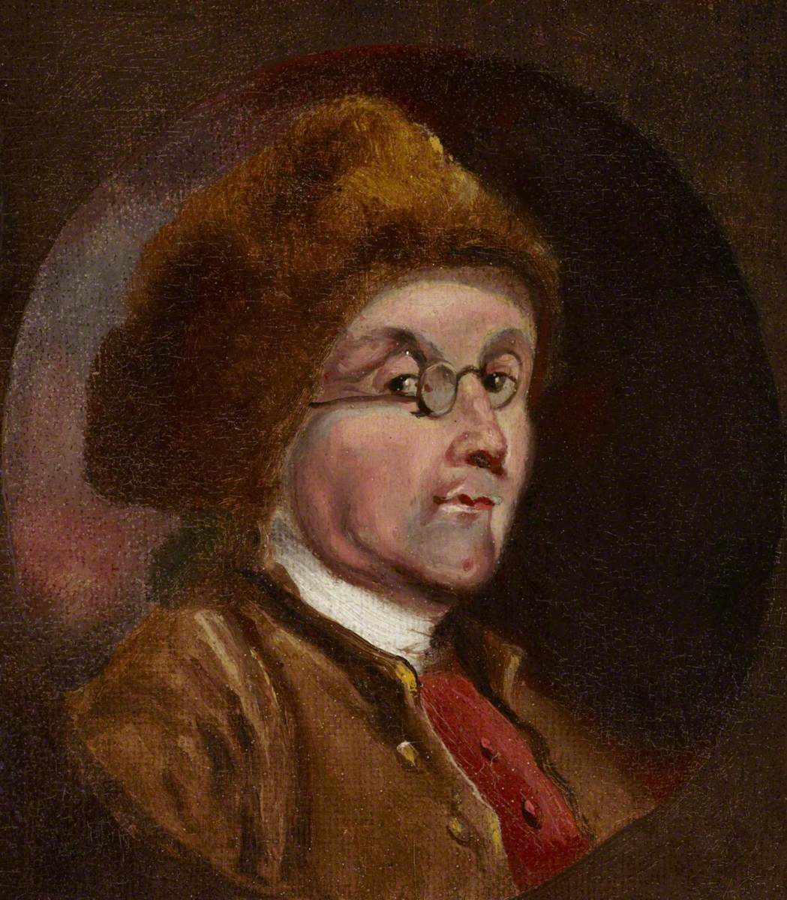
U.S. Representatives to France
John Adams and Benjamin Franklin

Slide 16
Additional Powers in the Articles
Congress had the authority to…
Borrow money
Establish military forces
Settle arguments between the states
Manage relations with American Indians

Slide 17
The North West Ordinance
Passed by Congress in 1787 to manage the development of the newly acquired Northwest territory.
Set procedures for granting statehood to territories within the region.

Slide 18
One of the most important bills passed by the national government under the Articles of Confederation.
It placed a ban on slavery with the Northwest Territory.
Also served as a model for admitting states to join the Union as equals.
Desire of the country’s leaders to prevent new states from being unfairly ruled by the original states.

Slide 19
Limits on Power
The exclusion of a president and an executive branch meant that there were no officials to carry out Congress’s laws.
Congress had no power to tax.

Slide 20
Congress had no power to regulate trade among states or with foreign countries.
The lack of national courts meant that the government was forced to rely on state courts to enforce national laws.

Slide 21
Obstacles to Unity Resurface
Cultural, economic, and geographic obstacles.

Slide 22
Cultural Differences
Religion and ways of life varied from state to state.
Baptist Church strong in Rhode Island and North Carolina.
Presbyterian Church had the most members in New Jersey and Delaware.

Slide 23
Although 48 percent of the colonists were from England, settlers had also come from Germany, France, and Sweden.

Slide 24
Economic Differences
Slavery
Southern plantation owners used slaves to work their fields.
Many people opposed this practice.

Slide 25
Slavery violated the principles on which the nation was founded, especially the need to protect the natural rights of all human beings.

Slide 26
Geographic Isolation
Size of the new nation made it difficult to form ties among the states.
Transportation between northern and southern states was not easy or quick.

Slide 27
Pressure for a Stronger Government
Annapolis Convention
1786
Only five states attended- Delaware, New Jersey, New York, Pennsylvania, and Virginia.

Slide 28
The delegates determined that a future meeting should be called to consider changes to the Articles.

Slide 29
Shays’s Rebellion (Daniel Shay) – 1786
Armed farmers trying to prevent the state from seizing property of people who could not pay their debts.

Slide 30
The rebellion was put down by force.
Congress officially recognized the need for a meeting among the states.

