Slide 1
Government
Chapter 2 Section 2: Independence

Slide 2
What do you think were some obstacles to Union?

Slide 3
Obstacles
One obstacles to colonial unity stemmed from the colonists’ having come to North America for different reasons.
Early colonists who settled in Virginia, for example, were sent by a company that wanted to make money from the region’s natural resources.

Slide 4
The Puritans of the Massachusetts Bay Colony came to establish an ideal society in which they could freely practice their religion.
The colony of Georgia, meanwhile, was created as a refuge for debtors who would otherwise have been put in jail.

Slide 5
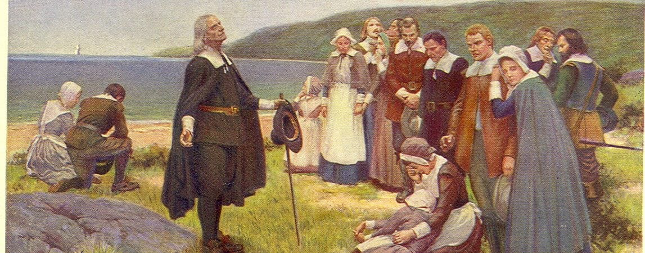

Slide 6
The New England colonies developed fishing, lumber, and crafts industries.
In contrast, South Carolina’s colonists grew crops that thrived in a warm, moist climate.

Slide 7
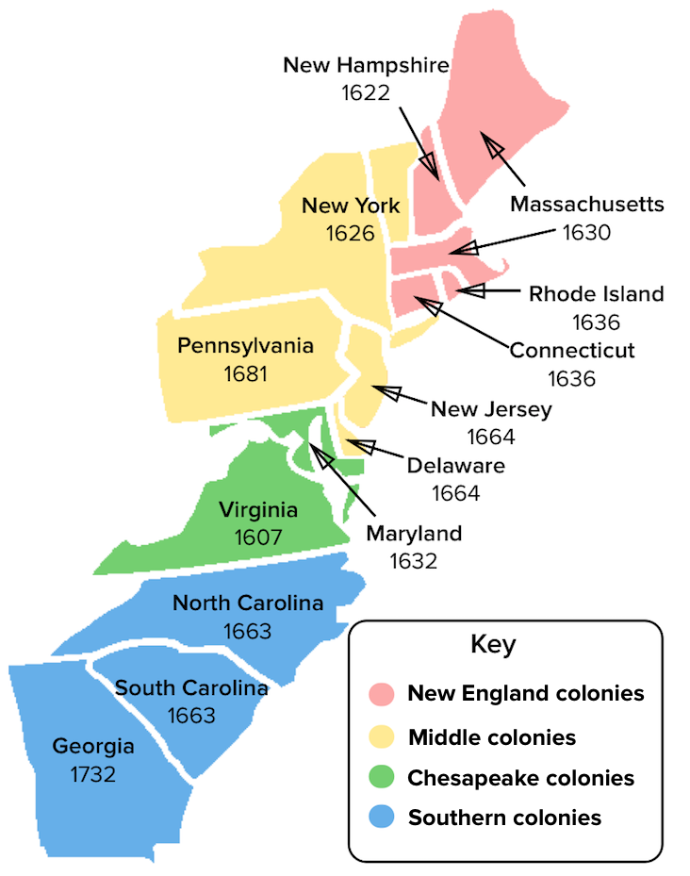

Slide 8
Attempts at Unity
Despite their differences, the English colonists did face some of the same dangers, such as the possibility of conflict with neighboring American Indians and non-English colonists.
The need for defense produced two important, though unsuccessful, attempts at unity.

Slide 9
New England Confederation of 1643
  The first attempt at Unity
  Colonies agreed to work to defend against attacks by American Indians or by settlers or nearby Dutch colonies.
  Few powers
  The objection of just one colony could keep the confederation from action
  Disagreements often prevented cooperation.
  The confederation ended in 1684.

Slide 10
Conflict between Britain and France brought a new effort at unity 70 years later.
France controlled a part of present-day Canada and other land to the west of the British Colonies.
The British government called a meeting of colonial representatives n 1754.

Slide 11
Representatives of the seven British colonies met with the Iroquois in Albany, New York, to form an alliance and develop a plan of action.
At the meeting, colonial representatives adopted the Albany Plan of Union, proposed by Benjamin Franklin.

Slide 12
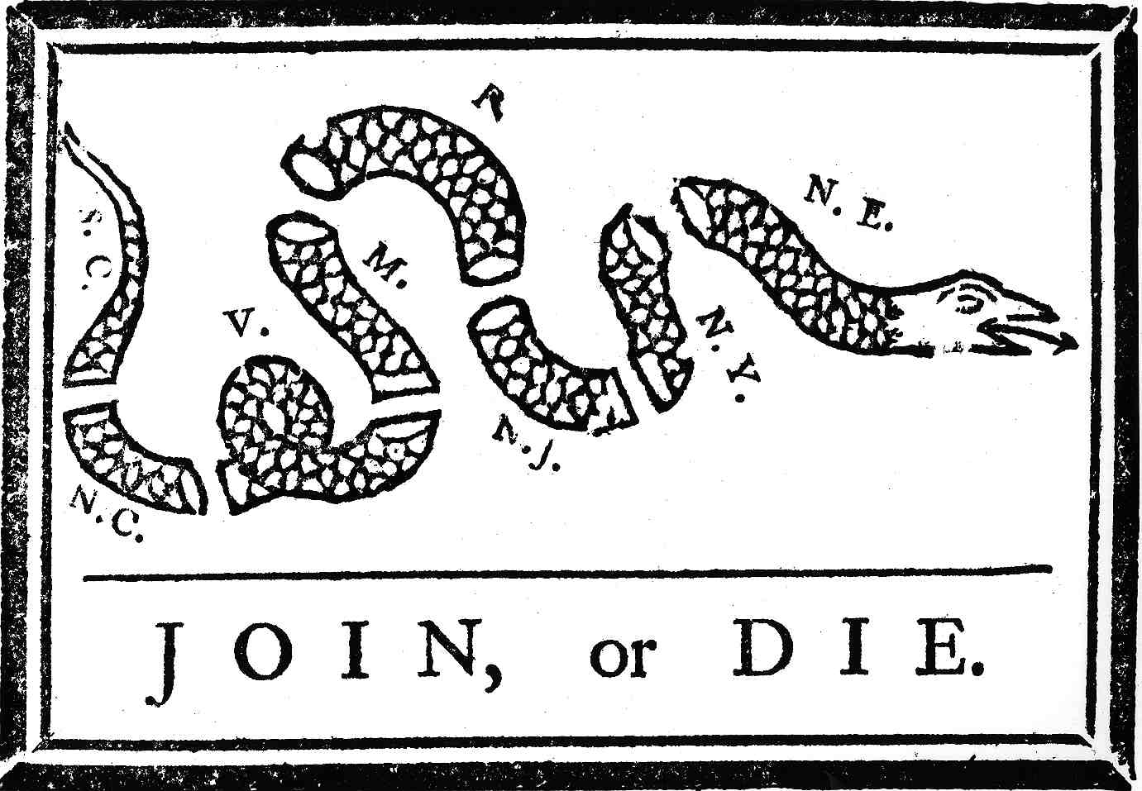

Slide 13
May 9, 1754
This cartoon shows a snake cut into eight pieces, each labeled with the name of one of the colonies.
The position of each colony in the snake corresponds to the geographic position of the colonies along the American coast, with the snake's tail pointing south and the head pointing north.

Slide 14
The cartoon depicts the early American colonies as a snake divided into eight segments. Toward the head of the snake, “NE” represents New England, followed by “NY” (New York), “NJ” (New Jersey), “P” (Pennsylvania), “M” (Maryland), “V” (Virginia), “NC” (North Carolina) and “SC” (South Carolina).
Even though there were four “New England” colonies, Franklin lumped them into one category to stress the need for colonial unity. At the time, the colonists fiercely debated expanding west of the Appalachian Mountains and fighting the French and their Indian allies.

Slide 15
JOIN, or DIE is a political cartoon, attributed to Benjamin Franklin and first published in his Pennsylvania Gazette on May 9, 1754. The original publication by the Gazette is the earliest known pictorial representation of colonial union produced by a British colonist in America.

