Slide 1
Chapter 2 Origins of U.S. Government Section 1: Early Influences

Slide 2
English colonists brought with them important ideals that had formed the basis of government in England.

Slide 3
An English Heritage
Great Britain does not have a written constitution - a basic set of laws and principles establishing the nation’s government, it has laws, historical documents, and judicial decisions dating back hundreds of years.

Slide 4
Two important British ideals strongly influenced the colonists in North America:
Limited government
Representative government

Slide 5
Limited Government
Before the 1200s there were few limits on government in England.
Monarchs could tax people or seize property at will, as well as give land to people who were loyal to them.

Slide 6
Student-body presidents
A president must act within the rules set by the school administration and an elected student council.

Slide 7
The English nobles- the wealthy landowners who enjoyed certain social and legal privileges, were no happier with their monarch’s unlimited power than you would be with an all-powerful student body president.

Slide 8
In 1215 nobles forced King John to sign the Magna Carta, or “Great Charter.”
Limited the monarchy’s power by helping establish the rule of law, under which government leaders, even monarchs, must act according to set laws.

Slide 9
Monarchs could no longer levy taxes without the nobles’ approval.
The charter also gave people accused of crimes the right to a trial by their peers, or equals.

Slide 10
Although the Magna Carta was meant only for the nobility, in time its protections applied to all English citizens.

Slide 11
The Magna Carta laid the foundations for government that promotes the public good.
Remember, government promotes the public good when it reflects the interests of society as a whole instead of the narrow interests of the few or of one individual, such as a monarch.

Slide 12
Representative Government
Representative government has its roots in a council of nobles and high religious officials that advised monarchs even before the signing of the Magna Carta.

Slide 13
Over time the advisory council evolved into a bicameral, or two chamber, legislature called Parliament.
Nobles composed the upper house, or the House of Lords.
The lower house, or the House of Commons, included lesser officials and local representatives.

Slide 14
As representatives of the people, members of Parliament worked to limit the power of English monarchs.

Slide 15
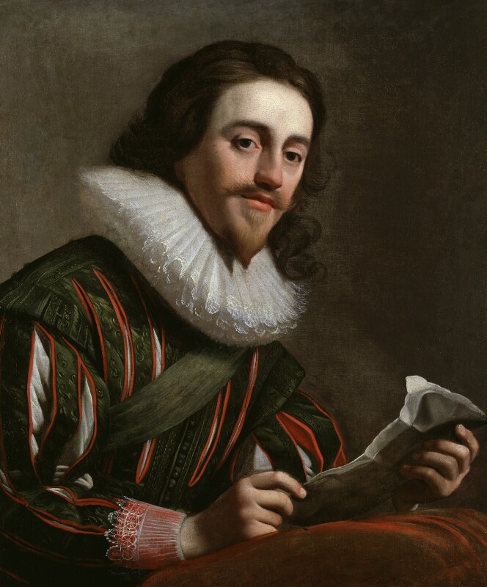
The Petition of Right
Signed by Charles I in 1628, it limited the ability of the monarch to act on his or her sole authority.
Monarchs could not imprison people illegally, force citizens to house soldiers in their homes, or establish military rule during times of peace.

Slide 16
The Petition of Right was part of an extended conflict between Charles and Parliament which erupted into a civil war.
The army of Parliament defeated Charles’s supporters. Charles was beheaded in 1649, and England did not have another king until 1660 when Charles II assumed the throne.
James II, Charles’s brother, succeeded him in 1685.

Slide 18
King James II

Slide 19
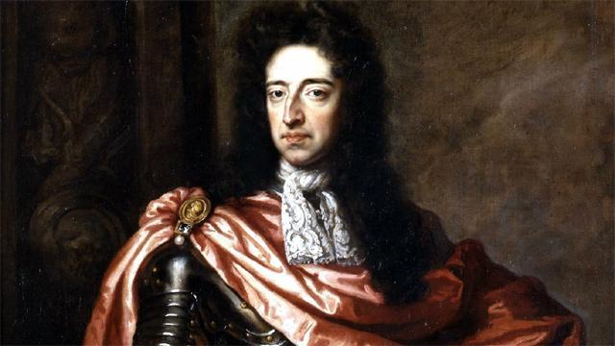
Parliamentary leaders who disagreed with James and his policies forced him from the throne by encouraging William of Orange, the husband of James's daughter Mary, to invade England.

Slide 20
The Glorious Revolution of 1688
William arrived with his troops, and James fled the country.
Parliament then asked William and Mary to serve as king and queen of England.
Before they took the throne, however, Parliament forced them to accept the English Bill of Rights.

Slide 21
William III and Mary II

Slide 22
The English Bill of Rights
Established that the monarchy could not rule without consent of Parliament.
Right to petition the king without fear of punishment and free parliamentary elections.
Forbade the monarch from maintaining an army without parliamentary consent and said that Parliament should operate without royal interference.

Slide 23
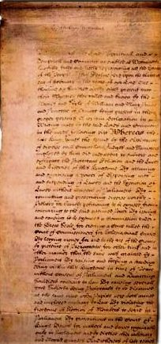
Along with the Magna Carta and the Petition of Right, the English Bill of Rights helped protect citizens’ rights from government violation.

Slide 24
Colonial Development
By the time the Petition of Right and the English Bill of Rights were passed, English colonists had begun to settle parts of North America.
The first permanent English colony was established at Jamestown, Virginia, in 1607.

Slide 25
Charters
The Jamestown colony was the first of several permanent colonies established by charter.
Charter- an agreement whereby the English monarch gave settlers the right to establish a colony.

Slide 27
The efforts to limit government in the colonies were evident in most charters.
The Massachusetts charter guaranteed elections. Officers where chosen from among the male settlers who were given the charter.
The charter also gave these men the power and authority to establish an assembly that would make laws, elect officers, and govern the colony.

Slide 28
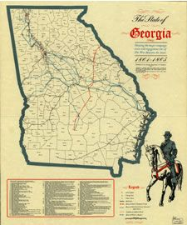
Governments
With the addition of Georgia in 1733, the number of colonies grew to 13.
Each colony had a system that reflected the ideals of limited and representative government.

Slide 29
Three types of colonies
Royal
The most common type, belonged directly to the crown. Virginia was a royal colony.
Proprietary
Territory was granted by the king to an individual (or small group of individuals), called a proprietor, and put under the proprietor's personal control. Pennsylvania and Maryland were proprietary colonies.
Corporate
Founded without any authorization from the English government. Connecticut and Rhode Island were corporate colonies.

