Slide 1
Economics Chapter 3: U.S. Private and Public sectors
Section 1: The U.S. Private Sector

Slide 2
Households
Households play the starring role in a market economy.
All those who live under one roof are considered part of the same household.

Slide 3
Households’ demands for goods and services determines what gets produced.

Slide 4
As buyers of goods and services and sellers of resources, households make all kinds of economic choices.
These choices include what to buy, how much to save, where to live, and where to work.

Slide 5
Evolution of the Household
In 1850 about two-thirds of America’s labor force worked on farms.
The economy was primarily agricultural, and each farm household was largely self-sufficient.

Slide 6
With the introduction of labor-saving machinery, disease-resistant seeds, and better fertilizers, farm productivity increased sharply.
Because each farmer produced much more, fewer farmers were needed to grow enough food to feed the nation.

Slide 7
As a result, many workers and their families moved from farms to cities where they became less self-sufficient.

Slide 8
In 1950, only about 15 percent of married women with children under 18 years old were in the labor force.
Since then, higher education levels among married women and a growing need for workers increased women’s earnings, raising their opportunity cost of not working.

Slide 9
The rise of two-earner households has affected the family as an economic unit.
Less production occurs in the home.
More goods and services are purchased in markets.

Slide 10
The rise of two-earner families has reduced the significance of specialization within the household.

Slide 11
Households Maximize Utility
There are more than 110 million U.S. households.
What exactly do households attempt to accomplish in making decisions?

Slide 12
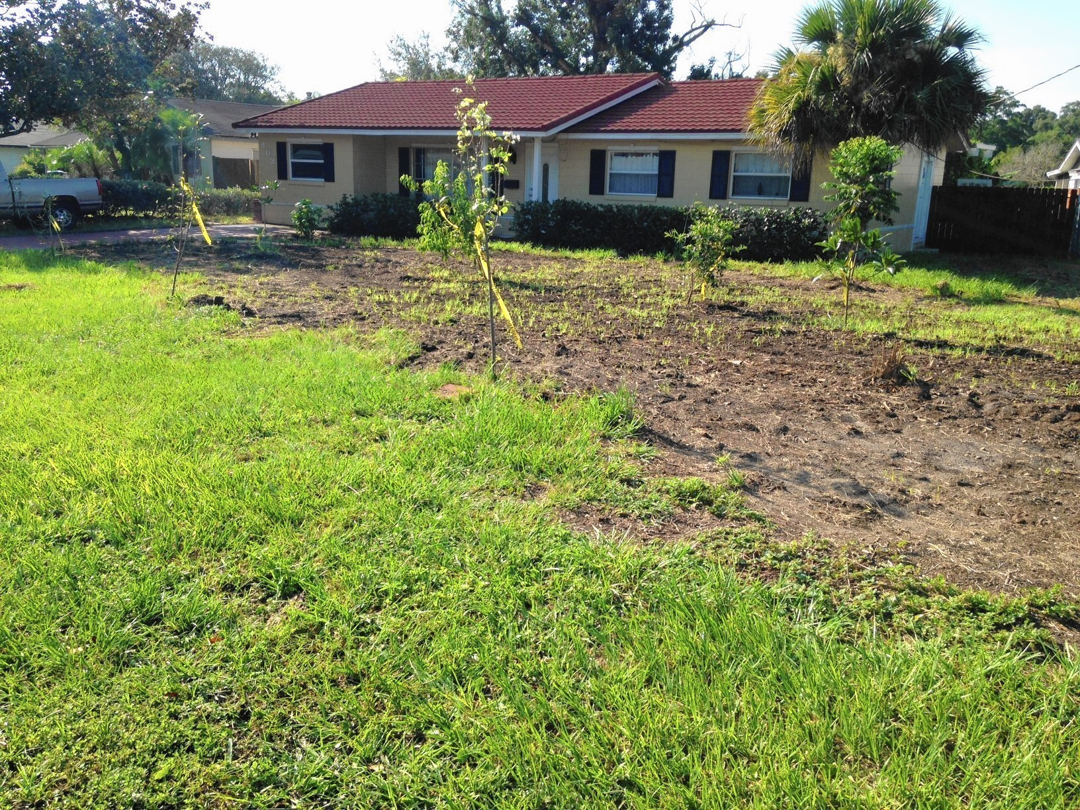
Economists assume that households attempt to maximize their utility – their level of satisfaction or sense of well-being.
Utility maximization depends on each household’s personal goals, not on some objective standard.

Slide 13
Firms
Resource providers often organize as firms.
A firm is an economic unit formed by a profit-seeking entrepreneur who combines resources to produce goods and services and accepts the risk of profit and loss.

Slide 14
Evolution of the firm
Specialization and comparative advantage help explain why households are no longer self-sufficient.
If the consumer had to visit and make agreements with each specialist, the resulting transaction costs- the cost of time and information required for exchange- could easily cancel out the efficiency gained from specialization.

Slide 15
Cottage Industry System
Workers’ rural cottages served as tiny factories.
Production usually occurred during the months when farming tasks were few- when the opportunity cost for farm workers as lower.

Slide 16
The Industrial Revolution
Technological developments, such as water power and later steam power, increased the productivity of each worker and contributed to the shift of employment from rural farm to urban factoroy.

Slide 17
Work, therefore, became organized in large, centrally powered factories that…

