Slide 1
Economics Chapter 2 section 2:
Production Possibilities Frontier

Slide 2
Efficiency and the production Possibilities Frontier
How much can an economy produce with the resources available?
What are the economy’s production capabilities?
To help consider these questions, you need a simple model of the economy, beginning with some simplifying assumptions.

Slide 3
Simplifying Assumptions
Here are the model’s simplifying assumptions.
1. To reduce the analysis to manageable proportions, the model limits the output to two broad classes of products: consumer goods, such as pizzas and haircuts, and capital goods, such as pizza ovens and hair clippers.
2. The focus is on production during a given period- in this case, a year.
3. The resources available in the economy are fixed in both quantity and quality during the period.
4. Society’s knowledge about how best to combine resources to produce output – that is, the available technology- does not change during the year.

Slide 4
PPf Model
Given the resources and the technology available in the economy, the production possibilities frontier (PPF) shows the possible combinations of the two types of goods that can be produced when available resources are employed fully and efficiently.

Slide 5
Efficiency means producing the maximum possible output from available resources.

Slide 6
Inefficient and Unattainable production
By using resources more efficiently or by using previously idle resources, the economy can produce more of at least one good without reducing the production of the other good.

Slide 7
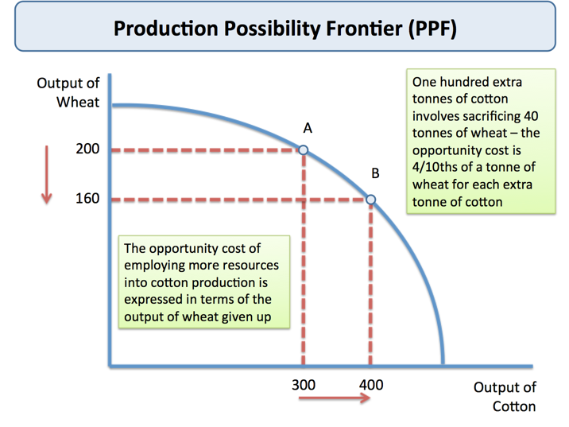

Slide 8
The Shape of the PPF
Any movement along the PPF involves giving up some of one good to get more of the other.
Movement down the curve indicates that the opportunity cost of more capital goods is fewer consumer goods.

Slide 9
The resources in the economy are not all perfectly adaptable to the production of both types of goods. Therefore, the opportunity cost of capital goods increases as the economy produces more capital goods and fewer consumer goods.

Slide 10
The shape of the production possibilities frontier reflects the law of increasing opportunity cost.
If the economy uses all resources efficiently, the law of increasing opportunity cost states that each additional increment of one good requires the economy to give up successively larger increments of the other good.

Slide 11
The law of increasing opportunity cost also applies when moving from the production of capital goods to the production of consumer goods.
If resources were perfectly adaptable to the production of both types of goods, the amount of consumer goods sacrificed to make more capital goods would remain constant.

Slide 12
Shifts of the PPF
The production possibilities frontier assumes that resources available in the economy and the level of technology are fixed during the period.

Slide 13
An outward shift of the PPF reflects economic growth, which is an expansion in the economy’s production possibilities or ability to produce.

Slide 14
Changes in Resources Availability
An increase in the labor force, working longer hours, retiring later, and skilled labor all shift the PPF outward.
In contrast, a decrease in the availability or quality of resources shifts the PPF inward.

Slide 15
Increase in Stock of Capital goods
An economy’s PPF depends in part on its supply of the stock of capital goods.
The more capital goods an economy produces during one period, the more output it can produce in the next period.

Slide 16
Technological Change
Another change that could shift the economy’s PPF outward is a technological discovery that employs available resources more efficiently.
The internet has increased the efficiency of resource markets by boosting each firm’s ability to identify resource suppliers.

Slide 17
Lessons from the PPF
The PPF demonstrates several concepts introduced so far…
Efficiency
Scarcity
Opportunity cost
Law of increasing opportunity cost
Economic growth
Choice
Each point along the economy’s production possibilities frontier is an efficient combination of output.

