Slide 1
Economics
Chapter 1 Section 2: Economic Theory

Slide 2
The Role of Theory
An economic theory, or economic model, is a simplification of economic reality that is used to make predictions about the real world.

Slide 3
Simplify Assumptions
To help develop a theory, economics make simplifying assumptions.
Once category of assumptions is the other-things-constant assumption.
The idea is to identify the variables of interest and then focus exclusively on the relations among them, assuming that nothing else of importance changes- that other things remain constant.

Slide 4
Economics also make assumptions about what motivates people-how people behave.
These are called behavioral assumptions.
Perhaps the most basic behavioral assumption is that people make choices based on their own self-interest.

Slide 5
Rational Self-Interest
By rational, economists mean that you try to make the best choices you can, given the information available.
In general, rational self-interest means that you try to maximize the expected benefit achieved with a given cost or to minimize the expected cost of achieving a given benefit.

Slide 6
Normative Versus Positive Statements
Positive Economic Statement- a statement about economic reality that can be supported or rejected by reference to the facts. (The US unemployment rate is at a 48-year low and the average hourly earnings rose 2.8%).

Slide 7
Normative Economic Statement- reflects someone's opinion which cannot always be shown to be true or false by reference to the facts.

Slide 8
Marginal Analysis
Economic choice usually involves some adjustment to the existing situation, or the status quo.

Slide 9
Compare Marginal Cost with Marginal Benefit
Economic choice is based on a comparison of the expected marginal benefit and the expected marginal cost of the action under consideration.
Marginal means incremental, additional, extra, or one more.
Marginal refers to a change in the status quo.

Slide 10
Choice Requires Time and Information
Rational choice takes time and requires information, but time and information are scarce and valuable.
Consider your choice about going to college.
You may have already talked to friends, relatives, teachers, and guidance counselors about it.
You might review school catalogs, college websites, and visit campuses.
The decision will take time and money, and probably will involve some hassle and worry.

Slide 11
Market Economics and National Economics
Market Economics, or Microeconomics, focuses on your economic behavior and the economic behavior of others who make choices involving…
what to buy and what to sell
how much to work and how much to play
how much to borrow and how much to save.

Slide 12
National Economics, or Macroeconomics, focus on the performance of the economy as a whole, especially the national economy.

Slide 13
Market Participants
There are four types of decision makers in the economy:
Households
Firms
Governments
Rest of the world

Slide 14
Four Types of Participants
Households play the leading role in the economy.
As consumers, households demand the goods and services produced.
As resource owners, households supply the resources used to produce goods and services.

Slide 15
Firms, governments, and the rest of the world demand the resources that households supply, and then use these resources to supply the goods and services that households demand.

Slide 16
Markets
Markets are the means by which buyers and sellers carry out exchange..
By bringing together the two sides of exchange- demand and supply- markets determine price and quantity.

Slide 17
Goods and services are bought and sold in product markets.
Resources are bought and sold in resource markets.
The most important resource market is the labor, or job, market.

Slide 18
A Circular-Flow Model
Circular-flow model- describes the flow of resources, products, income, and revenue among economic decision makers.
A simple circular-flow model focus on the interaction between households and firms in a market economy.

Slide 19
The flows of resources and products are supported by the flows of income and expenditure- that is, by the flow of money.
The supply and demand for products come together in product markets to determine the prices for goods and services, which flow as revenue firms.

Slide 20
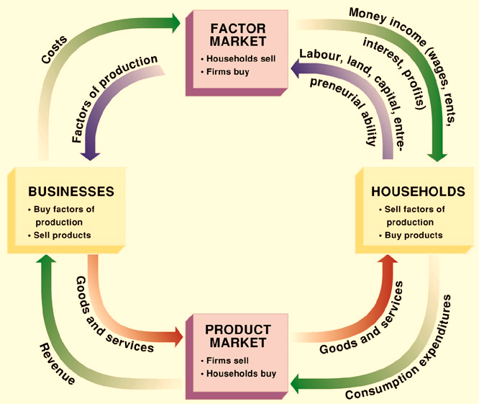
Resources and products flow in one direction- in this case, counterclockwise- and the corresponding payments flow in the other direction- clockwise.

