Slide 1
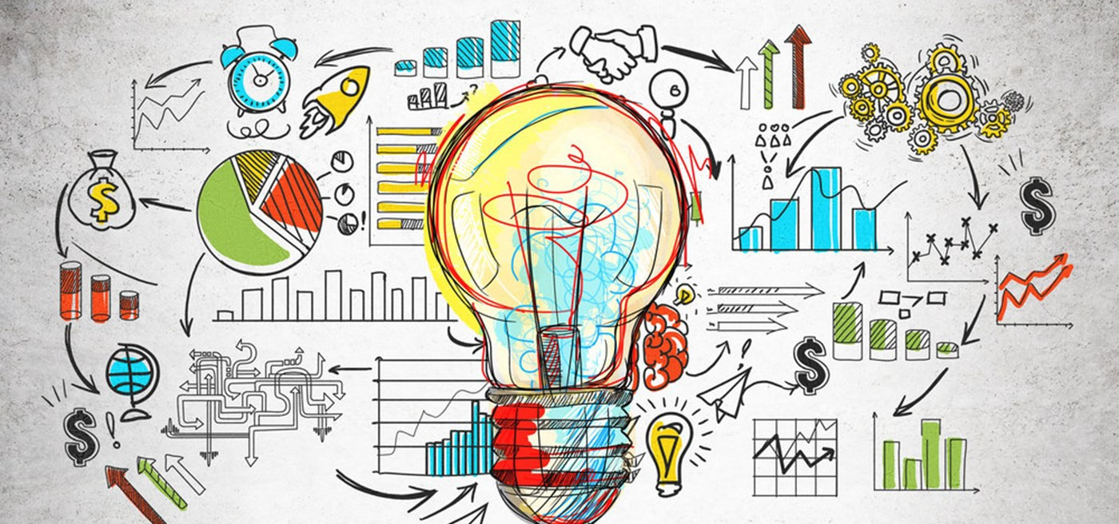
Chapter 1: What is Economics
Section 1: The Economic Problem

Slide 2
Economic Choices
Economics is about making choices.
You make economic choices every day.
You make choices about whether to get a part-time job or focus on your studies, buy a car or save for college, pack a lunch, or buy a lunch.

Slide 3
The Economic Problem
Although your wants, or desires, are virtually unlimited, the productive resources available to help satisfy these wants are scarce.

Slide 4
Scarcity- the condition facing all societies because there are not enough productive resources to satisfy people’s unlimited wants.
Productive Resources- (factors or production) are the inputs used to produce the goods and services that people want.
Because productive resources are scarce, goods and services are scarce too.

Slide 5
A productive resource is scarce when it is not freely available.
Because productive resources are scarce, you must choose from among your many wants.

Slide 6
Whenever you choose, you must go without satisfying some other wants.
The problem of scarce resources but unlimited wants exists for each of the roughly seven billion people on the planet.

Slide 7
Economics Defined
Economics- examines how people use their scarce resources to satisfy their unlimited wants.
A taxicab driver uses the cab and other scarce resources, such as knowledge of the city, driving skills, gasoline, and time, to earn income.

Slide 8
Productive Resources
Productive resources, also called factors of production, or simply resources, sort into three broad categories:
1. Human resources
2. Natural resources
3. Capital resources

Slide 9
Human Resources
Human Resources- the broad category of human efforts, both physical and mental, used to produce goods and services.
Labor, such as the labor of a cab driver or a brain surgeon, is the most important of the human resources.
Labor- the physical and mental effort used to produce goods and services.
Labor itself comes from a more fundamental human resource: time.
Without time you can accomplish nothing.

Slide 10
Human resources also include the special skills supplied by an entrepreneur, who tries to earn a profit by developing a new product an existing one.
An entrepreneur seeks to discover profitable opportunities by purchasing resources and assuming the risk of business success or failure.

Slide 11
Profit equals the revenue from sales minus the cost of production.
If production costs exceed revenue, the entrepreneur suffers a loss.
Profit provides the incentive that makes entrepreneurs willing to accept the risk of losing money.
All companies in the world today began as an idea in the mind of an entrepreneur.

Slide 12
Natural Resources
Natural Resources are so-called “gifts of nature,” including land, forests, minerals, oil reserves, bodies of water, and even animals.
Natural Resources can be divided into renewable resources and exhaustible resources.

Slide 13
A renewable resource can be drawn on indefinitely if used wisely.
Timber is a renewable resource if felled trees are replaced to provide a steady supply.

Slide 14
An exhaustible resource- such as oil, coal, or copper ore- does not renew itself and so is available in a limited amount.
Each gallon of oil burned is gone forever.
Sooner or later, all oil wells will run dry.

Slide 15
Capital Resources
Capital resources, commonly called capital goods, include all human creations used to produce goods and services.
Capital goods consist of factories, trucks, machines, tools, buildings, airports, highways, and other manufactured items employed to produce goods and services.

Slide 16
Goods and Services
Good- something you can see, feel, and touch.
It requires scarce resources to produce, and it satisfies human wants.

Slide 17
Service- not physical, yet is uses scarce resources to satisfy human wants.
Movies, concerts, phone calls, internet connections, and your next haircut are all services.

Slide 18
No Free Lunch
All goods involve a cost to someone.
Because goods and services are produced using scarce resources, they are themselves scarce.
A good or service is scarce if the amount people desire exceeds the amount available at zero price.

Slide 19
Your text will use the term “goods” to refer to goods and services.
A few goods seem free because the amount freely available (that is, available at a zero price) exceeds the amount people want.
Air and seawater often seem free because you can breathe all the air you want and have all the sea water you can haul away.
However, even those goods that appear to be free come with strings attached.

Slide 20
Goods that are truly free are not the subject matter of economics. Without scarcity, there would be no need for prices and no economic problem.

