Slide 1
Psychology Chapter 2 Section 3: Methods of Observation

Slide 2
Based on our observations of other people (and also ourselves), we tend to make generalizations about human behavior and human nature.

Slide 3
Our observations and generalizations usually serve us fairly well in our daily lives.
No matter how many experiences we have had, most of our personal observations are fleeting and haphazard.

Slide 4
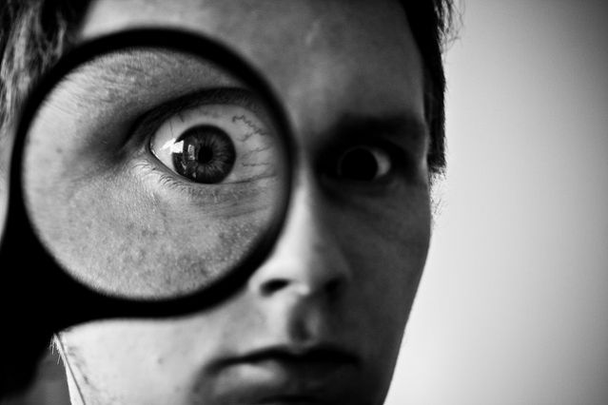
We ignore the obvious because it does not fit our ideas about how things ought to be.

Slide 5
We cannot draw scientific conclusions based only on our own unstructured observations.

Slide 6
The Testing Method
Intelligence Tests – measure general learning ability.
Aptitude Tests – measure specific abilities and special talents, such as musical ability and mechanical skills.
Personality Tests – measure people’s character traits and temperament.

Slide 7
The Case-Study Method
A case study is an in-depth investigation of an individual or a small group.
Psychologists use what they learn in a case study to generalize broader principles that apply to the larger population.

Slide 8
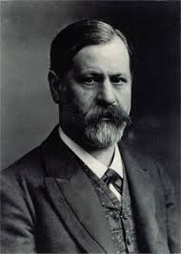
Sigmund Freud developed psychoanalytic theory largely on the basis of case studies.
Psychoanalytic Theory
Freud believed that people could be cured by making conscious their unconscious thoughts and motivations, thus gaining insight.

Slide 9
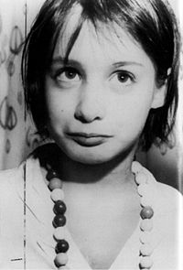
Rare circumstances.
Genie – 20 months old, her father locked her in a small room. She was kept there until she was recued at the age of 13.

Slide 10
Social contacts were limited to her mother, who fed her, and her father, who often beat her.
No one spoke to her and in all those years, she herself did not say a word.

Slide 11
After being recused, Genie’s language development followed the normal sequence of language development.
She never learned to use language as well as most people.

Slide 12
What psychologists can learn from this case study.
Suggests that there is a special period in early childhood when it is easiest for people to learn language.
Just be cautious of generalizing, since this case study cannot be replicated.

Slide 13
Longitudinal and Cross-Sectional Methods
Longitudinal method- researchers select a group of participants and then observe those participants over a period of time, often years of even decades.
Observations are usually conducted at intervals, perhaps once a year.

Slide 14
Longitudinal studies are very time consuming.
No guarantee the participants will remain available.

Slide 15
Cross-sectional method
Researchers select a sample that includes people of different ages.
Researchers then compare the behavior of the participants in the different age groups.
Information gained in cross-sectional studies is less reliable than information from longitudinal studies.

Slide 16
The Naturalistic-Observation Method
Naturalistic observation – or field study
observe other people in their natural habitats.
Psychologists do not interfere with the person they are observing.

Slide 17
Laboratory- Observation Method
A laboratory is any place that provides the opportunity for observation or experimentation.
Many laboratories are quite formal.
Used to control the environment of a study.

Slide 18
Analyzing Observations
Correlation
A measure of how closely one thing is related to another.

Slide 19
Positive and Negative Correlation
Positive Correlation – one goes up, so does the other (need for achievement and salaries) .
Negative Correlation – as one goes up, the other goes down (stress and health).

Slide 20
Limits of Correlation
Correlation describes relationships.
It does not, however, reveal cause and effect.

