Slide 1
AP European History Chapter 15 Section 5 The Flourishing of European Culture

Slide 2
In the midst of religious wars and growth of absolutism, European culture continued to flourish.

Slide 3
The Changing Faces of Art
The artistic Renaissance came to an end when a new movement called Mannerism emerged in Italy in the 1520s and 1530s.

Slide 4
Mannerism
The worldly enthusiasm of the Renaissance gave way to anxiety, uncertainty, suffering, and yearning for spiritual experience.
Mannerism reflected this environment in its deliberate attempt to bread down the High Renaissance principles of balance, harmony, and moderation.
(the term Mannerism derives from critics who considered their contemporary artists to be second-rate imitators, painting “in the manner of” Michelangelo’s late style).

Slide 5
Italian Mannerist painters deliberately distorted the rules of proportion by portraying elongated figures that conveyed a sense of suffering and a strong emotional atmosphere filled with anxiety and confusion.

Slide 6
Mannerism spread from Italy to other parts of Europe and perhaps reached it apogee in the work of El Greco (1541-1614).
El Greco’s elongated and contorted figures, portrayed in unusual shades of yellow and green against an eerie background of turbulent grays, reflect the artist’s desire to create a world of intense emotion.

Slide 7
The Baroque Period
Mannerism was replaced by Baroque.
Embraced by the Catholic reform movement.
Baroque artists sought to bring together the classical ideals of Renaissance art with the spiritual feelings of the sixteenth-century religious revival.
Known for its used of dramatic effects to arouse the emotions.

Slide 8
Perhaps the greatest figure of the Baroque was the Italian architect and sculptor Gian Lorenzo Bernini (1598-1680), who completed Saint Peter’s Basilica at the Vatican and designed the vase colonnade enclosing the piazza in front of it.

Slide 9
Throne of Saint Peter by Bernini

Slide 10
Ecstasy of Saint Teresa by Bernini

Slide 11
Artemisia Gentileschi (1593-1653)
She moved to Florence and began a successful career as a painter.
At the age of 23, she became the first woman to be elected to the Florentine Academy of Design.

Slide 12
Judith Beheading Holofernes – Gentileschi

Slide 13
French Classicism
In the second half of the seventeenth century, France replaced Italy as the cultural leader of Europe.
French late Classicism, with its emphasis on clarity, simplicity, balance, and harmony of design was a rather austere version of the High Renaissance style.

Slide 14
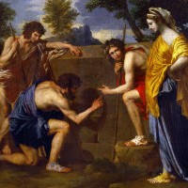
Nicholas Poussin (1594-1665)
Exemplified grandeur in the portrayal of noble subjects.
His choice of scenes from classical mythology, the orderliness of his landscapes, the postures of his figures copied from the sculptures of antiquity , and his use of brown tones all reflect French Classicism.

Slide 15
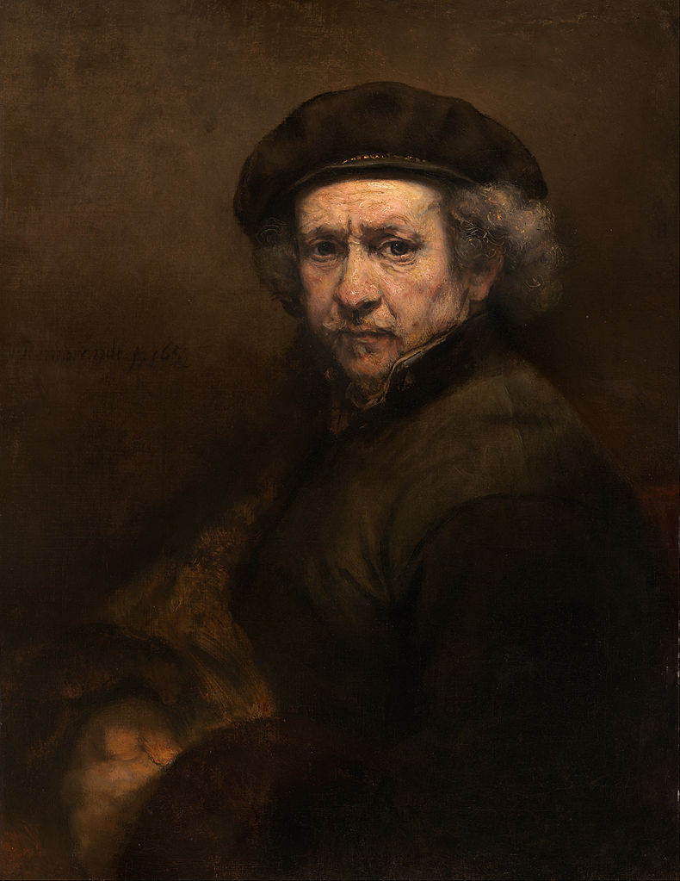
Dutch Realism
The finest product of the golden age of Dutch painting was Rembrandt van Rijn (1606-1669).
Protestant Painter
He refused to follow his contemporaries.

Slide 16
Wonderous Age of Theater
The greatest age of English literature is often called the Elizabethan era because much of the English cultural flowering of the late sixteenth and early seventeenth centuries occurred during the reign of Queen Elizabeth I.

Slide 17
William Shakespeare (1564-1616).
When he appeared in London in 1592,, Elizabethans were already addicted to the stage.
“Complete man of the theater.”
Although best known for writing plays, he was also an actor and shareholder in the chief company of the time, the Lord Chamberlain’s Company, which played in theaters as diverse as the Globe and the Blackfiars.

Slide 18
Beginning in the 1580s, the agenda for playwrights was set by Lope de Vega (1562-1635) – Spain.
Incredibly prolific writer.
Lope de Vega was more cynical compared to Shakespeare.
Wrote plays for money.

Slide 19
French playwrights wrote more for an elite audience and were forced to depend on royal patronage.
Louis XIV used theater as he did art and architecture- to attract attention to his monarchy.

Slide 20
Jean –Baptiste Racine (1639-1699)
In Phedre, which has been called his best play, Racine followed closely the plot of the Greek tragedian Euripides’s Hippolytus.
Conflicts between love and honor

Slide 21
Jean-Baptiste Moliere (1622-1673)
Wrote, produced, and acted in a series of comedies that often satirized the religious and social world of his time.
In Tartuffe, he ridiculed religious hypocrisy.

