Slide 1
Chapter 13 Section 8 Part 2: The England of Elizabeth

Slide 2
Queen Elizabeth I
After the death of Queen Mary in 1558, her half-sister Elizabeth ascended the throne of England.
During Elizabeth’s reign, England rose to prominence as the relatively small island kingdom became the leader of the Protestant nations of Europe, laid the foundations for a world empire, and experienced a cultural renaissance.

Slide 4
The daughter of King Henry VIII and Ann Boleyn, Elizabeth had had a difficult early life.
During Mary’s reign, she had even been imprisoned for a while and had learned early to hide her true feelings from both private and public sight.

Slide 5
She moved quickly to solve the difficult religious problem she had inherited from Mary, who had become extremely unpopular when she tried to return England to the Catholic fold.

Slide 6
Religious Policy
Elizabeth’s religious policy was based on moderation and compromise.
She wanted to prevent England from being torn apart over matters of religion.
Parliament cooperated with the queen in initiating the Elizabethan religious settlement in 1559.

Slide 7
The Catholic legislation of Mary’s reign was repealed, and the new Act of Supremacy designated Elizabeth as “the only supreme governor of this realm, as well in all spiritual or ecclesiastical things or causes, as temporal.”

Slide 8
Act of Uniformity
This Act of Uniformity restored the church service of the Book of Common Prayer from the reign of Edward VI with some revisions to make it more acceptable to Catholics.
Elizabeth’s religious settlement was basically Protestant, but it was a moderate Protestantism that avoided overly subtle distinctions and extremes.

Slide 9
The Catholics and the Puritans
The new religious settlement worked, at least to the extent that is smothered religious differences in England in the second half of the sixteenth century.
Two groups, however, the Catholics and the Puritans, continued to oppose it.

Slide 10
Mary, Queen of Scots
One of Elizabeth’s greatest challenges came from her Catholic cousin, Mary, queen of Scots, who was next in line to the English throne.
Mary was ousted from Scotland by rebellious Calvinist nobles in 1568 and fled for her life to England.
There Elizabeth placed her under house arrest and for fourteen years tolerated her involvement in a number of ill-planted Catholic plots designed to kill Elizabeth and replace her on the throne with the Catholic Mary.

Slide 11
Mary, Queen of Scots

Slide 12
In 1587, after Mary became embroiled in a far more serious plot, Elizabeth had her cousin beheaded to end the threats to he regime.
Potentially more dangerous to Anglicanism (Western Christian tradition that evolved out of the practices, liturgy and identity of the Church of England) in the long run were the Puritans.

Slide 13
The Puritans
The word Puritan first appeared in 1564 when it was used to refer to Protestants within the Anglican church who, inspired by Calvinist theology, wanted to remove any trace of Catholicism from the Church of England.
Elizabeth managed to keep the Puritans in check during her reign.

Slide 14
Elizabeth proved as adept in government and foreign policy as in religious affairs.
Well served administratively by the principal secretary of state.
Talents of Sir William Cecil and Sir Francis Walsingham, who together held the office for thirty-two years, ensured much of Elizabet’s success in foreign and domestic affairs.

Slide 15
Elizabeth also handled Parliament with much skill; it met only thirteen times during her entire reign.
Caution, moderation, and expediency also dictated Elizabeth’s foreign policy.
She realized war could be disastrous for her island kingdom and her own rule.

Slide 16
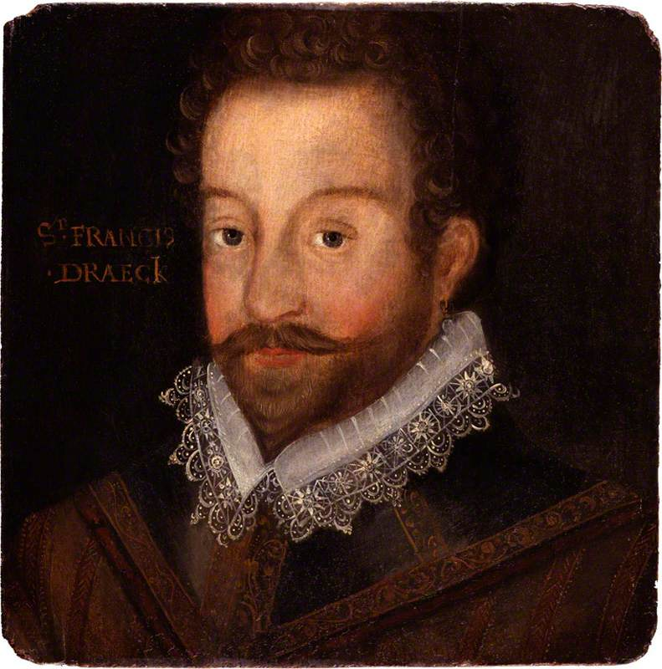
Francis Drake – English piracy
Unofficially, however, she encouraged English seamen to raid Spanish ships and colonies.
Francis Drake was especially adept at plundering Spanish fleets loaded with gold and silver from Spain’s New World empire.

Slide 17
While encouraging English piracy and providing clandestine aid to French Huguenots and Dutch Calvinists to weaken France and Spain, Elizabeth pretended complete aloofness and avoided alliances that would force her into war with any major power.

Slide 18
Elizabeth was drawn into more active involvement in the Netherlands. This move accelerated the already mounting friction between Spain and England.
After years of resisting the idea of invading England as too impractical, Philip II of Spain was finally persuaded to do so by advisers who assured him that the people of England would rise against their queen when the Spaniards arrived.

Slide 19
Philip was convinced that the revolt in the Netherlands would never be crushed as long as England provided support for it.
A successful invasion of England would mean the overthrow of heresy and the return of England to Catholicism, surely an act in accordance with the will of God.

Slide 20
Philip ordered preparations for a fleet of warships that would rendezvous with the army of the duke o Parma in Flanders (Belgium) and escort his troops across the English Channel for the invasion.

Slide 21
The armada was a disaster
The Spanish fleet that finally set sail had neither the ships nor the troops that Philip had planned to send.
The flaw..
“We are sailing against England in the confident hope of a miracle.”

Slide 22
The hoped-for miracle never materialized. The Spanish fleet, battered by a number of encounters with the English, sailed back to Spain.
Although the English and Spanish would continue their war for another sixteen years, the defeat of the Spanish Armada guaranteed for the time being that England would remain a Protestant country.

