Slide 1
Chapter 13 Section 8- Part 1: Politics and the Wars of Religion in the Sixteenth Century

Slide 2
The French Wars of Religion (1562-1598)
Religion was at the heart of the French civil wars of the sixteenth century.
Concerned by the growth of Calvinism, the French kings tried to stop its spread by persecuting Calvinists but had little success.

Slide 3
Huguenots (French Calvinists)
Came from all levels of society: artisans and shopkeepers hurt by rising prices and a rigid guild system; merchants and lawyers in provincial towns whose local privileges were tenuous; and members of the nobility.

Slide 4
Possibly 40 to 50 percent of the French nobility became Huguenots, including the house of Bourbon, which stood next to the Valois in the royal line of succession and ruled the southern French kingdom of Navarre.
The conversion of so many nobles made the Huguenots a potentially dangerous political threat to monarchical power.

Slide 5
The Catholic majority greatly outnumbered the Calvinist minority.
The Valois monarchy was staunchly Catholic, and its control of the Catholic church gave it little incentive to look favorably upon Protestantism.

Slide 6
When Henry II (1547-1559) was killed accidently in a tournament, he was succeeded by a series of weak and neurotic sons, two of whom were dominated by their mother, Catherine de ’Medici (1519-1589).

Slide 7
As regent for her sons, the moderate Catholic Catherine looked to religious compromise as a way to defuse the political tensions but found to her consternation that both sides possessed their share of religious fanatics unwilling to make concessions.

Slide 8
Ultra Catholics
The extreme Catholic party- known as the ultra Catholics- favored strict opposition to the Huguenots and was led by the Guise family.
The religious issue was not the only factor that contributed to the French civil wars.

Slide 9
Towns and provinces, which had long resisted the growing power of monarchical centralization, were only too willing to join a revolt against the monarchy.
This was also true of the nobility, and because so many of them were Calvinists, they formed and important base of opposition to the crown.

Slide 10
The French Wars of Religion, then, presented a major constitutional crisis for France and temporarily halted the development of the French centralized territorial state.
The claim of the state’s ruling dynasty to a person’s loyalties was temporarily superseded by loyalty to one’s religious belief.

Slide 11
The wars erupted in 1562 when the powerful duke of Guise (France) massacred a peaceful congregation of Huguenots at Vassy.
In the decade of the 1560s, the Huguenots held their own. Too small to conquer France, their armies were so good at defensive campaigns that they could not be defeated either, despite the infamous Saint Bartholomew’s Day massacre.

Slide 12
Saint Bartholomew’s Day massacre.
The massacre of Huguenots in August 1572 occurred at a time when the Catholic and Calvinist parties had apparently been reconciled through the marriage of the sister of the reigning Valois king, Charles IX (1560-1574), and Henry of Navarre, the Bourbon ruler of Navarre, who had been responsible for introducing Calvinist ideas into her kingdom.

Slide 13
Henry, duke of Guise, King Henry III, Henry of Navarre
The turning point in the conflict came in the War of the Three Henrys in 1588- 1589.
Henry, duke of Guise, in the pay of Philip II of Spain, seized Paris and forced King Henry III to make him chief minister.
To rid himself of Guise and then joined with Henry of Navarre (who meanwhile had returned to Calvinism), who was next in line to the throne, to crush the Catholic Holy League and retake the city of Paris.

Slide 14
End to the French Wars of Religion.
Although successful, Henry III in turn was assassinated in 1589 by a monk who was repelled by the spectacle of a Catholic king cooperating with a Protestant.
Henry of Navarre now claimed the throne. Realizing, however, that he would never be accepted by Catholic France, Henry took the logical way out and converted once again to Catholicism.
With his coronation in 1594, the French Wars of Religion finally came to and end.

Slide 15
Edict of Nantes – 1598
The religious problem persisted until the Edict of Nantes was issued in 1598.
It acknowledged Catholicism as the official religion of France but guaranteed the Huguenots the right to worship in selected places in every district and allowed them to retain a number of fortified towns in the protection.

Slide 16
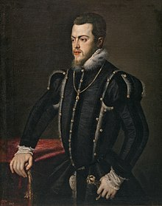
Phillip II and the Cause of Militant Catholicism
The greatest advocate of militant Catholicism in the second half of the sixteenth century was King Philip II of Spain (1556-1598), the son of heir Charles V.

Slide 17
Major goals of Phillip II:
Consolidate and secure the lands he had inherited from his father.
Strict Conformity to Catholicism enforced by the Spanish Inquisition.
Establishment of a strong monarchal authority.

Slide 18
Spain’s preeminence depended on a prosperous economy fueled by its importation of gold and silver from its New World possessions.
Crushing burden of direct and indirect taxes. The attempt to make Spain a great power led to its decline after Philip’s reign.
Philip’s greatest misfortune came from his attempts to crush the revolt in the Netherlands and his tortured relations with Queen Elizabeth of England.

Slide 19
The Revolt of the Netherlands
One of the richest parts of Philip’s empire, the Spanish Netherlands was of great importance to the Most Catholic King.
The Netherlands consisted of seventeen provinces (modern Netherlands, Belgium, and Luxemburg). The seven northern provinces were largely Germanic in culture and Dutch-speaking, while the French- and Flemish speaking southern provinces were closely tied to France.

Slide 20
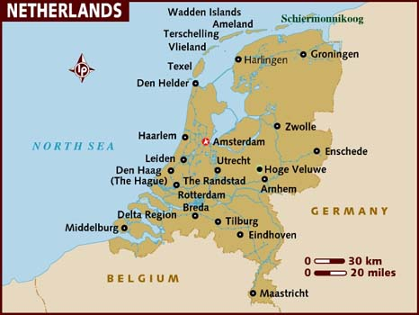

Slide 21
The Netherlands had become prosperous through commerce and a flourishing textile industry.
Due to location, the Netherlands was open to the religious influences of the of the age.

Slide 22
Though some inhabitants had adopted Lutheranism or Anabaptism (the doctrine that baptism should only be administered to believing adults, held by a radical Protestant sect that emerged during the 1520s and 1530s), by the time of Philip II, Calvinism was also making inroads.
These provinces had no real political bond holding them together except their common ruler, and that ruler was Philip II, a foreigner who was out of touch with the situation in the Netherlands.

Slide 23
Phillip II hoped to strengthen his control in the Netherlands regardless of the traditional privileges of the separate provinces which was strongly opposed by the nobles, towns, and provincial states, which stood to lose politically if the jealously guarded privileges and freedoms were weakened.

Slide 24
Resentment against Philip was also aroused when the residents of the Netherlands realized that the taxes they paid were being used for Spanish interests.
Religion became a major catalyst for rebellion when Philip attempted to crush Calvinism.

Slide 25
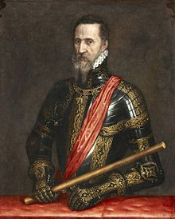
Violence erupted in 1566 when Calvinists- especially nobles, began to destroy statues and stained-glass windows in Catholic Churches.
Philip responded by sending the duke of Alva with ten thousand veteran Spanish and Italian troops to crush the rebellion.

Slide 26
Levying of a permanent sales tax alienated many merchants and commoners who now joined the nobles and Calvinists in the struggle against Spanish rule.

Slide 27
Council of Troubles
Nicknamed by the Dutch the Council of Blood inaugurated a reign of terror in which even powerful aristocrats were executed.
The revolt now became organized, especially in the northern provinces where William of Nassau, the prince of Orange, also known as William the Silent, and Dutch pirates known as the “Sea Beggars” mounted growing resistance.

Slide 28
In 1573, Philip removed the duke of Alva and shifted to a more conciliatory (pacify) policy to bring an end to costly revolt.

Slide 29
Pacification of Ghent
William of Orange wished to unify all seventeen provinces, a goal seemingly realized in 1576 with the Pacification of Ghent.
This agreement stipulated that all the provinces would stand together under William’s leadership, respect religious differences, and demand that Spanish troops be withdrawn.

Slide 30
Religious differences proved too strong for any lasting union.
When the duke of Parma, the next Spanish leader arrived in the Netherlands, he astutely (accurately) played on the religious differences of the provinces and split their united front.

Slide 31
The Two Unions
The southern provinces formed a Catholic union- the Union of Arras- in 1579 and accepted Spanish control.
William of orange organized the northern, Dutch speaking states into a Protestant union – the Union of Utrecht – determined to oppose Spanish rule.

Slide 32
The Netherlands was now divided along religious, geographical, and political lines into two hostile camps.
The struggle dragged on until 1609, when a twelve-year truce ended the war, virtually recognizing the independence of the northern provinces.

Slide 33
United Provinces
These “United Provinces” soon emerged as the Dutch Republic, although the Spanish did not formally recognize them as independent until 1648.
The ten southern provinces remained a Spanish possession.

