Slide 1
Chapter 13 Section 7: The Catholic Reformation

Slide 2
By the mid-sixteenth century, Lutheranism had become established in parts of Germany and Scandinavia, and Calvinism in parts of Switzerland, France, the Netherlands, and eastern Europe.

Slide 3
In England, the split from Rome had resulted in the creation of a national church.

Slide 4
Catholic Reformation/ Counter Reformation
We call the story or the revival of Roman Catholicism the Catholic Reformation, although some historians prefer to use the term Counter Reformation, especially for those elements of the Catholic Reformation that were directly aimed at stopping the spread of Protestantism.

Slide 5
The best feature of medieval Catholicism were revived and then adjusted to meet new conditions, a situation most apparent in the revival of mysticism (belief that union with or absorption into the Deity or the absolute) and monasticism.

Slide 6
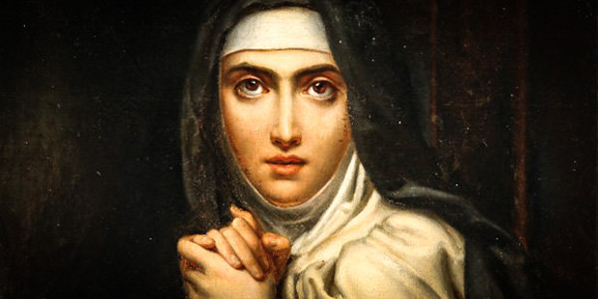
Spanish mystic Saint Teresa of Avila (1515-1582)
A nun of the Carmelite order, Teresa experienced a variety of mystical visions that she claimed resulted in the ecstatic union of her soul with God.
She founded a new order of barefoot Carmelite nuns and worked to foster their mystical experiences.

Slide 7
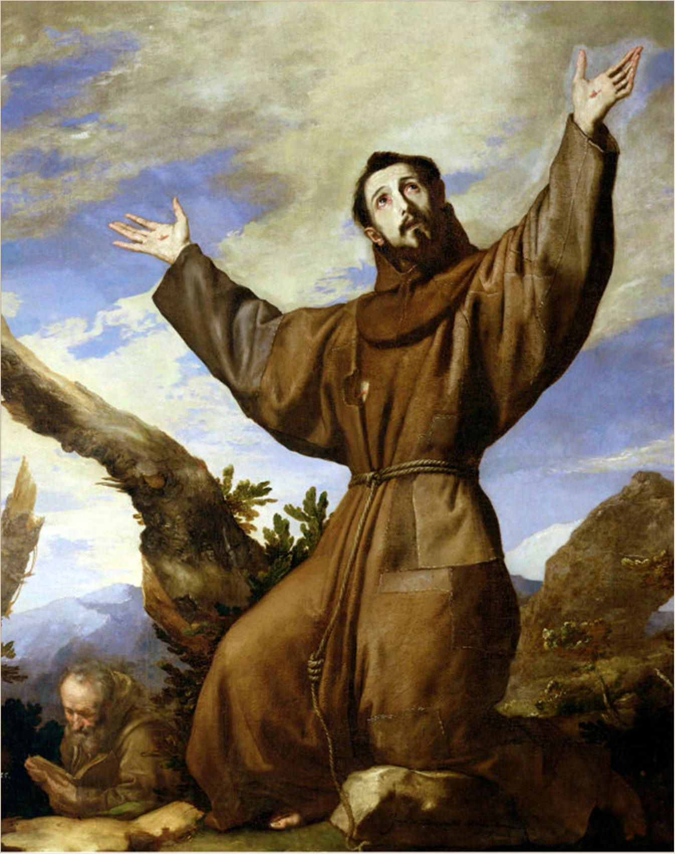
Old orders, such as the Benedictines and Dominicans, were reformed and renewed.
The Capuchins emerged when a group of Franciscans decided to return to the simplicity and poverty of Saint Francis of Assisi (Italy), the medieval founder of the Franciscan order.

Slide 8
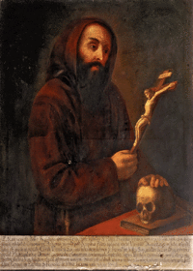
Going out to preach
In addition to caring for the sick and the poor, the Capuchins focused on preaching the Gospel directly to the people and emerged as an effective force against Protestantism.

Slide 9
The Theatines, founded in 1524, placed their emphasis on reforming the secular (no religious or spiritual basis) clergy and encouraging those clerics (a priest or religious leader) to fulfill their duties among the laity.
Established orphanages and hospitals to care for victims of war and plague.

Slide 10
The Ursulines, a new order of nuns founded in Italy in 1535, focused their attention on establishing schools for the education of girls.

Slide 11
The Oratory of Divine Love, first organized in Italy in 1497, was not a new religious order but an informal group of clergy and laymen who worked to foster reform by emphasizing personal spiritual development and outward acts of charity.

Slide 12
The “ philosophy of Christ,” advocated by the Christian humanist Erasmus, was especially appealing to many of them.
The Oratory’s members included a number of cardinals who favored the reform of the Catholic church.

Slide 13
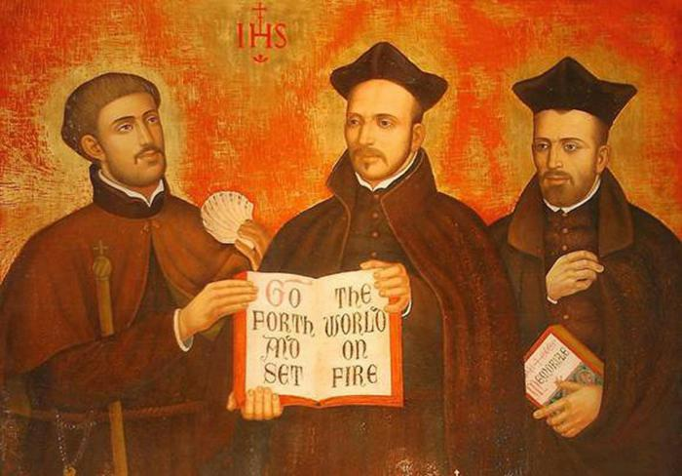
The Society of Jesus
Of all the new religious orders, the most important was the Society of Jesus, known as the Jesuits, who became the chief instrument of the Catholic Reformation.
Iesus Hominum Salvator, Jesus, Savior of Men

Slide 14
Founded by a Spanish nobleman, Ignatius of Loyola (1491-1556), whose injuries in battle cut short his military career.
Loyola experienced a spiritual torment similar to Luther’s but, unlike Luther, resolved his problems not by a new doctrine but by a decision to submit his will to the will of the church.

Slide 15
Ignatius of Loyola (Spain) (1491-1556),

Slide 16
The Spiritual Exercises
Written by Ignatius of Loyola.
Was a training manual for spiritual development emphasizing exercises by which the human will could be strengthened and made to follow the will of God as manifested through his instrument, the Catholic Church.

Slide 17
Loyola gathered together a small group of individuals who were eventually recognized as a religious order, the Society of Jesus, by a papal bull in 1540.
Absolute obedience to the papacy.
Resembled the structure of a military command.

Slide 18
A two year novitiate (the period or state of being a novice, especially in a religious order) weeded out all but the most dedicated.

Slide 19
The Jesuits pursued three major activities:
1. Established highly disciplined schools, borrowing freely from humanist schools for their educational methods
2. Propagation of the Catholic faith among non-Christians.
3. Determined to carry the Catholic banner and fight Protestantism.

Slide 20
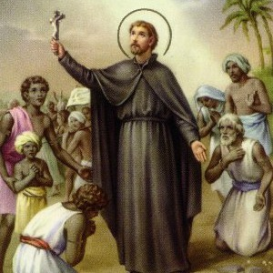
Francis Xavier (1506-1552), one of the original members of the Society of Jesus, carried the message to India and Japan before dying of fever.
Although conversion efforts in Japan proved short-lived, Jesuit activity in China, especially that of the Italian Matteo Ricci, was more long-lasting.

Slide 21
A Revived Papacy
The involvement of the Renaissance papacy in dubious finances and Italian political and military affairs had given rise to numerous sources of corruption.

Slide 22
Pope Paul III
The pontificate of Pope Paul III (1534-1549) proved to be a turning point in the reform of the papacy.
He continued Renaissance papal practices by appointing his nephews as cardinals, involving himself in politics, and patroninzing arts and letters on a lavish scale.

Slide 23
Pope Paul III

Slide 24
Advocates of reform, such as Gasparo Contarini and Gain Pietro Caraffa, were made cardinals.
In 1535, Paul took the audacious step of appointing a reform commission to study the church’s condition.
The commission’s report in 1537 blamed the church’s problems on the corrupt policies of popes and cardinals.

Slide 25
Paul III also formally recognized the Jesuits and summoned the council of trent.
In 1541, a colloquy had been held at Regensburg in a final attempt to settle the religious division peacefully.

Slide 26
Cardinal Contarini
Here Catholic moderates, such as Cardinal Contarini, who favored concessions to Protestants in the hope of restoring Christian unity, reached a compromise with Protestant moderates on a number on a number of doctrinal issues.

Slide 27
When Contarini returned to Rome with these proposals, Cardinal Caraffa and other hard-liners, who regulated all compromise with Protestant innovations as heresy, accused him of selling out to the heretics.

Slide 28
It soon became apparent that the conservative reformers were in the ascendancy when Caraffa was able to persuade Paul III to establish the Roman Inquistion or Holy Office in 1542 to ferret out doctrinal errors.
There was to be not compromise with Protestantism.

Slide 29
When Cardinal Caraffa was chosen pope as Paul IV (1555-1559), he so increased the power of the Inquisition that even liberal cardinals were silenced.
This “first true pope of the Catholic Counter-Reformation,” as he has been called, also created the Index of Forbidden Books, a list of books that Catholics were not allowed to read. It included all the works of Protestant theologians as well as authors considered :unwholesome,” a category general enough to include the works of Erasmus.

Slide 30
Rome, the capital of Catholic Christianity, was rapidly becoming Fortress Rome; any hope or restoring Christian unity by compromise was fast fading.
The activities of the Council of Trent made compromise virtually impossible.

Slide 31
The Council of Trent
In 1542, Pope Paul III took the decisive step of calling for a general council of Christendom to resolve the religious differences created by the Protestant revolt.

Slide 32
It was not until March 1545, however, that a group of cardinals, archbishops, bishops, abbots, and theologians met in the city of Trent on the border between Germany and Italy and initiated the Council of Trent, which met intermittently from 1545-1563 in three major sessions.

Slide 33
Moderate Catholic reformers hoped compromise would be made in formulating doctrinal definitions that would encourage Protestants to return to the church.
Conservatives, however, favored an uncompromising restatement of Catholic doctrines in strict opposition to Protestant positions. The latter group won, although not without a struggle.

Slide 34
The final doctrinal decrees of the Council of Trent reaffirmed traditional Catholic teachings in opposition to Protestant beliefs.

Slide 35
Scripture and tradition were affirmed as equal authorities in religious matters; only the church could interpret Scripture.
Both faith and good works were declared necessary for salvation.
The seven sacraments, the Catholic doctrine of transubstantiation, and clerical celibacy were all upheld.

Slide 36
Belief in purgatory and in the efficacy of indulgences was affirmed, although the hawking of indulgences was prohibited.

Slide 37
Of the reforming decrees that were passed, the most important established theological seminaries in every diocese for the training of priests.

Slide 38
After the Council of Trent
After the Council of Trent, the Roman Catholic church possessed a clear body of doctrine and a unified church under the acknowledged supremacy of the popes, who had triumphed over bishops and councils.

Slide 39
The Roman Catholic church had become one Christian denomination among many with an organized framework and doctrinal pattern that would not be significantly altered for four hundred years.
The Catholic church entered a militant phase, as well prepared as the Calvinists to do battle for the Lord.
An era of religious warfare was about to unfold.

