Slide 1
Chapter 13 Section 6: The Social Impact of the Protestant Reformation

Slide 2
Catholicism had praised the family and sanctified its existence by making marriage a sacrament.
The Catholic church’s high regard for abstinence from sex as the surest way to holiness made the celibate state of the clergy preferable to marriage.

Slide 3
Because not all men could remain chaste, marriage offered the best means to control sexual intercourse and give it a purpose, the procreation of children.
Luther even argued that sex in marriage allowed one to make use of this sex in order to avoid sin.
Calvin argued if a man’s power to tame lust fails him, then he must marry.

Slide 4
Because Protestantism had eliminated any idea of special holiness for celibacy, abolishing both monasticism and a celibate clergy, the family could be placed at the center of human life, and a new stress on “mutual love between man and wife” could be extolled (praise enthusiastically).

Slide 5
The Role of Wives… did they improve?
Not always the case…
More often reality reflected the traditional roles of husband as the ruler and wife as the obedient servant whose chief duty was to please her husband.
Wives were to obey husbands and bear children.

Slide 6
For most Protestant women, family life was their only destiny.
Protestantism even removed the woman from her traditional role as controller of religion in the home.

Slide 7
Education for boys and girls.
Protestant reformers called on men and women to read the Bible and participate in religious services together.
In this way, the reformers provided a stimulus for the education of girls so they could read the Bible and other religious literature.

Slide 8
The city council of Zwickau
Established a girls’ school in 1525.
These schools were designed to encourage proper moral values rather than intellectual development and really did little to improve the position of women in society.
When women attempted to take more active roles in religious life, reformers – Lutheran and Calvinist alike – shrank back in horror.

Slide 9
The equality of the Gospel did not mean over throwing the inequality of social classes or the sexes.

Slide 10
Education in the Reformation
Renaissance humanism had significantly altered the content of education, and Protestant educators were very successful in implementing and using humanist methods to Protestant secondary schools and universities.

Slide 11
Protestant schools were aimed at a much wider audience.
Protestantism created an increased need for at least a semiliterate body of believers who could read the Bible for themselves.

Slide 12
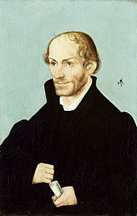
Martin Luther advocated that all children should have the opportunity of an education provided by the state.
Luther’s ideas were shared by his Wittenberg coworker, Philip Melanchthon, whose educational efforts earned him the title of Pracecepter Germaniae, the Teacher of Germany.
Melanchton divided students into three classes or divisions based on their age or capabilities.

Slide 13
Following Melanchthon’s example, the Protestants in Germany were responsible for introducing the gymnasium, or secondary school, where the humanist emphasis on the liberal arts based on instruction in Greek and Latin was combined with religious instruction.

Slide 14
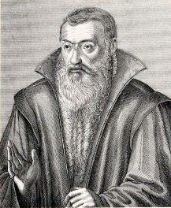
School in Strasbourg
Founded by Johannes Sturm in 1538, which served as a model for other Protestant schools.

Slide 15
John Calvin’s Genevan Academy
Founded in 1559, was organized in two distinct parts.
The “private school” or gymnasium was divided into seven classes for young people who were taught Latin and Greek grammar and literature as well as logic.

Slide 16
In the “public school,” students were taught philosophy, Hebrew, Greek, and theology.

Slide 17
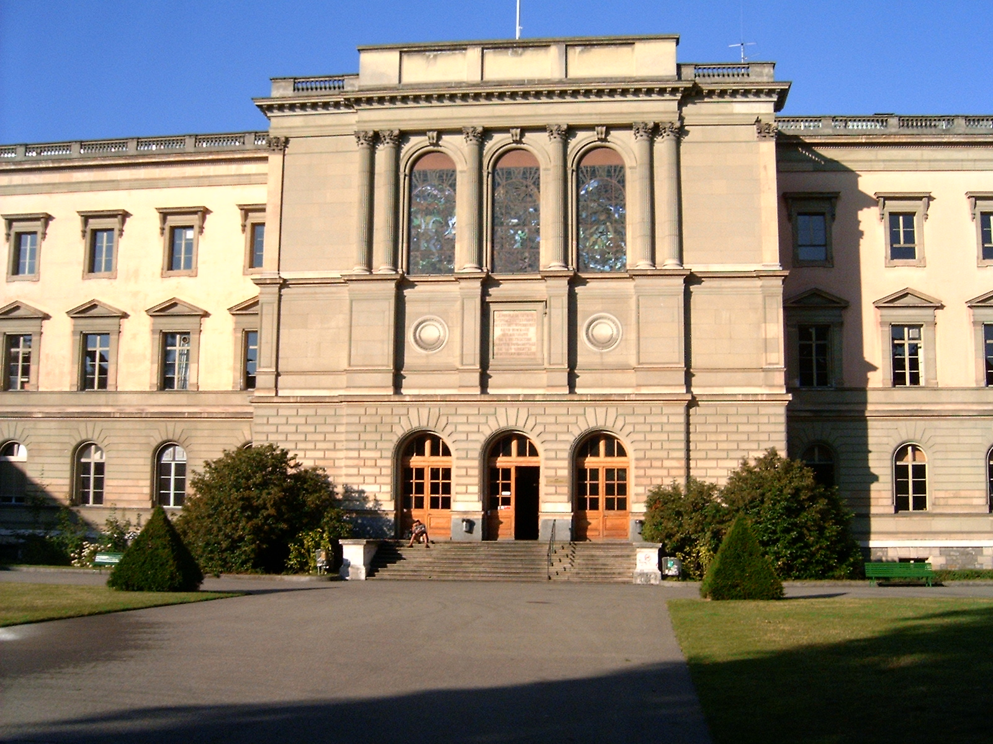
The Genevan Academy, which eventually became a university, came to concentrate on preparing ministers to spread the Calvinist view of the Gospel.

Slide 18
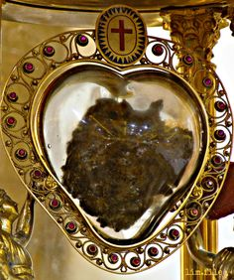
Religious Practices and Popular Culture
The Protestant Reformation abolished or severely curtailed such customary practices as indulgences, the veneration of relics and saints, pilgrimages, monasticism, and clerical celibacy.
heart relic of Saint Camillus

Slide 19
The elimination of saints put an end to the numerous celebrations of religious holy days and changed a community’s sense of time.

Slide 20
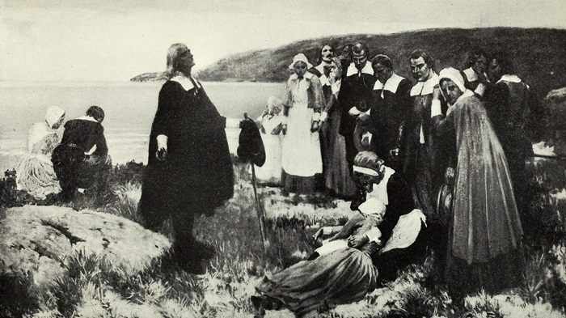
The Puritans (as English Calvinists were called), for example, attempted to ban drinking in taverns, dramatic performances, and dancing.

Slide 21
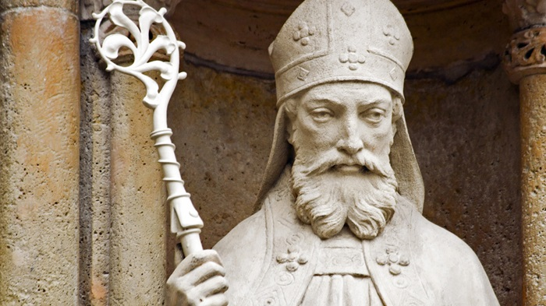
Dutch Calvinists denounced the tradition of giving small presents to children on the feast of Saint Nicholas, in early December.
Many of these Protestant attacks on popular culture were unsuccessful.

