Slide 1
Chapter 13 Section 5: The Spread of the Protestant Reformation

Slide 2
For both Catholics and Protestant reformers, Luther’s heresy raised the question of what constituted the correct interpretation of the Bible.

Slide 3
Lutheranism and Scandinavia
In 1397, the Union of Kalmar had brought about the unification of Denmark, Norway, and Sweden under the rule of one monarch, the king of Denmark.
This union failed to achieve any real social or political unification of the three states, particularly since the independent-minded landed nobles worked to frustrate any increase in monarchical centralization.

Slide 4
In 1520, (1513-1523) of Denmark, ruler of the three Scandinavian kingdoms, was overthrown by Swedish barons led by Gustavus Vasa.
Three years later, Vasa became king of an independent Sweden (1523-1560) and took the lead in establishing a Lutheran Reformation in his country.
By the 1530s, the Swedish Lutheran National Church had been created.

Slide 5
Gustavus Vasa.

Slide 6
Christian II had also been deposed as the king of Denmark by the Danish nobility; he was succeeded by his uncle, who became Frederick I (1523-1533).
Frederick encouraged Lutheran preachers to spread their evangelical doctrines and to introduce a Lutheran liturgy into the Danish church service.

Slide 7
Frederick I (1523-1533).

Slide 8
In the 1530s, under Frederick’s successor, Christian III (1534-1559), a Lutheran state church was installed with the king as the supreme authority in all ecclesiastical (relating to the Christian Church or its clergy) affairs.
Christian was also instrumental in spreading Lutheranism to Norway.
By the 1540s Scandinavia had become a Lutheran stronghold.
Like the German princes, the Scandinavian monarchs had been the dominant force in establishing state-run churches.

Slide 9
Christian III (1534-1559),

Slide 10
The Zwinglian Reformation
In the sixteenth century, the Swiss Confederation was a loose association of thirteen self-governing states called cantons.
Theoretically part of the Holy Roman Empire, they had become virtually independent in 1499.
The six forest cantons were democratic republics; the seven urban cantons, which included Zurich, Bern, and Basel, were mostly governed by city councils controlled by narrow oligarchies of wealthy citizens.

Slide 11
Ulrich Zwingli (1484-1531) was ordained a priest in 1506 and accepted an appointment as a cathedral priest in the Great Minister of Zurich in 1518.
Through is preaching there, Zwingli began the Reformation in Switzerland.
Zwingli’s preaching of the Gospel caused such unrest that in 1523 the city council held a public disputation or debate in the town hall.

Slide 12
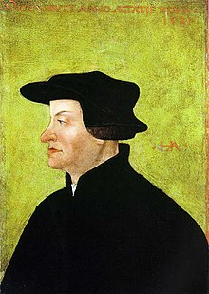
Ulrich Zwingli (1484-1531)

Slide 13
The disputation became a standard method of spreading the Reformation to many cities. It gave an advantage to reformers, since they had the power of new ideas and Catholics were not used to defending their teachings.
Zwingli was permitted to continue to proclaim the Gospel and the pure sacred Scripture.

Slide 14
Evangelical reforms were promulgated in Zurich by a city council strongly influenced by Zwingli.
Zwingli looked to the state to supervise the church.
“A church without the magistrate is mutilated and incomplete.”
Magistrate- a civil officer or lay judge who administers the law

Slide 15
Relics and images were abolished; all paintings and decorations were removed from the churches and replaced by whitewashed walls.
The Mass was replaced by a new liturgy consisting of Scripture reading, prayer, and sermons.
Music was eliminate from the service as distraction from the pure word or God.

Slide 16
Monasticism, pilgrimages, the veneration of saints, clerical celibacy, and the pope’s authority were all abolished as remnants of papal Christianity.
Zwingli’s reform movement soon spread to other cities in Switzerland, including Bern in 1528 and Basel in 1529.
By 1528, Zwingli’s reform movement faced a serious political problem as the forest cantons remained staunchly Catholic.

Slide 17
Zurich feared an alliance between them and the Habsburgs.
Zwingli attempted to build a league of evangelical cities by seeking an agreement with Luther and the German reformers.

Slide 18
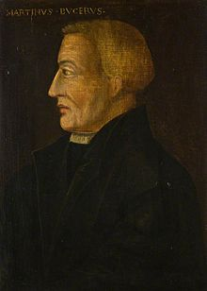
Martin Bucer (1491-1551)
Instituted a moderate reform movement containing characteristics of both Luther’s and Zwingli’s movements in Strasbourg and other southern German cities.

Slide 19
Both the German and the Swiss reformers realized the need for unity to defend against imperial and conservative opposition.
Protestant political leaders, especially Landgrave Philip of Hesse, fearful of Charles V’s ability to take advantage of the division between the reformers, attempted to promote an alliance of the Swiss and German reformed churches by persuading the leaders of both groups to attend a colloquy (or conference) at Marburg to resolve differences.

Slide 20
Landgrave Philip of Hesse

Slide 21
The Marburg Colloquy of 1529
The gathering agreed on everything except on the interpretation of the Lord’s Supper.
Zwingli believed that the scriptural words “This is my body, This is my blood” should be taken figuratively, not literally, and refused to accept Luther’s insistence on the real presence of the body and blood of Jesus “in, with, and under the bread and wine.”
The Marburg Colloquy of 1529 produced no agreement and no evangelical alliance.

Slide 22
The Swiss civil war of 1531
October, 1531, war erupted between the Swiss Protestant and Catholic cantons.
Zurich’s army was routed, and Zwingli was found wounded on the battlefield.
His enemies killed him, cut up his body, and burned the pieces, scattering the ashes.

Slide 24
Religious Passions and War
The Swiss civil war of 1531 provided an early indication of what religious passions would lead to in the sixteenth century.
The disciples of Christianity resorted to violence and decision by force.
When he heard of Zwingli’s death, Martin Luther, who had not forgotten the confrontation at Marburg, is supposed to have remarked that Zwingli got what he deserved.
The Marburg Colloquy was a meeting at Marburg Castle, Marburg, Hesse, Germany which attempted to solve a disputation between Martin Luther and Ulrich Zwingli over the Real Presence of Christ in the Eucharist.

Slide 25
The Radical Reformation: The Anabaptists
Some people rejected magisterial reformation and favored a far more radical reform movement.
Collectively called the Anabaptists, these radicals actually formed a large variety of groups who nevertheless shared some common characteristics.

Slide 26
Anabaptism was especially attractive to the peasants, weavers, miners, and artisans who had been adversely affected by the economic changes of the age.
All Anabaptists felt the true Christian church was a voluntary association of believers who had undergone spiritual rebirth and had then been baptized into the church.

Slide 27
Anabaptist advocated adult rather than infant baptism.
They also tried to return literally to the practices and spirit of early Christianity.
They followed a strict sort of democracy in which all believers were considered equal.
Anabaptists rejected theological speculation in favor of simple Christian living according to what they believed was the pure word of God.

Slide 28
The Lord’s Supper was interpreted as a remembrance, a meal of fellowship celebrated in the evening in private houses according to Jesus’ example.

Slide 29
Separation of church and state
Finally, unlike the Catholics and other Protestants, most Anabaptists believed in the complete separation of church and state.
Not only was government to be excluded from the realm of religion, but it was not even supposed to exercise political jurisdiction over real Christians.
Indeed the chief thing Protestants and Catholics could agree on was the need to persecute Anabaptists.

Slide 30
Swiss Brethren – Zurich
Their ideas frightened Zwingli, and they were soon expelled from the city.
As their teachings spread through southern Germany, the Austrian Habsburg lands, and Switzerland, Anabaptists suffered ruthless persecution, especially after the Peasant’s War of 1524-1525, when the upper classes resorted to repression.

Slide 31
Virtually stamped out in Germany, Anabaptist survivors emerged in Moravia (Czechoslovakia) and Poland, and in the Netherlands, Anabaptism took on a strange form.

Slide 32
1530s- city of Munster in Westphalia in northwestern Germany near the Dutch border was the site of an Anabaptist uprising the determined the fate of Dutch Anabaptism.

Slide 33
Although converted to Lutheranism in 1532, Munster experienced a more radical mass religious hysteria that led to legal recognition for the Anabaptists.
Soon Munster became a haven for Anabaptists from the surrounding neighborhood, especially the more wild-eyed variety known as Melchiorites who adhered to a vivid millenarianism (the doctrine of or belief in a future (and typically imminent) thousand-year age of blessedness, beginning with or culminating in the Second Coming of Christ)

Slide 34
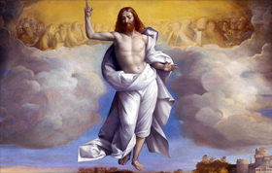
They believed that the end of the world was at hand and that they would usher in the kingdom of God with Munster as the New Jerusalem.

Slide 35
By the end of February 1534, these millenarian Anabaptists had taken control of the city (Munster), driven out those they considered godless or unbelievers, burned all books except the Bible, and proclaimed communal ownership of all property.

Slide 36
New Jerusalem and John of Leiden
Eventually the leadership of the New Jerusalem fell into the hands of one man, John of Leiden, who proclaimed himself king of the New Jerusalem.
As king, he would lead out the elect from Munster to cover the entire world and purify it of evil by the sword in preparation for Jesus’ Second Coming and the creation of a New Age.
In this new kingdom, John of Leiden believed, all goods would be held in common and the saints would live without suffering…it was not to be.

Slide 37
John of Leiden 1509-1536

Slide 38
As Catholics and Lutherans recaptured the city in June 1535 and executed the radical Anabaptist leaders in a gruesome fashion.
The New Jerusalem had ceased to exist.

Slide 39
Torture
They were chained to a post and made to wear spiked collars which dug into their necks as the skin was ripped from their bodies with hot iron tongs.
The torture lasted for a full hour as the executioners picked flesh from their bodies while being careful to keep the men alive and conscious throughout the ordeal.
The idea behind this torture was that the pain endured by the body would be enough for the soul to recant so that the men were not cast into an eternal hell.
They were finally executed by a dagger to the heart and the bodies were placed in cages which hung from the walls of St. Lambert’s Church. Although the corpses have long since been removed, the cages still remain there to this day.

Slide 41
Iron baskets that held the corpses of the leaders of the Münster Rebellion at the steeple of St. Lambert's Church.

Slide 42
Pacifist Tendencies
Purged of its fantasies and it more extreme elements, Dutch Anabatistism reverted to its pacifist tendencies, especially evident in the work of Menno Simons (1496-1561), the man most responsible for rejuvenating Dutch Anabaptism.

Slide 43
Menno Simons

Slide 44
Menno Simons
A popular leader, Menno dedicated his life to the spread of a peaceful, evangelical Anabaptism that stressed separation from the world in order to truly emulate the life of Jesus.

Slide 45
Mennonites
Simons imposed strict discipline on his followers and banned those who refused to conform to the rules.
The Mennonites, as his followers were called, spread from the Netherlands into northwestern Germany and eventually into Poland and Lithuania as well as the New World.

Slide 46
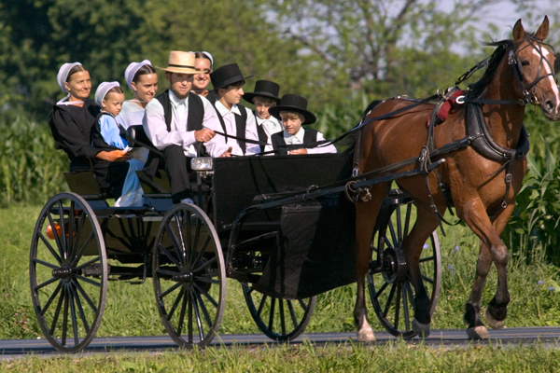
Both the Mennonites and the Amish, who are also descended from the Anabaptists, maintain communities in the United States today.

