Slide 1
Chapter 13 Section 4: Germany and the Reformation and Politics
PART 2

Slide 2
Habsburg-Valois Wars (1521-1544)
Fought intermittently for twenty four years (1521-1544), preventing Charles from concentrating on the Lutheran problem in Germany.
Meanwhile Charles V faced two other enemies
The Habsburg emperor expected papal cooperation in dealing with the Lutheran heresy.
Papal policy, however, was guided by political considerations, not religious ones.

Slide 3
Fearful of Charles’s power in Italy, Pope Clement VII (1523-1534) joined the side of Francis I in the second Habsburg-Valois War (1527-1529), but with catastrophic results.

Slide 5
A Bloody Sacking
In April 1527, the Spanish-imperial army of Charles V went berserk while attacking Rome and gave the capital of Catholicism a fearful and bloody sacking.
Clement came to terms with the emperor, and by 1530, Charles V stood supreme over much of Italy.

Slide 6
The Ottoman Turks
A new threat to the emperor’s power had erupted in the eastern part of his empire.
The Ottoman Turks, under Suleiman the Magnificent (1520-1566), had defeated and killed King Louis of Hungary, Charles’s brother-in-law, at the Battle of Mohacs in 1526.

Slide 8
The Turks overran most of Hungary, moved into Austria, and advanced as far as Vienna, where they were finally repulsed in 1529.

Slide 9
Politics in Germany
By the end of 1529, Charles was ready to deal with Germany.
The second Habsburg-Valois War had ended, the Turks had been defeated temporarily, and the pope had been subdued.
Germany was a land of several hundred territorial states: princely states, ecclesiastical principalities, and free imperial cities.

Slide 10
Germany’s medieval development had enabled these states to become quite independent of imperial authority. They had no desire to have a strong emperor.
Charles’s attempt to settle the Lutheran problem at the Diet of Augsburg in 1530 proved completely inadequate, and the emperor wound up demanding that the Lutherans return to the Catholic church by April 15, 1531.

Slide 12
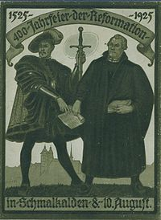
Schmalkaldic League
In February 1531, fearful of Charles’s intentions, eight princes and eleven cities –all Lutheran- formed a defensive alliance known as the Schmalkaldic League.
These Protestant German states vowed to assist each other “whenever any one of us is attacked on account of the Word of God and the doctrine of the Gospel.”
Religion was dividing the empire into two armed camps.

Slide 13
The renewed threat of the Turks against Vienna forced Charles once again to seek compromise instead of war with the Protestant authorities.
From 1532-1535, Charles was forced to fight off a Turkish, Arab, and Barbary attack on the Mediterranean coasts of Italy and Spain.

Slide 14
Two additional Habsburg-Valois Wars (1535-1538 and 1542-1544) soon followed and kept Charles preoccupied with military campaigns in southern France and the Low Countries.
Finally Charles made peace with Francis in 1544 and the Turks in 1545.
Fifteen years after the Diet of Augsburg, Charles was finally free to resolve his problem in Germany.

Slide 16
By the time of Luther’s death in February 1546, all hopes of a peaceful compromise had faded.
Charles brought a sizable imperial army of German, Dutch, Italian, and Spanish troops to do battle with the Protestants.

Slide 17
In the first phase of the Schmalkaldic Wars (1546-1547), the emperor’s forces decisively defeated the Lutherans at the Battle of Muhlberg.
Charles V was at the zenith of his power, and the Protestant cause seemed doomed.

Slide 18
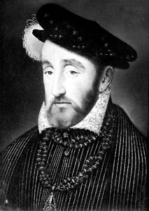
The Schmalkaldic League was soon reestablished and the German Protestant princes allied themselves with the new French king, Henry II (1547-1599) – a Catholic – to revive the war in 1552).

Slide 19
Charles V abandoned German affairs to his brother Ferdinand, abdicated all of his titles in 1556, and retired to his country estate in Spain to spend the remaining two years of his life in solitude.

Slide 20
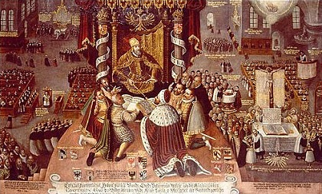
An end to religious warfare in Germany came in 1555 with the Peace of Augsburg, which marked an important turning point in the history of the Reformation.

Slide 21
The division of Christianity was formally acknowledged, with Lutheranism granted equal legal standing with Catholicism.
The peace settlement accepted the right of each German ruler to determine the religion of his subjects (but not the right of the subjects to choose their religion).
Charles’s V hope for a united empire had been completely dashed, and the idea of medieval Christian unity was irretrievably lost.
The rapid proliferation of new Protestant groups served to underscore that new reality.

