Slide 1
Chapter 13 Section 4: Germany and the Reformation and Politics

Slide 2
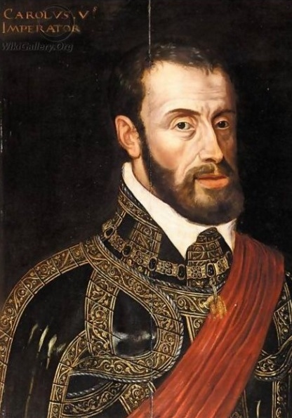
The fate of Luther’s movement was closely tied to political affairs.
In 1519, Charles I, king of Spain and grandson of Emperor Maximilian, was elected Holy Roman Emperor as Charles V (1519-1556).

Slide 3
Charles V ruled over an immense empire, consisting of Spain and its overseas possessions, the traditional Austrian Habsburg land, Bohemia, Hungary, the Low Countries, and the kingdom of Naples in southern Italy.

Slide 5
Charles V spent a lifetime in futile pursuits of his goals.
The French, the papacy, the Turks, and Germany’s internal situation cost him both his dream and his health.
At the same time, the emperor’s problems gave Luther’s movement time to grow and organize before facing the concerted onslaught of the Catholic forces.

Slide 6
The French, the Papacy, and the Turks
Charles V’s chief political concern was his rivalry with the Valois king of France, Francis I (1515-1547).
Francis became embroiled in the conflict with Charles over disputed territory in southern France, the Netherlands, the Rhineland, northern Spain, and Italy.

