Slide 1
Chapter 13 Reformation and Religious Warfare in the Sixteenth Century

Slide 2
Chapter Outline
Prelude to Reformation
Martin Luther and the Reformation in Germany
Germany and the Reformation: Religion and Politics
The Spread of the Protestant Reformation
The Catholic Reformation
Politics and the Wars of Religion in the Sixteenth Century

Slide 3
Focus Questions
Who were the Christian humanists, and how did they differ from the Protestant reformers?
What were Martin Luther’s main disagreements with the Roman Catholic church, and why did the movement he began spread so quickly across Europe?
What impact did the Protestant Reformation have on the society of the sixteenth century?
What measures did the Roman Catholic church take to reform itself and to combat Protestantism in the sixteenth century?
What role did religion play in the European wars of the sixteenth century?
What were the main tenants of the major Protestant groups, and how did they differ from each other and from Catholics? What were the results of these differences?

Slide 4
Prelude to Reformation
During the second half of the fifteenth century, the new classical learning that was part of Italian Renaissance humanism spread to northern Europe and spawned a movement called Christian or Northern Renaissance humanism whose major goal was the reform of Christianity.

Slide 5
Christian or Northern Renaissance Humanism
Northern humanists cultivated a knowledge of the classics, the one common bond that united all humanists into a kind of international fellowship.

Slide 6
Northern humanists (also called Christian humanists because of their profound preoccupation with religion) focused on the sources of early Christianity, the Holy Scriptures, and the writings of such church fathers as Augustine, Ambrose, and Jerome.
They found in these writings a simple religion that they came to feel had been distorted by the complicated theological arguments of the Middle Ages.

Slide 7
The most important characteristic of northern humanism was its reform program.

Slide 8
The northern humanists felt that through education in souces of classical, and especially Christian antiquity, they could instill a true inner piety or an inward religious feeling that would bring about a reform of the church and society.

Slide 9
Christian humanists supported schools, brought out new editions of the classics, and prepared new editions of the Bible and writings of the church fathers.

Slide 10
This belief in the power of education would remain an important characteristic of European civilization.
Christian humanists believed that to change society, they must first change the human beings who compose it.

Slide 11
The turmoil of the Renaissance shattered much of this intellectual optimism, as the lives and careers of two of the most prominent Christian humanists, Desiderius Erasmus and Thomas More illustrate.

Slide 12
Desiderius Erasmus (1466-1536) Holland

Slide 13
The most influential of all the Christian humanists was Desiderius Erasmus, who formulated and popularized the reform program of Christian humanism.

Slide 14
Born in Holland
Educated at one of the schools of the Brothers of the Common Life.
Brethren of the Common Life, religious community established in the late 14th century by Geert Groote at Deventer, in the Netherlands.
School and trend of spirituality stressing meditation and the inner life and criticizing the highly speculative spirituality of the 13th and 14th centuries.

Slide 15
Erasmus wandered to France, England, Italy, Germany, and Switzerland, conversing everywhere in the classical Latin that might be called his mother tongue.

Slide 16
Handbook of the Christian Knight
The Handbook of the Christian Knight, printed in 1503, reflected his preoccupation with religion.
Erasmus called his conception of religion “the philosophy of Christ,” by which he meant that Christianity should be a guiding philosophy for the direction of daily life rather than the system of dogmatic beliefs and practices that the medieval church seemed to stress (He emphasized inner piety and deemphasized the external forms of religion such as sacraments, pilgrimages, fasts, veneration of saints, and relics).

Slide 18
People needed to understand the original meaning of the Scriptures and early church fathers.
Standard Latin edition of the Bible (Vulgate), contained errors, Erasmus edited the Greek text of the New Testament from the earliest available manuscripts and published it, along with a Latin translation, in 1516.

Slide 19
To Erasmus, the reform of the church meant spreading an understanding of the philosophy of Jesus, providing enlightened education in the sources of early Christianity, and making commonsense criticism of the abuses in the church.

Slide 20
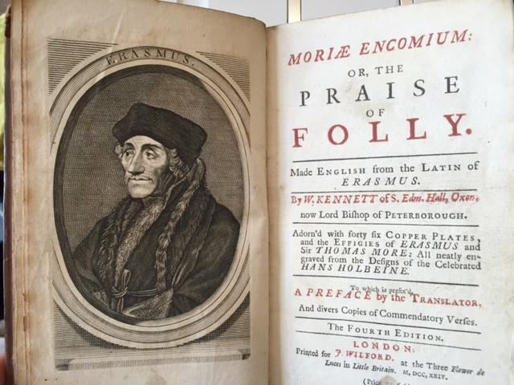
The Praise of Folly – 1511
Written by Erasmus in 1511
Erasmus was able to engage in a humorous yet effective critiscism of the most corrupt practices of his own society.
He was especially harsh on the abuses within the ranks of the clergy.

Slide 21
Erasmus’ program did not achieve the reform of the church that he so desired.
His moderation and his emphasis on education were quickly overwhelmed by the passions of the Reformation.

Slide 22
His work did help prepare the way for the Reformation; as contemporizes proclaimed, “Erasmus laid the eggs that Luther hatched.”
Erasmus eventually disapproved of Luther and the Prostetant reformers.
He had no intention of destroying the unity of the medieval Christian church; rather his whole program was based on reform within the church.

Slide 23
Thomas More (1478-1535)
Trained in law, he took an avid interest in the new classical learning and became proficient in both Latin and Greek.
Like the Italian humanists who believed in putting their learning at the service of the state, More embarked on a public career that took him to the highest reaches of power as lord chancellor of England.

Slide 25
Thomas Moore was well acquainted with other English Humanists and became an intimate friend of Erasmus.
Made translations from Greek authors and wrote both prose and poetry in Latin.
He spent many hours in prayer and private devotions.
Many praised his household as a shining model of Christian family life.

Slide 26
Utopia – 1516
More’s most famous work, and one of the most controversial of his age, was Utopia, written in 1516.
Account of the idealistic life and institutions of the community of Utopia (Greek for “nowhere”), an imaginary island on the vicinity of the New World.
It reflects More’s own concerns with the economic, social, and political problems of his day.

Slide 27
New social system in which cooperation and reason replaced power and fame as the proper motivating agents for human society.
Utopian society, therefore, is based on communal ownership rather than private property.
All persons work nine hours a day, regardless of occupation, and are rewarding according to their needs.

Slide 28
Possessing abundant leisure time and relieved of competition and greed, Utopians were free to do wholesome and enriching things.
More envisioned Utopia as an orderly world where social relations, recreation, and even travel were carefully controlled for the moral welfare of society and its members.

Slide 29
In serving King Henry VIII, More came face to face with the abuses and corruption he had criticized in Utopia.
But he did not allow idealism to outweigh his own ultimate realism, and in Utopia he justified his service to the king.

Slide 30
More’s religious devotion and belief in the universal Catholic church proved even more important than his service to the king, however.
More willingly gave up his life opposing England’s break with the Roman Catholic church over the divorce of King Henry VIII. (Executed by Decapitation)

