Slide 1
AP European History
Chapter 12- Recovery and Rebirth
The Age of the Renaissance
Text pp.302-335

Slide 2
Chapter Outline
Meaning and Characteristics of the Italian Renaissance
The Making of Renaissance Society
The Italian States in the Renaissance
The Intellectual Renaissance in Italy
The Artistic Renaissance
The European State in the Renaissance
The Church in the Renaissance
Conclusion

Slide 3
Focus Questions
What characteristics distinguish the Renaissance from the Middle Ages?
Who did Machiavelli’s works reflect the political realities of Renaissance Italy?
What has humanism, and what effect did it have on philosophy, education, attitudes toward politics, and the writing of history?
What were the chief characteristics of Renaissance art, and how did it differ in Italy and northern Europe?
Why do historians sometimes refer to the monarchies of the late fifteenth century as “new monarchies” or Renaissance states?
How did Renaissance art and the humanist movement reflect the political, economic, and social development of the period?

Slide 4
Question to Consider
Were the fourteenth and fifteenth centuries a continuation of the Middle Ages or the beginning of a new era?
Both positions can be defended.
You must considered when defending your position…
Political change
Economic change
Artistic change
Intellectual change

Slide 5
Humanists
Also known as intellectuals of the ages called their period (from the mid-fourteenth to the mid-sixteenth century) an age of rebirth, believing that they had restored arts and letters to new glory after they had been “neglected” or “dead” for centuries.

Slide 6
The Middle Ages
Europe between the fall of the Rome in 476 CE and the beginning of the Renaissance in the fourteenth century.
Many scholars call the era the “Medieval Period.”
Starting around the 14th century, European thinkers, writers and artists began to look back and celebrate the art and culture of ancient Greece and Rome.
It can be argued the people of the Middle Ages had squandered the advancements of their predecessors. Are you for or against this statement?

Slide 7
This way of thinking about the era in the “middle” or the fall of Rome and the rise of the Renaissance prevailed until relatively recently.
However, today’s scholars not that the era was as complex and vibrant as any other.
What changes in society stimulated the beginning of the Renaissance?

Slide 8
Section 1: Meaning and Characteristics of the Italian Renaissance.
The word Renaissance means rebirth.
Started in Italy, 1350 CE – 1550 CE.
Rebirth of antiquity of Greco-Roman civilization, marking a new age.
Between the end of the Roman Empire and their own era was a middle period (Middle Ages).
Characterized by darkness due to a lack of classical culture.

Slide 9
kappamapgroup.com/product/137-renaissance-italy-1350-1600/

Slide 10
Jacob Burckhardt claimed “Italians were the first born among the sons of modern Europe.”
He failed to recognize the depths of its religious sentiment; nevertheless, he established the framework for all modern interpretations of the Renaissance.

Slide 11
The Renaissance can still be viewed as a distinct period of European history that manifested itself first in Italy and then spread to the rest of Europe.

Slide 12
Urban society- commercial preeminence and political evolution.
Mid-fourteenth century, Northern Italy, Independent city states.

Slide 13
Within urban society, a secular spirit emerged as increasing wealth created new possibilities for the enjoyment of worldly things.
Secular- denoting attitudes, activities, or other things that have no religious or spiritual basis.

Slide 14
Above all, the Renaissance was an age of recovery from the “calamitous fourteenth century.”
Recuperation from the effects of the Black Death, political disorder, and economic recession.

Slide 15
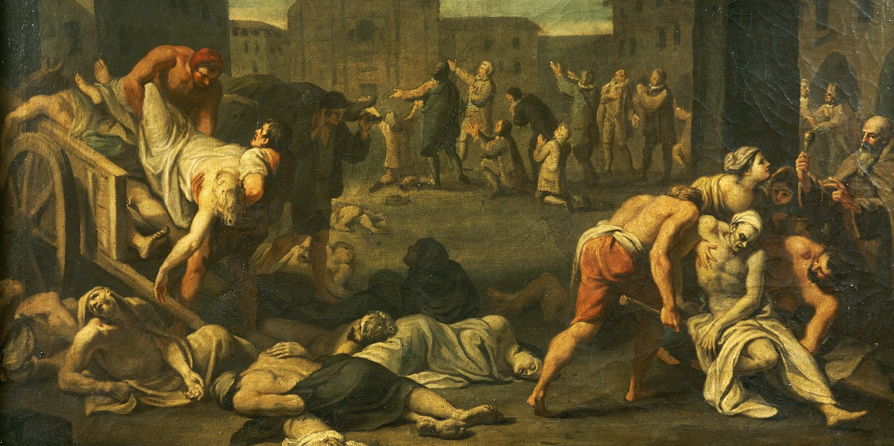
The Black Death - worldhistory.us/medieval-history

Slide 16
www.history.com/topics/black-death
The Black Death was a devastating global epidemic of bubonic plague that struck Europe and Asia in the mid-1300s.
The plague arrived in Europe in October 1347, when 12 ships from the Black Sea docked at the Sicilian port of Messina.
People gathered on the docks were met with a horrifying surprise: Most sailors aboard the ships were dead, and those still alive were gravely ill and covered in black boils that oozed blood and pus.
Sicilian authorities hastily ordered the fleet of “death ships” out of the harbor, but it was too late: Over the next five years, the Black Death would kill more than 20 million people in Europe – almost one-third of the continent’s population.

Slide 17
Increasingly aware of their own historical past, Italian intellectuals became intensely interested in the Greco-Roman culture of the ancient Mediterranean world.
Why?
(The Middle ages had in fact preserved much of ancient Latin culture. The classics were still read and studied, even during the dark times).

Slide 18
New attempts to reconcile the pagan philosophy of the Greco- Roman world with Christian thought, as well as new ways of viewing human beings was developing.
There was a revised emphasis on individual ability which became a major characteristic of the Italian Renaissance.

Slide 19
New social ideal of the well-rounded personality or universal person (l’uomo universal) who was capable of achievements in many areas of life.
However, not all Italians were part of the new social ideal.
It was primarily the wealthy upper class, who constituted a small percentage of the total population.

Slide 20
The achievements of the Italian Renaissance were the product of an elite, rather than a mass movement.
In the cities there was an indirect impact on ordinary people.
Accomplishments of the intellectuals and artists were most visible in the cities.

Slide 21
Again, what characteristics distinguished the Renaissance from the Middle Ages?

